Slide 1
DO NOW
Choose one of the following problems from the Industrial Revolution:
The spread of slums
Poor factory conditions/child labor
Political machines taking control of government
HOW WOULD YOU FIX IT?

Slide 2
MAKE-UP TESTS
http://goo.gl/JQFucb

Slide 3
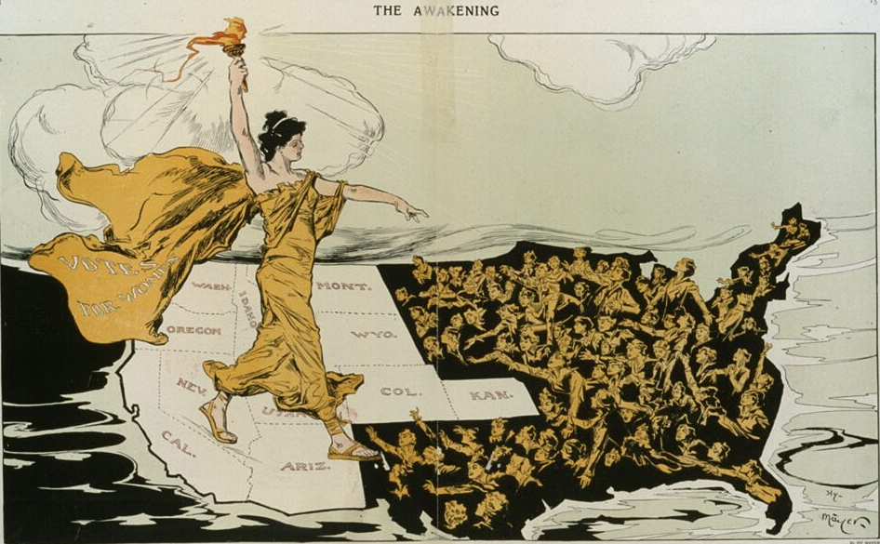
Beginning of Progressivism
March 5, 2014

Slide 4
Learning Goals
EQ:
How did America try to fix the problems of the Industrial Revolution?
LTs:
Define reform and progressivism.
Describe the basic goals of the Progressive Movement.
POU:
I can explain the basic goals of the Progressive Reform Movement.

Slide 5
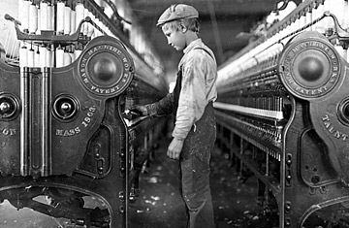
From our previous unit…
At the turn of the 20th century, there were many problems:
Poverty
The spread of slums
Poor factory conditions
Child labor
Political machines taking control of government
Big businesses controlling the economy

Slide 6
The Rise of Progressivism
To attack those problems, individuals organized reform movements
Reform: to make changes to something in order to improve it
These reformers were usually middle class, native born, and could be from either political party
Their reforms became known as progressivism
Muckrakers were journalists and writers who helped progressive reformers get attention

Slide 7
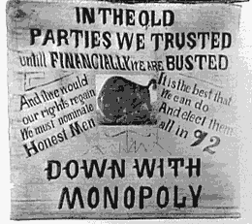
Progressive Reform Goals
Reform government and expand democracy
This meant to get more people, like women, to vote
To promote the social welfare
This meant to help people who couldn’t help themselves
Create economic reform
This meant limiting the power of big business and regulating its activities

Slide 8
Assignment
Read the handout that is being passed out by Mr. Lasseter.
Go to the following web address to answer the questions:
http://goo.gl/JcZnrS

