Slide 1
Failures of the league of nations: Hitler starts world war II
Mr. Patrick Lasseter – Interview Lesson – April 15, 2014

Slide 2
Lesson Learning Goals
Essential Question:
At what point is war unavoidable?
Lesson Objective:
Analyze Adolph Hitler’s actions by giving a detailed explanation of how Hitler’s aggression led to a declaration of war.
NC Standard 8.H.2.3
Summarize the role of debate, compromise, and negotiation during significant periods in the history of North Carolina and the United States.
CCSS.ELA-Literacy.RH.6-8.2
Determine the central ideas or information of a primary or secondary source; provide an accurate summary of the source distinct from prior knowledge.

Slide 3
Video Targets
I can recall the purpose of the League of Nations.
I can identify the aggressive actions of Hitler that led to World War II.
I can define the term appeasement.
I can describe why the League of Nations failed in preventing World War II.

Slide 4
League of Nations
An association of countries established in 1919 by the Treaty of Versailles to promote international cooperation and achieve international peace and security
Proposed by Woodrow Wilson’s Fourteen Points
The United States did not join the League!
Americans did not want to be caught in an alliance system
When the League was needed most, it was almost powerless to do anything.

Slide 5
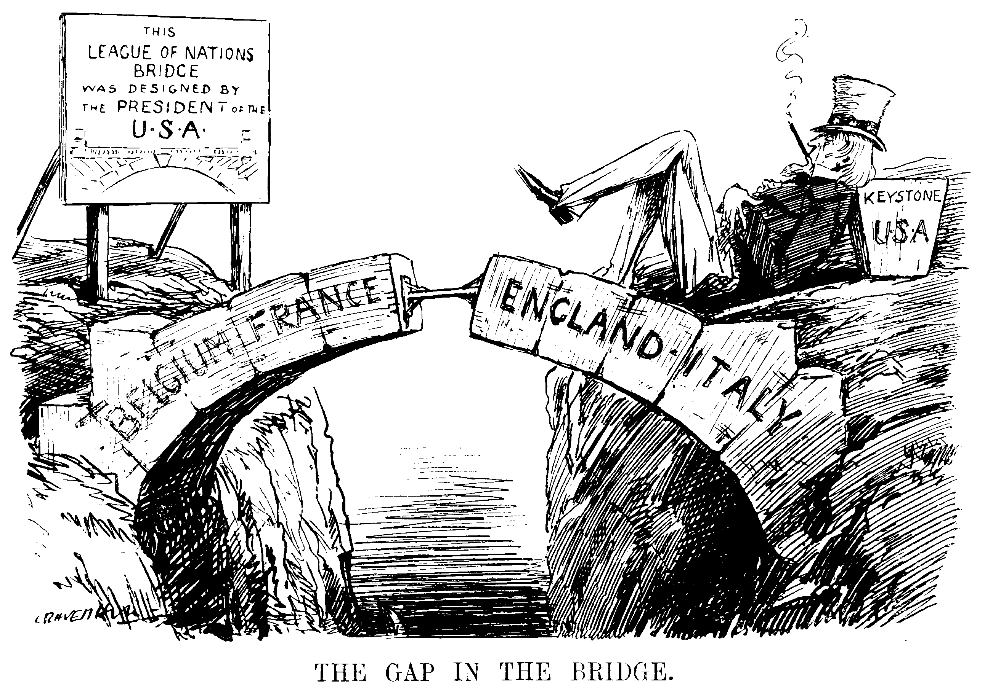
Predict: What might be the consequences of the U.S. not being involved in the League of Nations following World War I?

Slide 6
The League’s Decline
Let’s start looking at the events that would simultaneously lead to the breakup of the League of Nations and the beginning of World War II…
League of Nations Assembly Building – Geneva, Switzerland

Slide 7
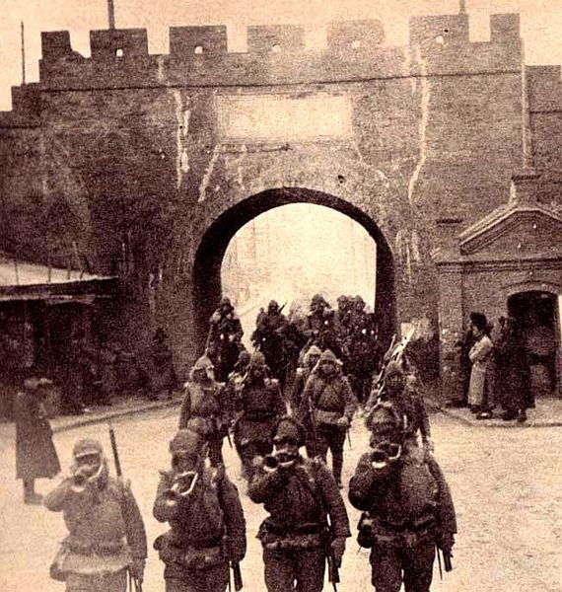
Japan
In 1931, Japan is hit badly by economic depression.
People lose faith in the government and look to the army for help.
The Japanese army soon invades Manchuria (in China).

Slide 8
L.O.N. Reaction
It tells Japan not to do it.
After Japan does it, they tell countries not to trade with Japan.
Many world countries are poor and need Japan to trade with.
Countries continue to trade with Japan.
The L.O.N. condemned Japan for its actions.
In response, Japan decided to leave the L.O.N.

Slide 9
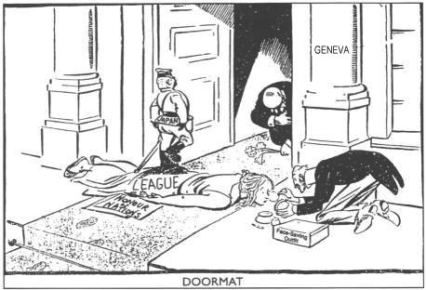
Think About It: How might Japan’s actions encourage other nations to do something similar?

Slide 10
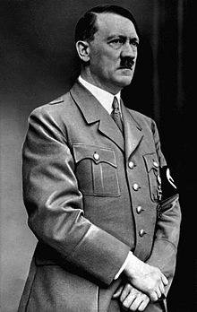
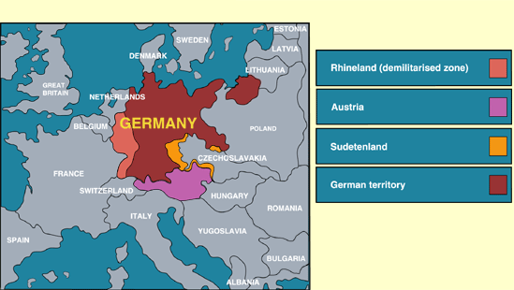
Hitler’s Rise to Power
In January 1933, Hitler becomes Chancellor of Germany and exits the League of Nations.
By 1935, he builds up an army.
In 1936, Hitler orders army to invade the Rhineland

Slide 11
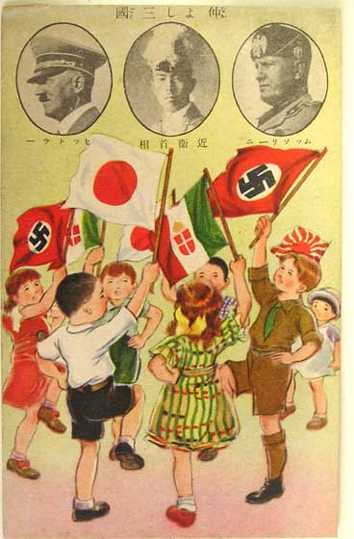
Hitler’s Aggression
In 1936, he makes alliances with Japan and Italy.
In 1938 Hitler takes back Austria, which it had lost in the Treaty of Versailles.
Propaganda post card celebrating the alliances of Germany with Italy and Japan.

Slide 12
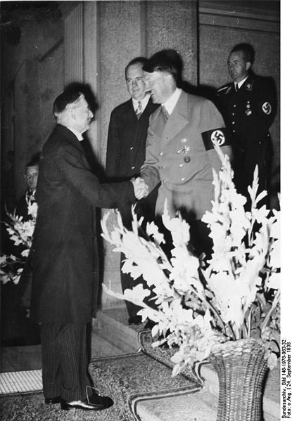
Britain and France
Britain and France are opposed to Hitler’s moves because they violate the Treaty of Versailles.
France and Britain are scared of another war
They begin practicing appeasement
A policy of giving into the demands of an aggressive nation in the hopes of avoiding war and keeping the peace
Neville Chamberlain, the British Prime Minister, meeting with Adolph Hitler, 1938

Slide 13
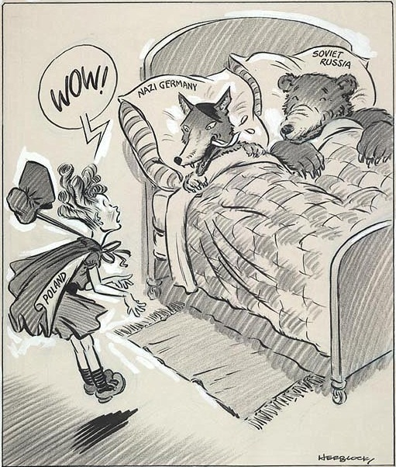
Hitler’s Continued Aggression
In 1938, Hitler also is given the Sudetenland
In 1939, Hitler invades Czechoslovakia
In early 1939, Hitler makes an alliance with the Soviet Union.
He is preparing to invade Poland...

Slide 14
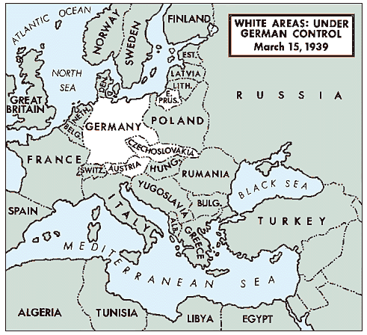
Germany Invades Poland
On September 1, 1939, the German army invades Poland and quickly takes control

Slide 15
Britain and France
On September 3, 1939, Britain and France finally declare war on Germany
They do not want to fight another World War, but they can no longer stand by and let Hitler take over Europe.
Plus, they had promised Poland they would help if Poland was invaded.

Slide 16
Why couldn’t the League of Nations stop Hitler?
It had no army to enforce anything
Japan, Germany, and Italy expanded without a way to stop them
Europe did not want another war
Countries like Britain and France were still hurting from WWI
Many countries did not belong to it
Without powerful countries, the legitimacy of the organization was questioned
Even the U.S. was not involved!
It only met 4 times a year
What if your school’s administration or teachers only met 4 times a year? Would enough get done?

Slide 17
Video Targets Review – Bring to Class
What was the purpose of the League of Nations?
What aggressive steps did Hilter take prior to World War II?
Define appeasement.
Why did the League of Nations fail in preventing World War II?

Slide 18
Preview of Tomorrow’s Lesson
We will examine primary source headlines which tell the story of Hitler’s aggression prior to World War II.
We will look at these together and independently.
Prepare for discussion, critical thinking, and composing your own article.

