Slide 1
DO NOW
Brainstorming:
List 3 to 5 things you know about slavery or the Civil War.

Slide 2
Northern Industry vs. Southern Agriculture
January 6, 2014

Slide 3
Learning Goals
EQ
How can change and differences lead to violent conflict?
LT
SWBAT explain how technology and population growth created political and social challenges.
POU (I’ll know I’ve got it when…)
I can explain how new technology impacted the economies of the northern and southern United States.

Slide 4
Main Ideas
New machines and factories changed the way people lived and worked in the late 1700s and early 1800s, especially in the North.
The invention of the cotton gin and the demand for cotton caused slavery to spread in the South.

Slide 5
Industrial Revolution
The Industrial Revolution began during the late 1700s
Machines began replacing hand-tools
Large-scale manufacturing replaced farming as the main form of work
In the U.S., most manufacturing occurred in the Northeast

Slide 6
Inventions
New types of factories and mills were built as well as new ways of making manufactured goods
Spinning mills that hired families
Textile factories that employed women
Interchangeable parts on guns (1801)
Sewing machine
Transportation
Steamboats (1807)
Steam Engine (1816)
Railroads
Communication
Telegraph (1837)

Slide 7
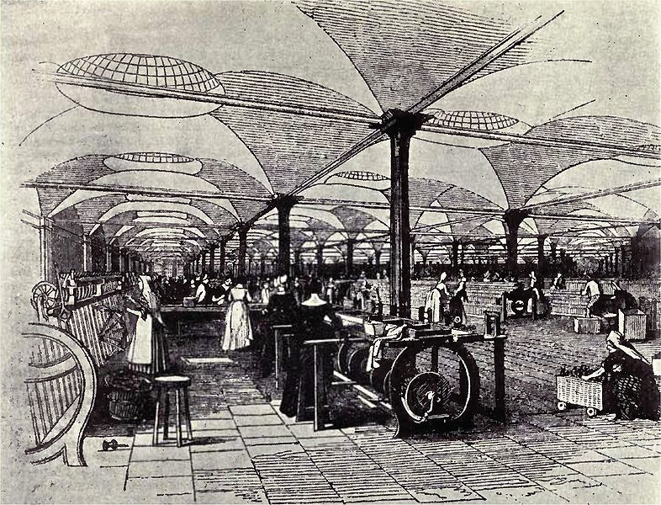

Slide 8
Inventions
Farm Production
Threshing machine for harvesting wheat faster (1834)
Lightweight steel plow invented by John Deere (1836)
The most important invention, though, was the COTTON GIN
Invented in 1793 by Eli Whitney
Separated cotton seed from the fibers, a job that used to be done by hand
Allowed Southern farmers to grow more cotton, which meant they “needed” more slaves!

Slide 9
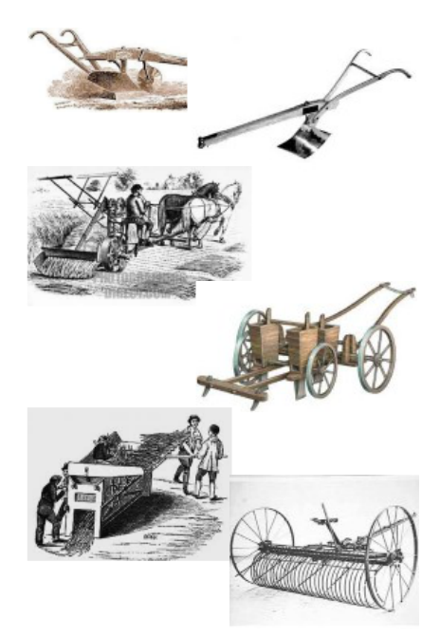
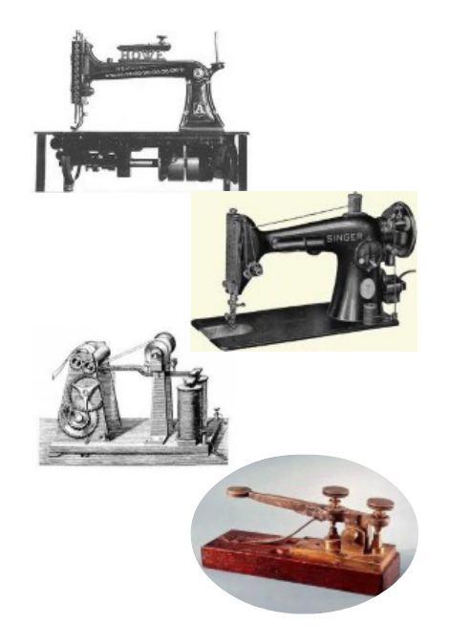

Slide 10
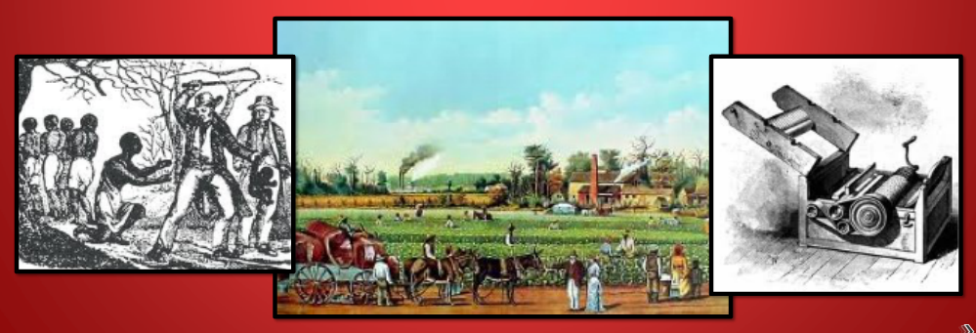
The Cotton Gin & Southern Agriculture
The Cotton Gin changed life in the South in four ways:
Cotton became the #1 crop
Cotton farming expanded west
Native Americans were driven off of land to make room for farming
Slavery continued as a source of labor

Slide 11
Southern Agriculture by the numbers
1/3 of Southern families owned slaves
1/10 had plantations (very large farms with slave labor)
Most Southern farmers supported slavery
1/3 of all people in the South were slaves
1/2 of all slaves worked on plantations

Slide 12
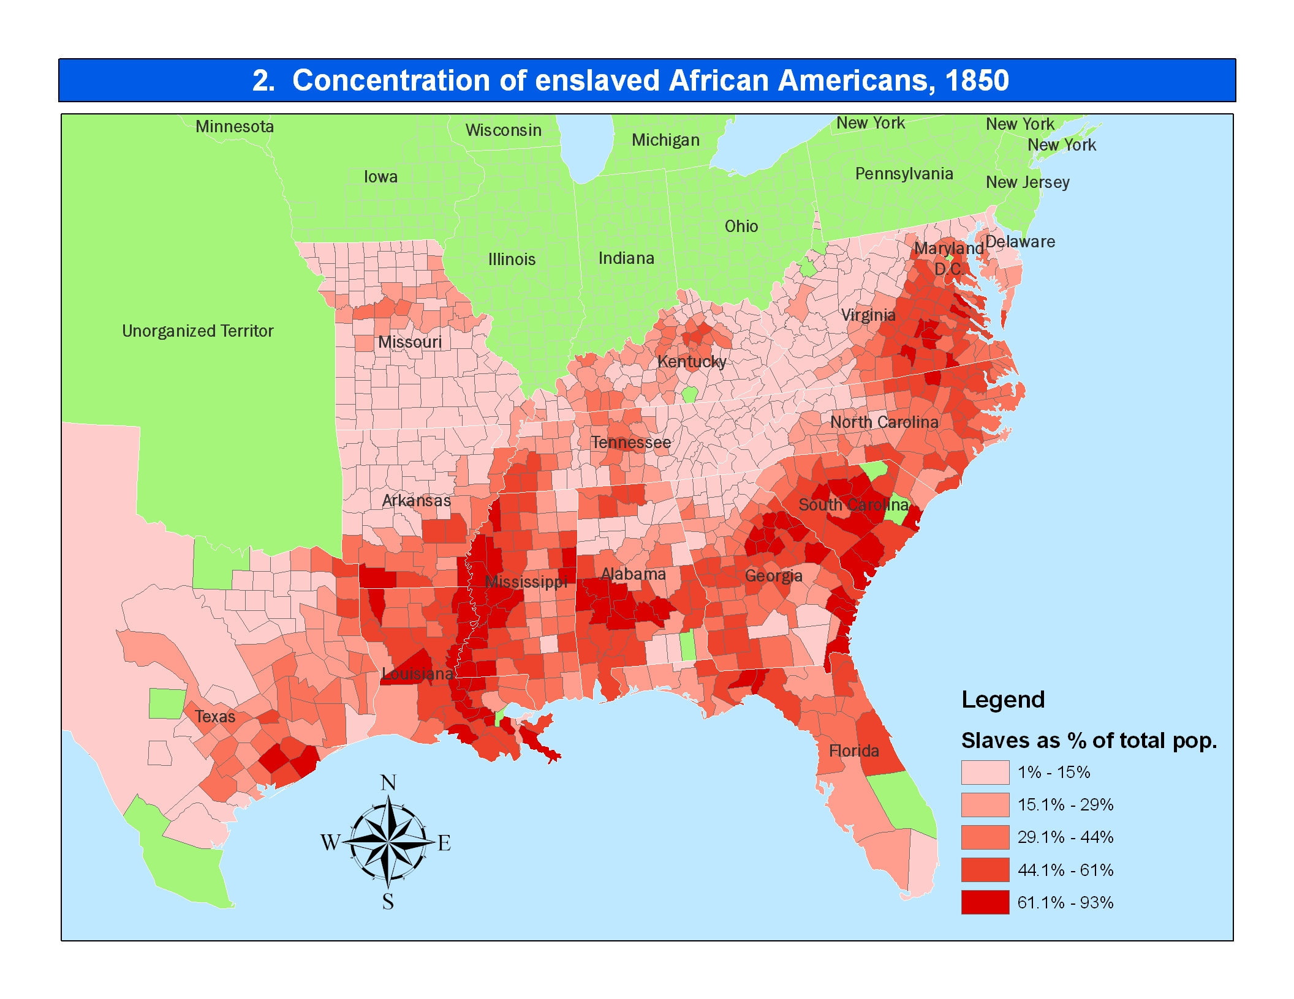

Slide 13
Sectional Differences
The North and South’s different ways of life led to many disagreements about how to run the country
Nullification Crisis over tariffs
States’ Rights
The Slavery Issue
The main difference was that the North wanted to protect Industry, and the South wanted to protect Agriculture and Slavery

