Slide 1
DO NOW
In the Bill of Rights every American is given equal protection of the law.
What groups of people have been denied equality during American history?
_____________________
_____________________
_____________________

Slide 2
Learning Goals
EQ
Why was a Civil Rights Movement needed?
LT
Define Civil Rights.
Explain why the Civil Rights Movement was needed.
POU
I can explain why the CRM came about in the United States.

Slide 3
Introduction to the Civil Rights Movement
May 12, 2014

Slide 4
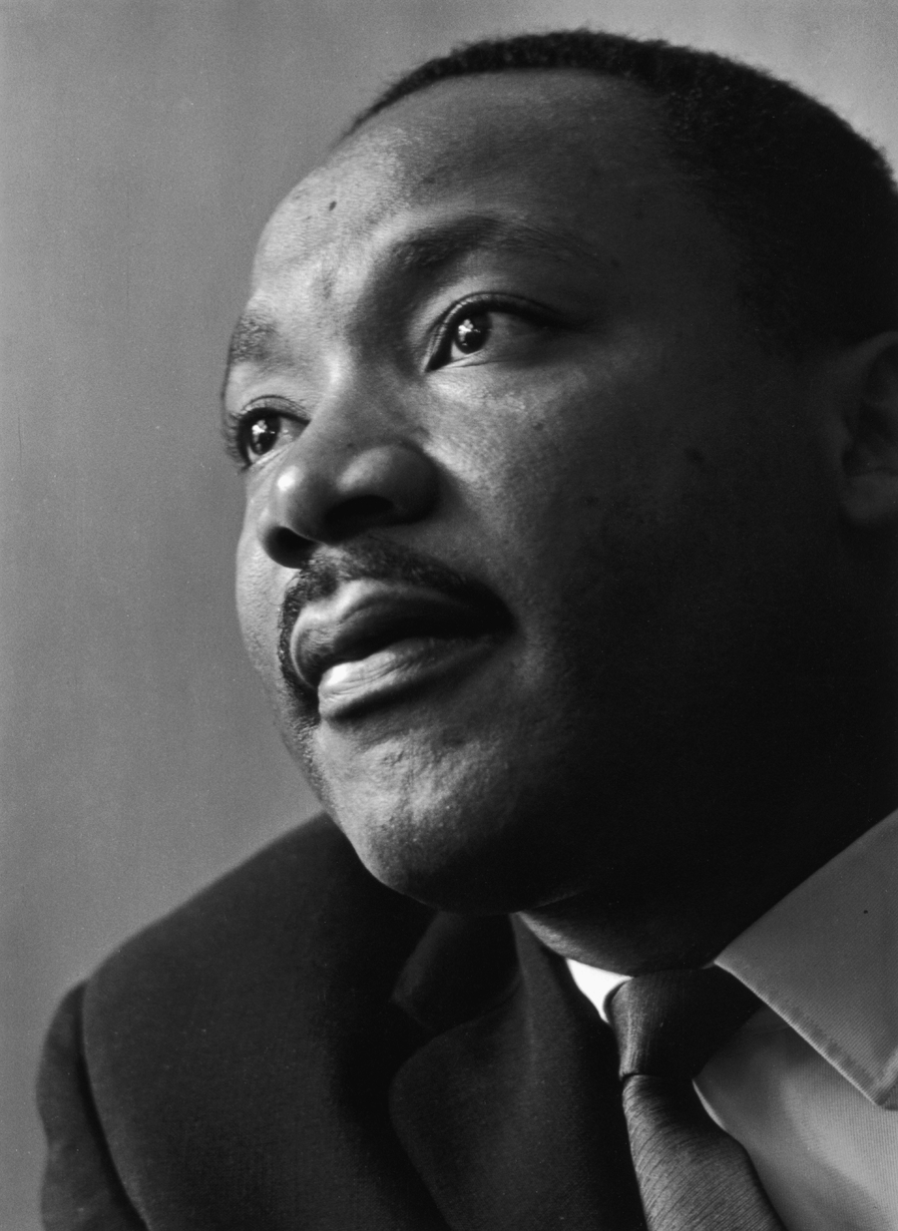
What do we mean by the term “Civil Rights Movement?”
Civil rights
the rights of citizens to political and social freedom and equality
Civil Rights Movement
A mass popular movement to secure equal rights and freedoms for African Americans in the United States
Peaked in the 1960s

Slide 5
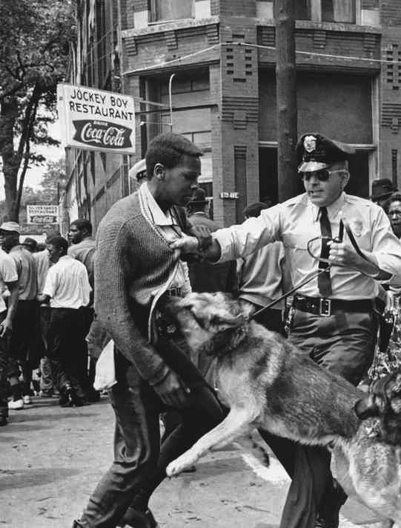
Why was the CRM needed?
Discrimination
the unjust treatment of different categories of people, esp. on the grounds of race, age, or sex
Segregation
the enforced separation of different racial groups in a country, community, or establishment
Violence
behavior involving physical force intended to hurt, damage, or kill someone or something

Slide 6
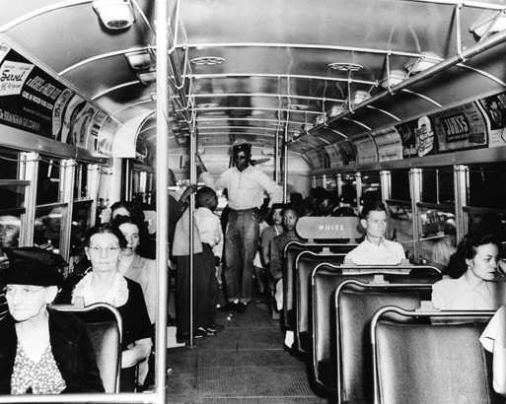
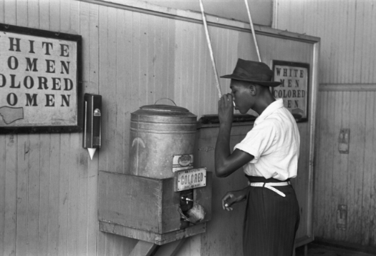
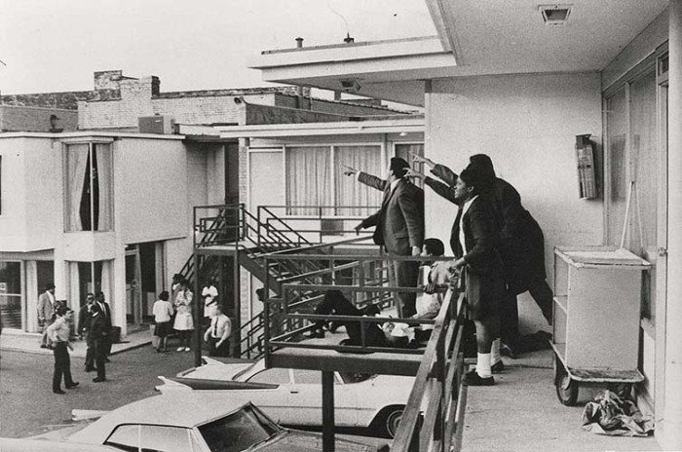
What did this look like?

Slide 7
When did the CRM begin?
1964?
First major Civil Rights legislation
1955?
Montgomery Bus Boycott
1954?
Brown v. Board of Education
1948?
Integration of Armed Forces
1909?
NAACP formed
1865?
End of Civil War
1859?
John Brown’s raid on Harper’s Ferry
Before?????

