Slide 1
DO NOW
What would it take to make you move to another city?
Where would you want to live?
Why would you move there?

Slide 2
Introduction to Westward Expansion
December 2, 2013

Slide 3
Intro to Westward Expansion
Essential Question
What causes people to move or migrate from one place to another?
Learning Target (SWBAT…)
Discuss the push & pull factors of migration to the U.S.
Explain how push & pull factors impact migration
POU (I’ll know I’ve got it when…)
I can distinguish between push & pull factors when reading about westward migration.

Slide 4
TODAY IN NOTES!
WESTWARD EXPANSION
BIG IDEAS
PUSH & PULL FACTORS
PUSH & PULL ACTIVITIES

Slide 5
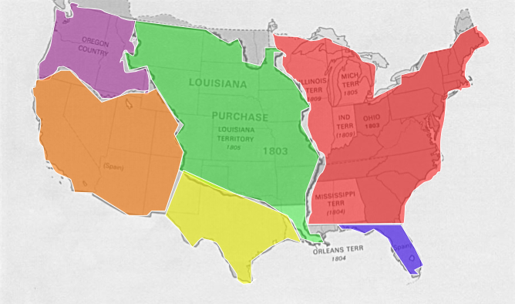
Westward Expansion
The settlement of new territories as America expanded between 1801 and 1861.
Westward migration was influenced by geography and economic opportunity.

Slide 6
BIG Ideas
There are push & pull factors that cause people to move or migrate.
People migrated westward in the United States throughout the 1800s.
The migration was aided by the Northwest Ordinance, the Louisiana Purchase, and the idea of Manifest Destiny.

Slide 7
BIG Ideas
During this expansion, the United States would fight (and win) the War of 1812 with England.
During the Jacksonian Era, President Andrew Jackson made changes (good and bad) that helped westward expansion.
To make room for settlers, Native Americans were forced off of land and made to move west. We call this Indian Removal.

Slide 8
Push & Pull Factors
Push Factors
Reasons that make you want to leave a place
Pull Factors
Reasons that draw you to live in a place
These factors can be economic, social, or political.

Slide 9
 | PUSH FACTORS | PULL FACTORS
ECONOMIC EXAMPLES
SOCIAL EXAMPLES
POLITICAL EXAMPLES

Slide 10
WORD SORT
Using your graphic organizer, sort the following into the categories of PUSH or PULL factors. 5 MINUTES.
Famine
War
Cheap, fertile land
Job opportunities
Poverty
More money
Bad climate
Drought
Family
Freedom
Tornados
Gold & silver
Good climate
Adventure

Slide 11
Personal Stories Activity
For each personal story, you will identify the push and pull factors that caused the person’s migration.
Answer the questions which accompany each story.
We will do the first one together.

Slide 12
