Slide 1
Do Now
In 3-4 sentences, explain WHY the League of Nations failed in preventing World War II.
Think back to yesterday’s notes.

Slide 2
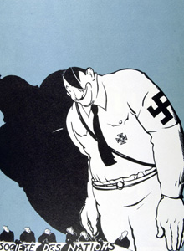
Hitler vs. the League of Nations
April 15, 2014
Political cartoon depicting Hitler and the League of Nations, 1935

Slide 3
Essential Question:
At what point is war unavoidable?
Lesson Objective:
Analyze Adolph Hitler’s actions by giving a detailed explanation of how Hitler’s aggression led to a declaration of war.
NC Standard 8.H.2.3
Summarize the role of debate, compromise, and negotiation during significant periods in the history of North Carolina and the United States.
CCSS.ELA-Literacy.RH.6-8.2
Determine the central ideas or information of a primary or secondary source; provide an accurate summary of the source distinct from prior knowledge.

Slide 4
World War II Build-up Headlines
The New York Times, 1919

Slide 5
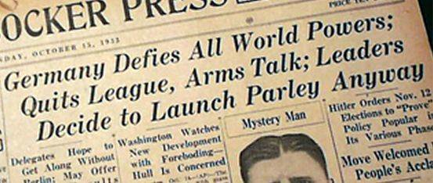
World War II Build-up Headlines
The Knickerbocker Press (Albany, NY) 1933.
Parley = a conference between opposing sides in a dispute

Slide 6
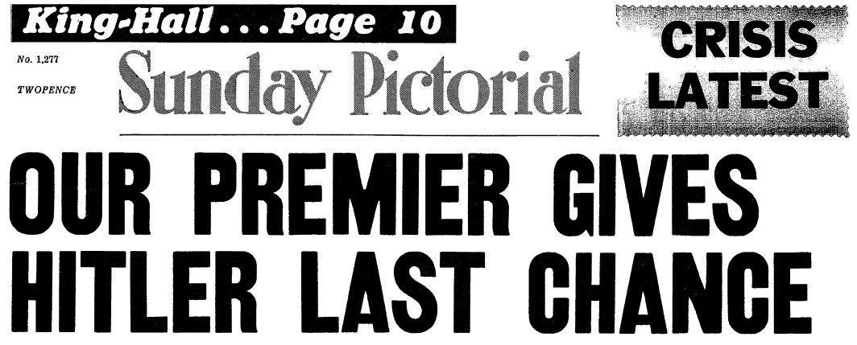
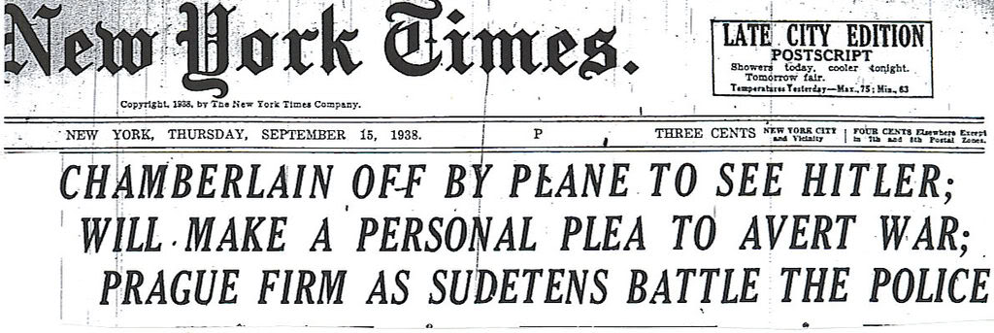
World War II Build-up Headlines
Sunday Pictorial (Great Britain) 1938.
New York Times, 1938

Slide 7
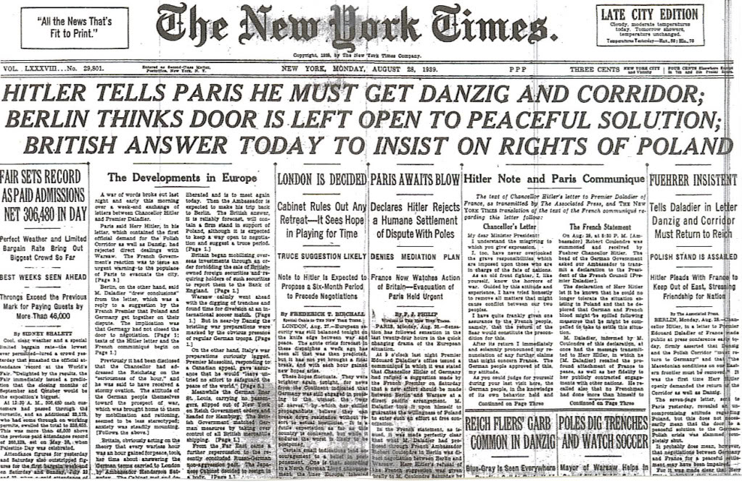
World War II Build-up Headlines
New York Times, 1938

Slide 8
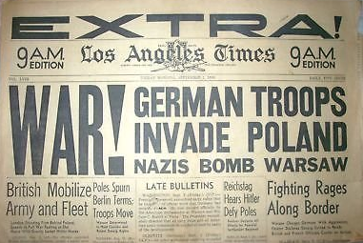
WAR!
Los Angeles Times, 1939.

Slide 9
Let’s look at more headlines…
We’ll do the first set together and answer the questions.
Then, do the next three sets on your own.
You will use what you learn/read for your exit ticket at the end of the lesson.

Slide 10
Exit Ticket Assignment
In this exit ticket, you will write an article in which you provide a detailed account of the actions of Adolph Hitler and the events that led up to World War II.
Also, think of what headline and photo may accompany your article! The date should reflect the actual start of World War II (September 1, 1939).
Use what you have learned from last night’s lesson and the headlines work.
In the exit ticket, you should answer the following questions:
What actions did Hitler take that led to war?
How did the rest of Europe respond to the actions of Hitler?
What failures of the Treaty of Versailles/League of Nations allowed Hitler to act the way he did?

