Slide 1
DO NOW
What is needed to start an industry?
List at least 4 things.

Slide 2
Causes of the Industrial Revolution
February 10, 2014

Slide 3
Learning Goals
EQ
How can technological change and innovation change a country?
LT
SWBAT identify the causes and effects of the Industrial Revolution.
POU (I’ll know I’ve got it when…)
I can list the causes of the Industrial Revolution in the United States.

Slide 4
Definitions
Industrial Revolution
The rapid development of industry in the 1700s and 1800s
a change from making things by hand to making them in factories

Slide 5
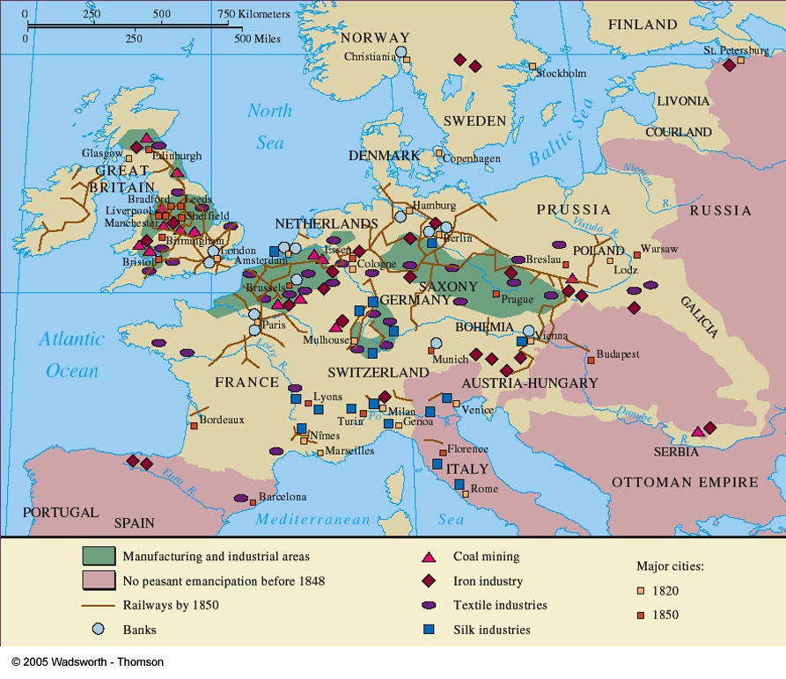
Where and When?
The I.R. began in Great Britain in the 1700s
About 1750-1920
In the U.S., the I.R. took place mostly in northern cities
Other places: Japan, Belgium, France, Germany

Slide 6
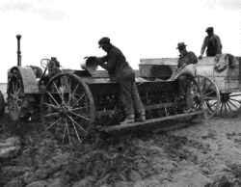
Cause #1 – Agrarian Revolution
In Britain, changes in farming methods helped start the I.R.
New farming tech produced more food
More food led to a population increase
These people would provide the workforce for the I.R.

Slide 7
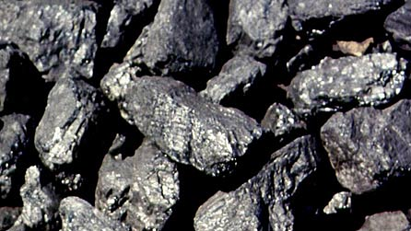
Cause #2 – Natural Resources
Britain had plenty of natural resources
Iron ore
Coal
Forests
Rivers, harbors
The United States had these same advantages!

Slide 8
Cause #3 – Capital
Capital is another way of saying MONEY
In Britain, the I.R. could start because they were a rich empire
The U.S. also had the capital to build railroads, factories, mines, and pay employees

Slide 9
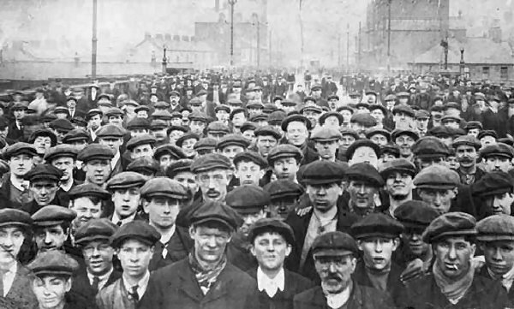
Cause #4 – People
In order to expand industry, build railroads, and develop natural resources, it took a lot of people
The U.S. had plenty of people to work in the new I.R. economy

Slide 10
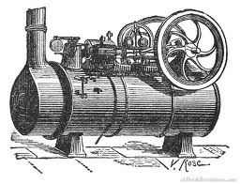
Cause #5 – Technology
Water and steam power replaced animal and people power
The steam engine was the main power source of the I.R.
Electricity would also change how industry worked

Slide 11
Assignment
Using your notes, go to the following website to answer your exit ticket for today:
http://goo.gl/gTdrrR
First, answer the exit ticket question.
What were the causes of the Industrial Revolution?
Then, create a test question that you would like to see on the test. It just might be used!

