Slide 1
DO NOW
Who were muckrakers?

Slide 2
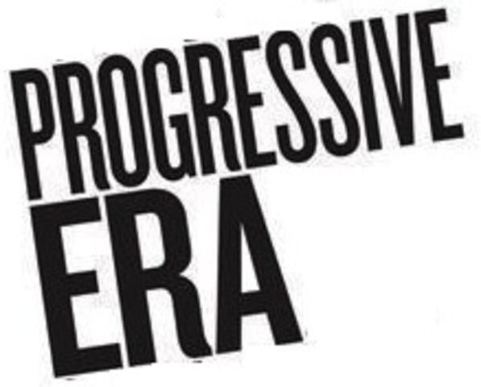
Theodore Roosevelt & Progressivism
March 6, 2014

Slide 3
Learning Goals
EQ:
How did America try to fix the problems of the Industrial Revolution?
LTs:
Describe political, economic, and social reforms of the Progressive Movement.
POU:
I can describe political, economic, and social reforms of the Progressive Movement.

Slide 4
Expanding Democracy
Patronage
elected officials give jobs, contracts for political support
Was a major problem with corrupt politics
Pendleton Civil Service Act (1883)
Requires people to take an exam for certain government jobs
Stops officials from firing workers for political reasons
Direct primary
voters, not the party, choose candidates
3 more reforms:
Initiative – allows voters to propose a law directly
Referendum – when a proposed law is submitted to vote of the people
Recall – allows people to vote an official out of office

Slide 5
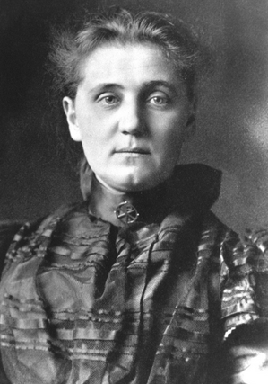
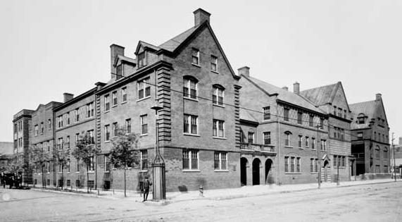
Social Welfare
Movements deal with poverty, unemployment, bad working conditions
Jane Addams helps poor at Hull House; helps unemployed of Chicago
Florence Kelley pushes for minimum wage laws and limits on hours
Prohibitionists work to outlaw alcohol

Slide 6
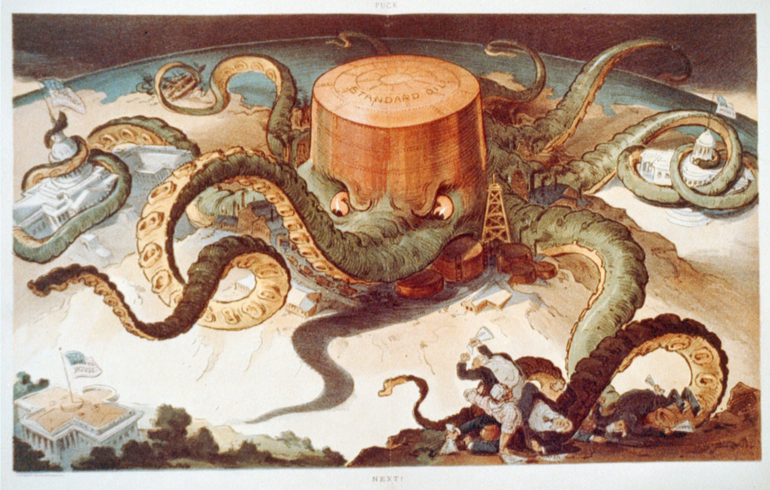
Economic Reform
Economic reform limits and regulates big business
Sherman Antitrust Act of 1890
Illegal for corporations to use trusts/monopolies to gain control of industries
Government does not enforce law at first
Requires a strong president to enforce

Slide 7
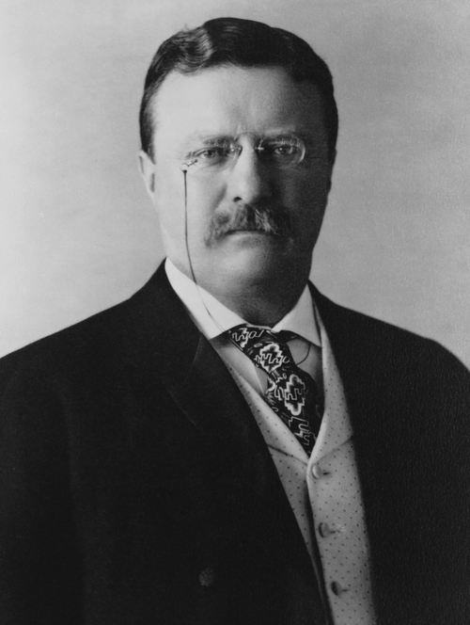
President Theodore Roosevelt the “Trust Buster”
Theodore Roosevelt = 1st Progressive President
Becomes president after William McKinley is assassinated
The Square Deal
Ensure fairness (“square deal”) for workers, consumers, big businesses
Uses Sherman Antitrust Act to bust up railroad trust and Standard Oil
Also signs Meat Inspection Act and Pure Food & Drug Act

Slide 8
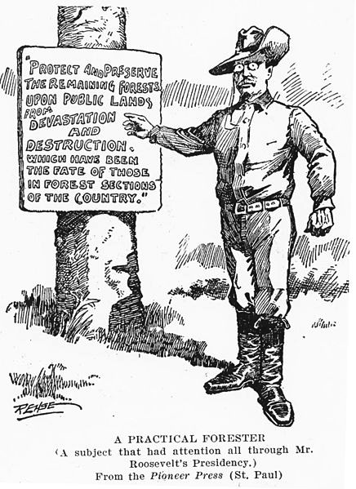
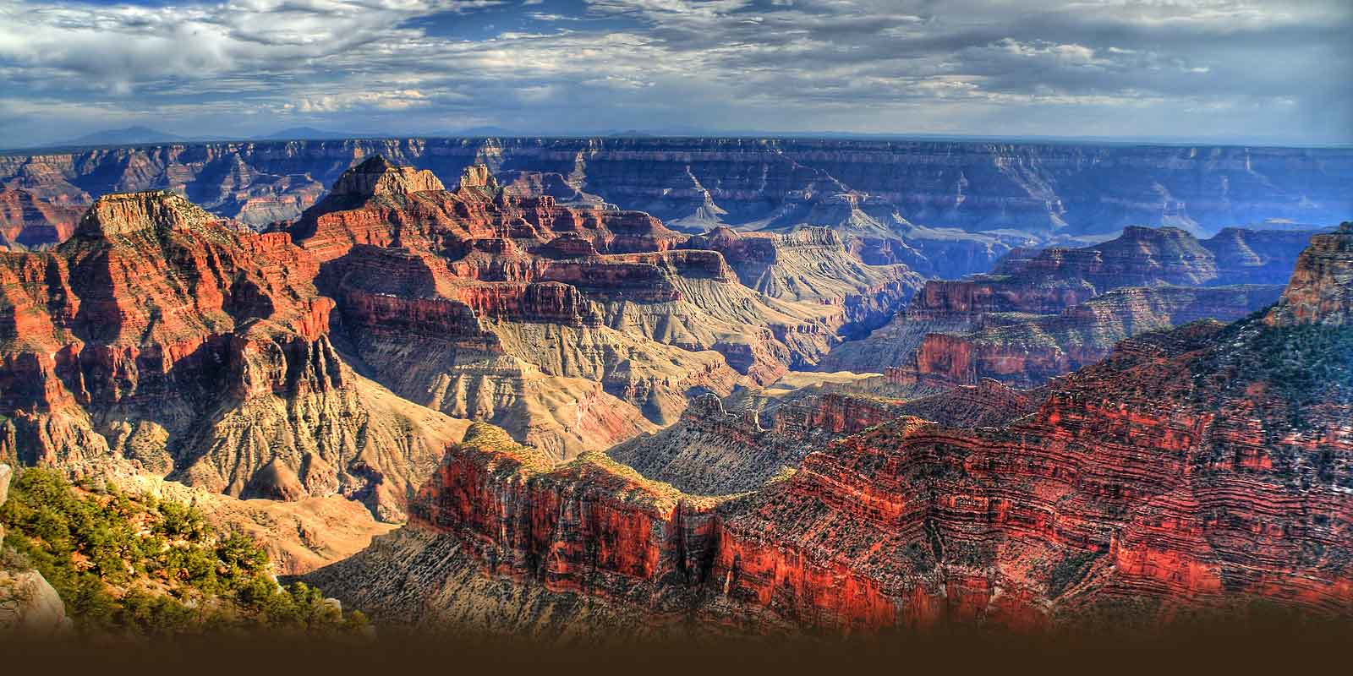
Conservation
Roosevelt = strong crusader for conservation
Conservation = controlling the use of America’s natural resources
Sets up 1st wildlife refuge, doubles number of US National Parks
Yellowstone and Yosemite National Parks
Antiquities Act preserves Grand Canyon and Petrified Forest

Slide 9
Assignment
http://goo.gl/4sWxye

