Slide 1
DO NOW
GET YOUR HOMEWORK OUT ON YOUR DESK.
Silently read the project information you received as you entered.
Write your name on top.
NO iPADS SHOULD BE USED AT THIS TIME.

Slide 2
Learning Goals
Essential Question:
What did the culture of the United States look like in the 1920s?
Learning Targets:
I can describe the American culture of the 1920s.
I can identify aspects of American cultural life in the 1920s.
POU:
I’ll know I’ve got it when I can create a keynote presentation, including pictures and text, describing life in the 1920s.

Slide 3
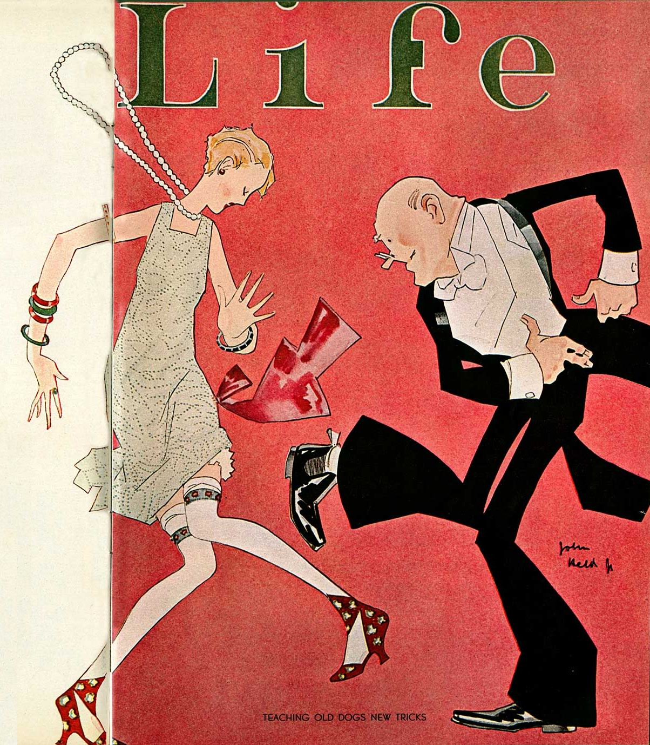
LIFE IN The Roaring ’20s
April 2, 2014
Mr. Lasseter

Slide 4
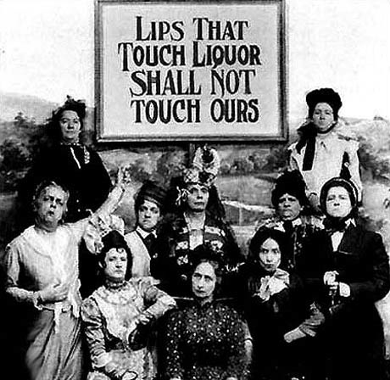
Prohibition began with the 18th Amendment. The Amendment was pushed for mainly by Christian women’s groups.
Prohibition

Slide 5
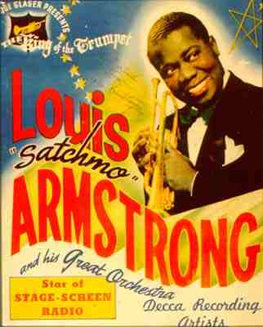
Jazz music was invented in America and became popular worldwide. Among the most popular jazz musicians was Louis Armstrong. Jazz began in New Orleans. If fact, the Utah Jazz basketball team used to be located in New Orleans!
Jazz Music

Slide 6
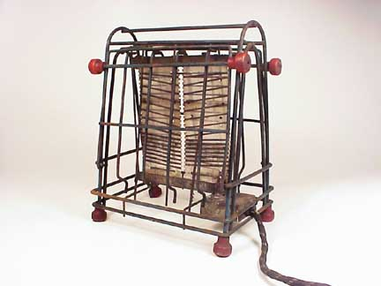
In the 1920s, electricity and new appliances, like this toaster, made routine chores much easier.
Home Appliances

Slide 7
Getting Around Prohibition

Slide 8
Flappers

Slide 9
The Harlem Renaissance

Slide 10
Sports

Slide 11
MY PICK: Advertising

Slide 12
MY PICK: Automobiles

Slide 13
The Roaring Twenties were a period of American history like no other! The creation of Jazz music, the first truly American music, was just a starting point. The speakeasies and dancing crazes that went along with the music made America vibrant. Along with this entertainment came breaking the law. Alcohol consumption at speakeasies, bootlegging, and criminal enterprises were directly disobeying the law of the land, Prohibition.
Due to new inventions in the home and at work, people had more time for leisure activities. Baseball became America’s Pastime, people went to the movies, read more, and enjoyed their new automobiles that they bought on credit.
There is a lot more to the 1920s than can be said here, but it certainly was ROARING!
THE END.

