Slide 1
DO NOW
How did the invention of the cotton gin affect life in the southern United States?

Slide 2
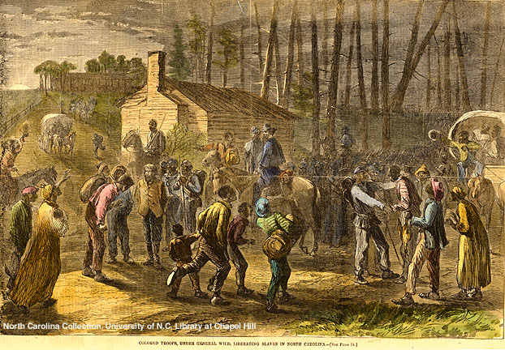
Slavery in North Carolina
January 7, 2014

Slide 3
Learning Goals
EQ
How can change and differences lead to violent conflict?
LT:
SWBAT explain how technology and population growth created political and social challenges.
POU (I’ll know I’ve got it when…)
I can examine the conditions of slavery in North Carolina.

Slide 4
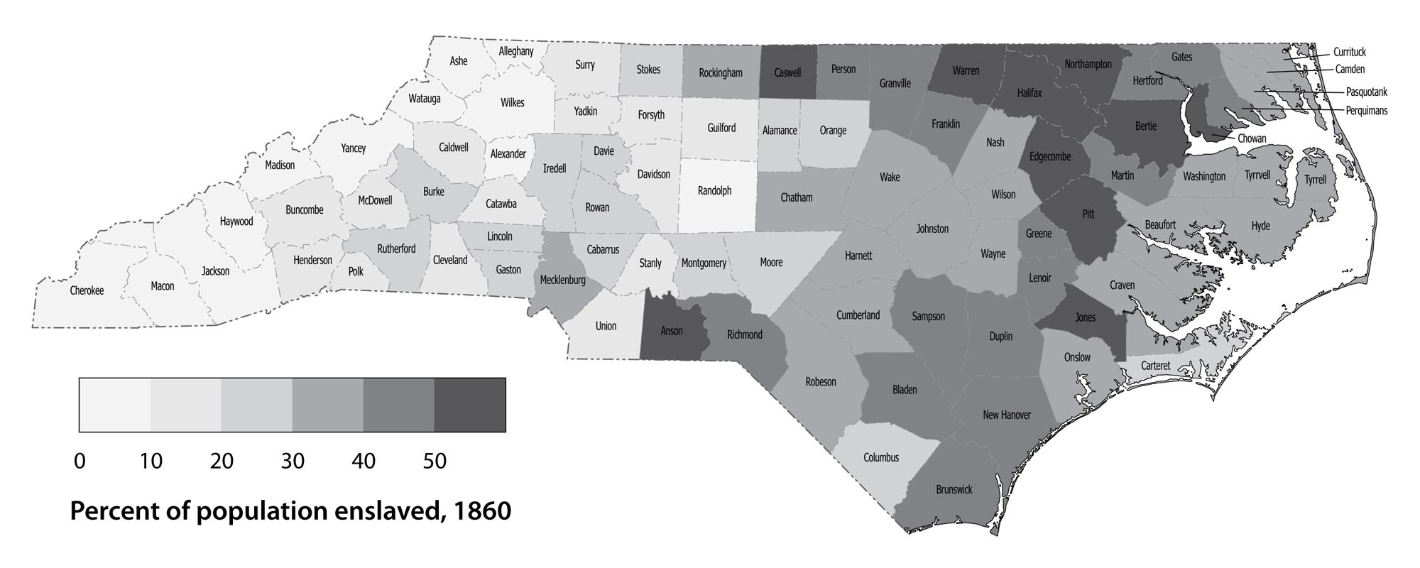
Slavery in North Carolina
Slavery was found in every NC county
The greatest amount of slaves was in the Coastal Plain and Tidewater regions—Why?
Better soil
Close to port cities

Slide 5
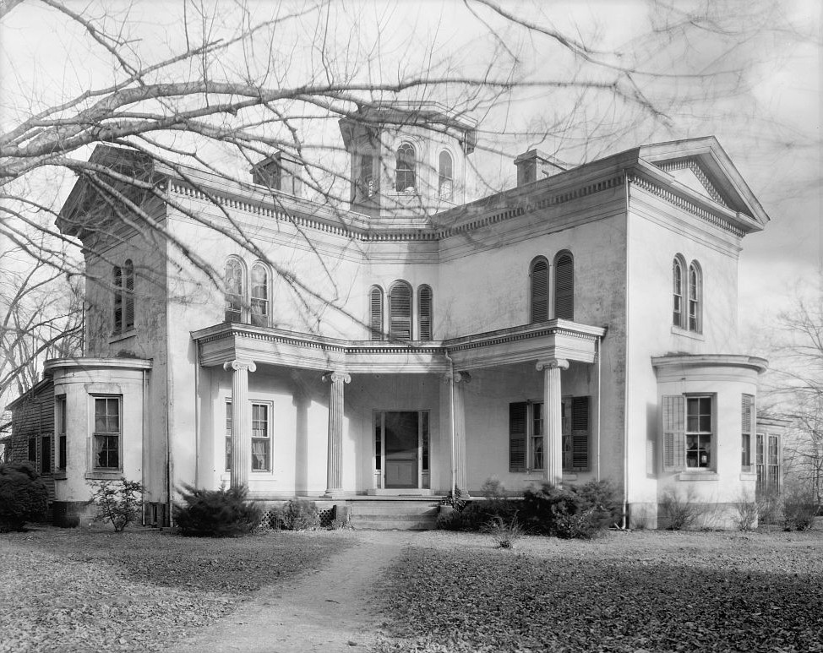
Plantation Life
Many slaves in NC lived on plantations
relatively large farms where most cash crops were grown with slave labor
Cash crops in NC were usually cotton or tobacco

Slide 6
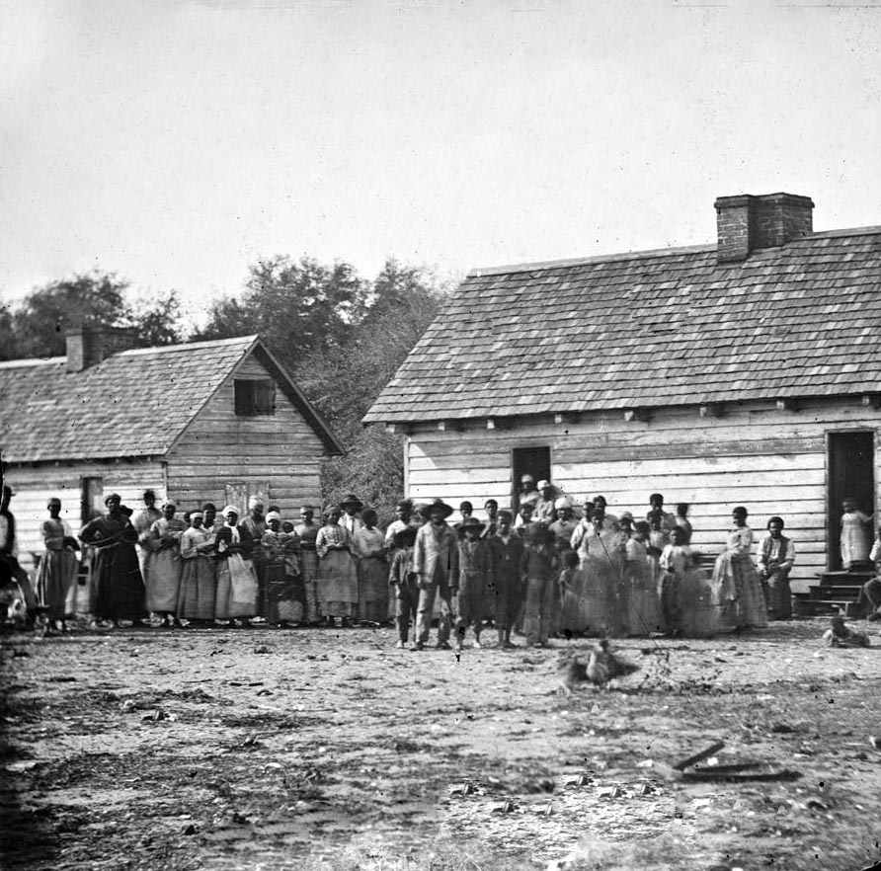
Plantation Organization
Slaves would
mostly work the fields
work from sunrise to sunset
clear land and raise livestock
be trained as skilled craftsmen, such as blacksmiths or cobblers

Slide 7
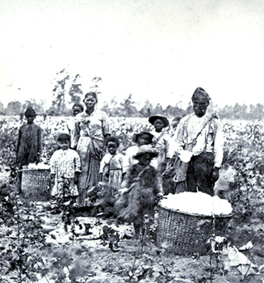
Working & Living Conditions
Supervised by overseers
Ate meals together and lived together
Housing was poor and often had no floors or windows

Slide 8
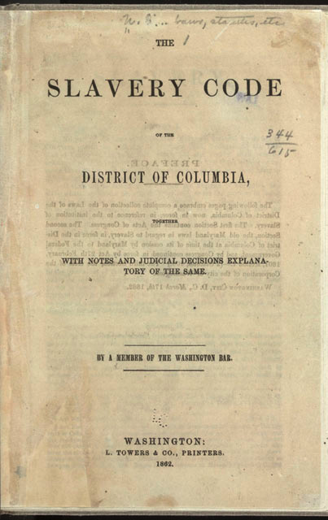
Slave Codes
Slave codes
Laws that governed every aspect of slave society
Applied only to slaves
Denied slaves many rights
Examples
Slaves could only travel with permission
Slaves could not be taught to read or write
No legal marriage

Slide 9
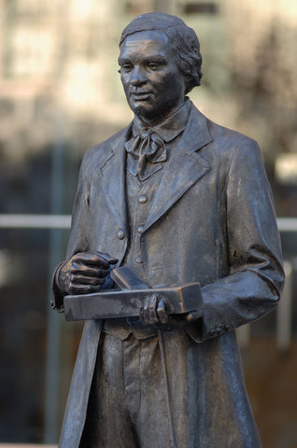
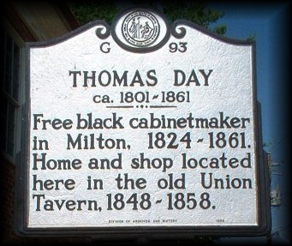
Free Blacks in North Carolina
In North Carolina, there were about 30,000 free black persons (about 900 of them owned slaves)
Free blacks had to carry papers and wear symbols to identify themselves
Rights of free blacks were still restricted
Most still worked on farms, but some were skilled craftsmen

