Slide 1
DO NOW - Copy the following notes into your notebook
World War I Major Players (1914-1920)
Allies
Central Powers
Great Britain
France
Russia
Serbia
Italy
7 other countries
United States (1917-20)
Germany
Austria-Hungary
Ottoman Empire
Bulgaria

Slide 2
Learning Goals
EQ:
Was the United States an imperialist nation?
LT:
Identify areas of the world that the United States tried to influence in the late 1800s/early 1900s.
Explain the causes of the Spanish-American War.
POU:
I can provide evidence for the claim that the United States was an imperialist nation.

Slide 3
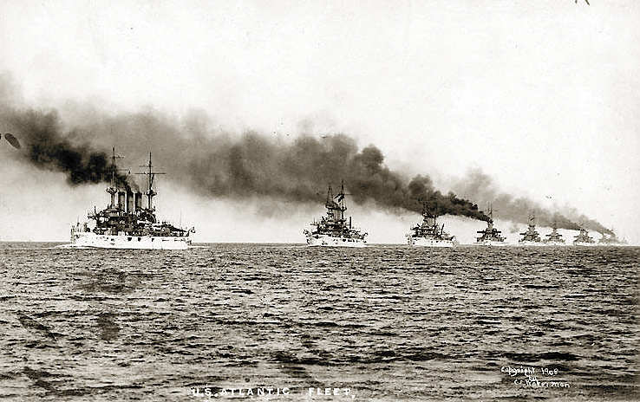
Becoming a World Power
March 21, 2014

Slide 4
Imperialism
The policy by which stronger nations extend their economic, political, or military control over weaker territories
WAS THE UNITED STATES AN IMPERIALIST NATION?
ARE WE STILL AN IMPERIALIST NATION?

Slide 5
U.S. Expansion
Many Americans in the late 1800s supported U.S. expansion due to three reasons:
Economic Interests
New territories mean more people to buy American products
Military Interests
Establishing military bases overseas could keep Americans safe at home
Cultural Superiority
Many Americans believed their government, religion, and race were superior to other societies

Slide 6
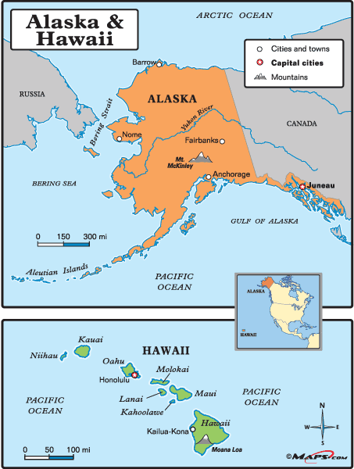
Alaska & Hawaii
The United States bought Alaska in 1867 for $7.2 Million
Originally seen as a mistake until gold was discovered there
The United States annexed Hawaii in 1898
Benefits:
Refueling station for U.S. Navy
American-owned sugar plantations made a lot of money

Slide 7
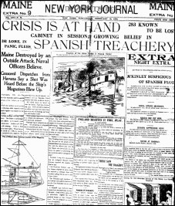
Expansion through War
In the 1890s, the United States became worried about a revolt in Spanish-owned Cuba
The United States traded a lot with Cuba, and relied on Cuba to buy American products
Yellow journalists wrote sensational stories about Spanish cruelty toward Cubans which made many Americans want to go to war with Cuba

Slide 8
Spanish-American War (1898)
Causes
Americans were eager to go to war to stop Spanish “cruelty”
Yellow journalists were writing stories to encourage war to get more readers
The U.S.S. Maine, an American battleship, exploded in Cuba, killing 260 sailors
This may have been an accident, but journalists and Americans blamed it on Spain
“Remember the Maine”

Slide 9
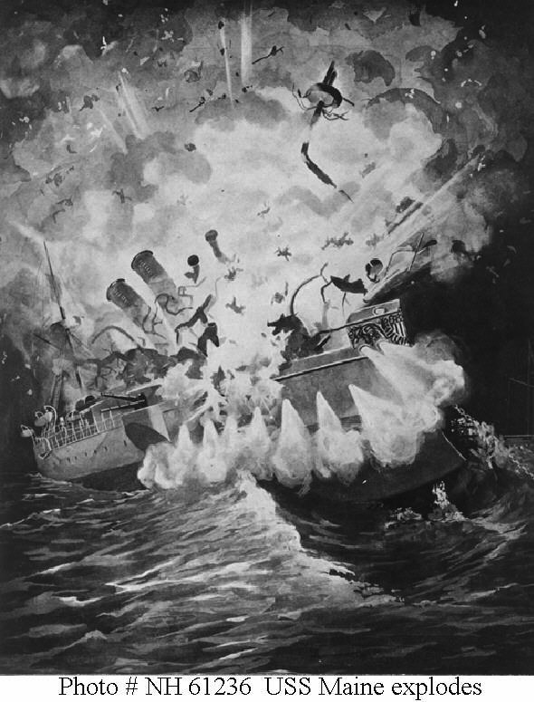
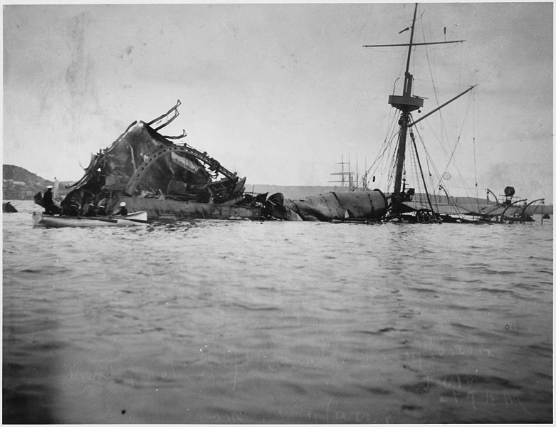
“Remember the Maine”

Slide 10
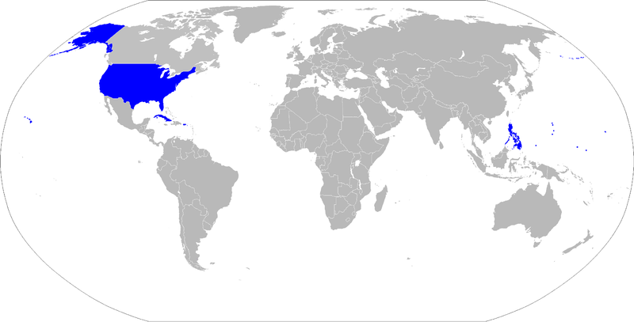
Results
The United States won the war within the year and gained the following territory around the world:
Puerto Rico
Guam
the Philippines
Cuba became a free country, but the United States had a major influence with everything they did

Slide 11
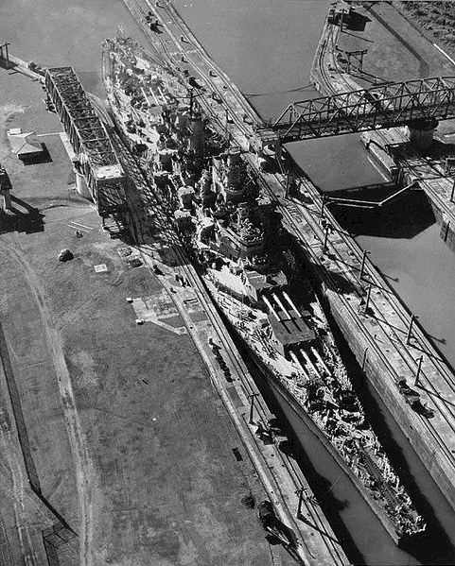
U.S. Influence in China & Latin America
China
The United States fought to keep trade with China open to all countries, not just a few
Latin America
The U.S. built the Panama Canal to increase trade
Also, the U.S. “policed” the region to make sure that the interests of the United States were protected

Slide 12
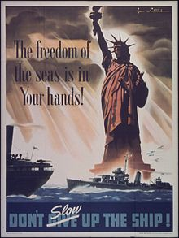
How does this relate to WWI?
The United States now had markets all over the world to sell its goods.
Goods were transported by ship to these places
The United States would enter World War I to protect its rights to ship goods wherever it wanted
This is called “Freedom of the Seas”

Slide 13
Exit Ticket
POU:
I can provide evidence for the claim that the United States was an imperialist nation.
http://goo.gl/E9N2r1

