Slide 1
DO NOW
What was the Louisiana Purchase?
Why is one reason it was important to the United States?

Slide 2
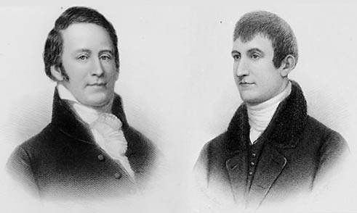
Exploring Louisiana Territory: Lewis & Clark
December 6, 2013

Slide 3
Learning Goals
EQ
How did the Louisiana Purchase impact the United States?
LT
I can explain the importance of the Louisiana Purchase
I can describe the impact of the Lewis & Clark Expedition
POU (I’ll know I’ve got it when…)
I can describe the impact of the Lewis & Clark Expedition and why it was important.

Slide 4
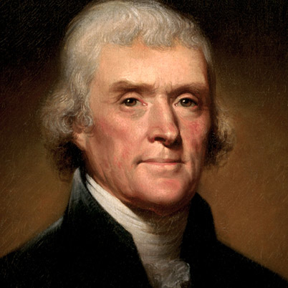
Louisiana Purchase
Originally, the U.S. wanted to buy the city of New Orleans
President Thomas Jefferson sent two representatives to France to try to buy the city
Surprisingly, France offered to sell all of Louisiana!

Slide 5
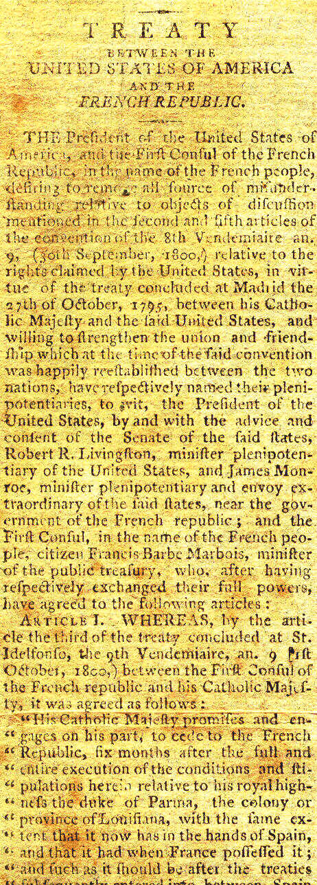
Louisiana Purchase
The representatives agreed to buy Louisiana for $15 Million
Many Congressmen were upset with Jefferson. They tried—and failed—to stop the purchase
The Louisiana Purchase DOUBLED the size of the United States!

Slide 6
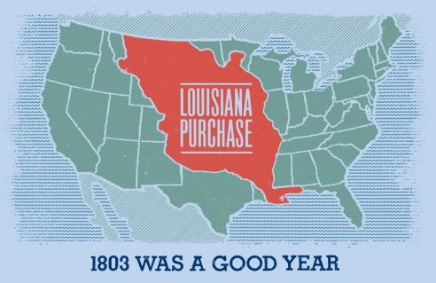
Importance of Louisiana Purchase
Doubled the size of the U.S.
Includes all or part of 14 current states
Trading & commerce
Exploration/settlement
National security

Slide 7
The Corps of Discovery
After buying Louisiana, Jefferson ordered an expedition to explore the land
He hired Meriwether Lewis and William Clark for the job

Slide 8
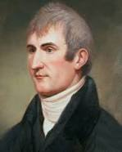
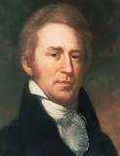
The Corps of Discovery
Meriwether Lewis
William Clark
Aide to Jefferson
Shy, Reclusive
Drew detailed maps of land, animals + plants
Served w/Lewis in Continental Army
Friendly, Outgoing

Slide 9
The Expedition
“Corps of Discovery” left St. Louis on May 14, 1804
Traveled on Missouri in special cargo boat
Many difficulties faced by Corps
Boat got stuck many times in river silt- was pulled upstream
Mosquitoes, fleas, gnats, leeches, snow, rapids

Slide 10
Expedition Route

Slide 11
The Journals
Required by Jefferson
Included 60 maps
Rivers, mountains
Very detailed
Sketches
Animals/plant life
140,000 words
Provided important credibility to journey

Slide 16
Indian Contacts
Visited/traded with nearly 50 tribes
Established etiquette for communicating with the tribes

Slide 17
Sacagawea
Joined expedition when her husband was hired by Clark
Invaluable to journey
Translated for the various tribes, provided horses + shelter

Slide 18
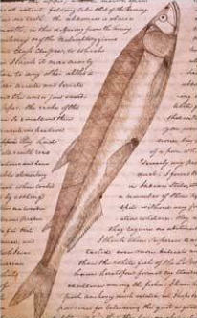
Achievements
Studied more than 50 tribes
Discovered 122 new animals
Described 178 new types of plants
Determined there was no Northwest Passage

Slide 19
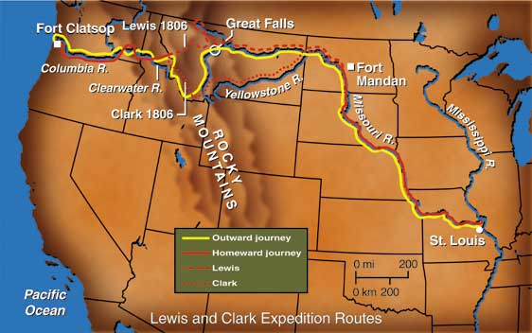
End of the Journey
Expedition reached Pacific Ocean in November 1805
Only 2nd non-native people to reach Pacific
Returned to St. Louis in Sept. 1806
Traveled 8,000 miles in 2 ½ years

