Slide 1
DO NOW
Take out your homework.
List three similarities between Booker T. Washington and W.E.B. DuBois.

Slide 2
LEARNING GOALS
EQ
Why was the Civil Rights Movement needed?
LT
Examine events of the early CRM and opposition that developed against it
POU
I can explain the importance of early CRM events and identify attempts at opposing them.

Slide 3
Civil Rights Movement: Early Days
May 13, 2014

Slide 4
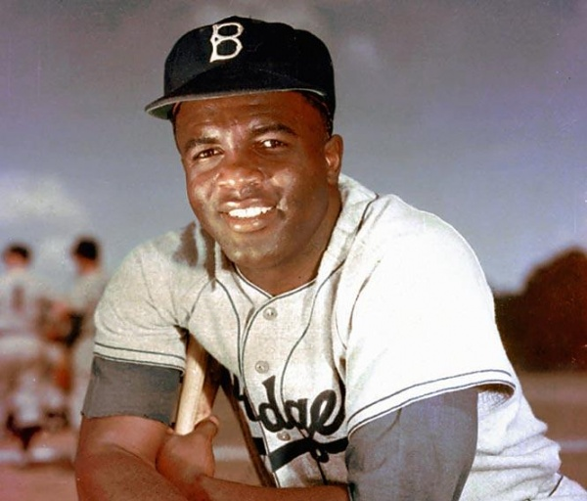
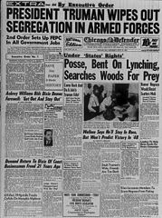
Integration in the 1940s
Integration
The act of ending segregation
Major League Baseball
In 1947, the Brooklyn Dodgers signed Jackie Robinson as the first black Major Leaguer
U.S. Military
In 1948, Harry Truman ordered the integration of the U.S. military
This was the first major integration ordered by the federal government!

Slide 5
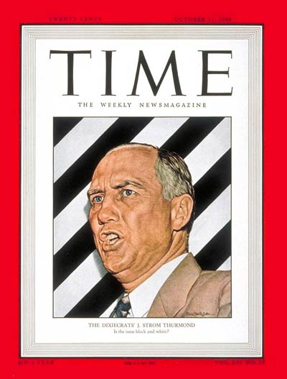
Political Opposition
White Southern Democrats typically opposed Civil Rights due to the issue of segregation and integration
In 1948, the States’ Rights Democratic Party or “Dixiecrats,” nominated a candidate for President
They believed in segregation
The Dixiecrats nominated Sen. Strom Thurmond for President in 1948.

Slide 6
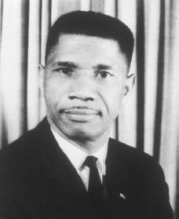
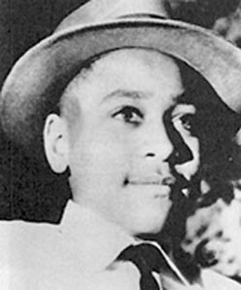
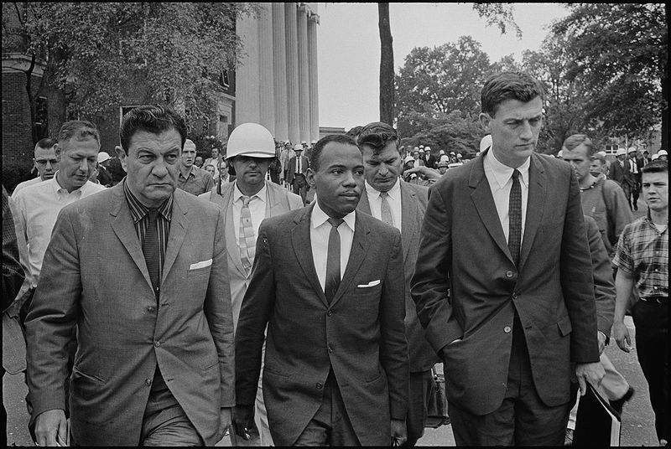
Violent Opposition
In addition to changes in politics, violence and intimidation were also used to fight against the Civil Rights Movement
Examples:
Little Rock Crisis in 1957
Riots at Ole Miss in 1962
Assassination of MLK in 1968

Slide 7
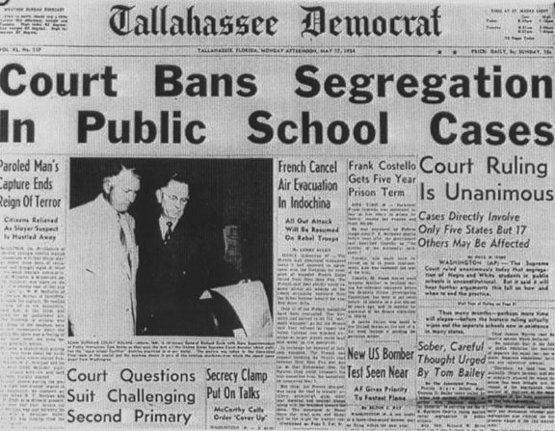
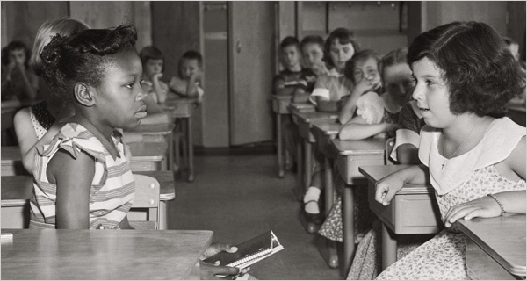
Brown v. Board of Education
1954
Ruled that “separate-but-equal is inherently unequal”
Said schools should integrate immediately
North Carolina would not integrate until 1970!

Slide 8
