Slide 1
DO NOW
Define appeasement.

Slide 2
Learning Goals
EQ:
Why did the U.S. enter World War II?
LTs:
I can identify the major players at war in World War II.
I can explain how the United States prepared for war prior to Pearl Harbor.
I can describe the events that led to the U.S. entering WWII.
POUs:
I can identify the major players of WWII by creating a chart.
I can explain the ways the United States prepared for war by outlining the steps.
I can describe the events of Pearl Harbor in an exit ticket.

Slide 3
World War II: The United States Enters the War
April 23, 2014

Slide 4
Allies vs. Axis
Allied Powers
Axis Powers
Great Britain
Winston Churchill (prime minister)
France
Occupied by Germany at start of war
Russia
Joseph Stalin (dictator)
United States
Franklin D. Roosevelt (president)
China
Chiang Kai-shek (president)
Germany
Adolf Hitler (dictator)
Italy
Benito Mussolini (dictator)
Japan
Hirohito (emperor)
Hideki Tojo (military leader)

Slide 5
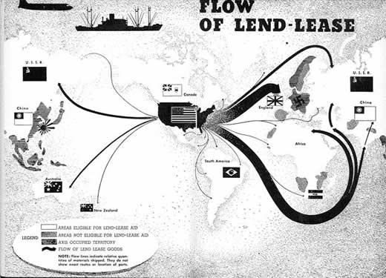
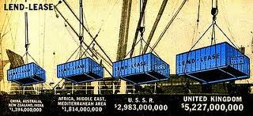
Preparing for War
Unlike the First World War, the U.S. began preparing for war even before joining the Allies
The U.S. also supplied the Allies with arms and other materials through the Lend-Lease Act
$50 Billion worth of supplies!

Slide 6
Preparing for War
Increased Production
Started making Jeeps, planes, and ships.
Hired more workers
Farmers grew more
Expansion of Government
Created government agencies to organize for war

Slide 7
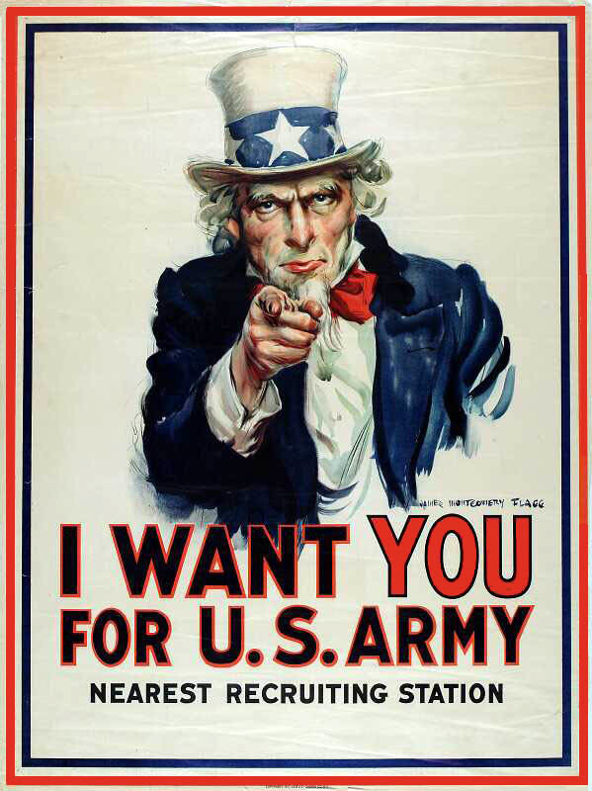
Preparing for War
3. Regulating of the Economy
Set prices, rationed items, and controlled wages.
Raised money by selling war bonds and raising taxes.
4. Raising the Army
Created a peace-time military draft
Activated the National Guard

Slide 8
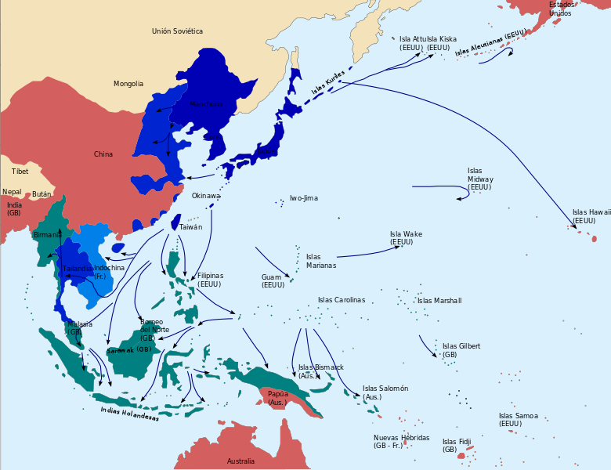
Declaring War
Japan wanted to dominate the Pacific and its oil supplies
They believed the United States Navy stood in their way

Slide 9
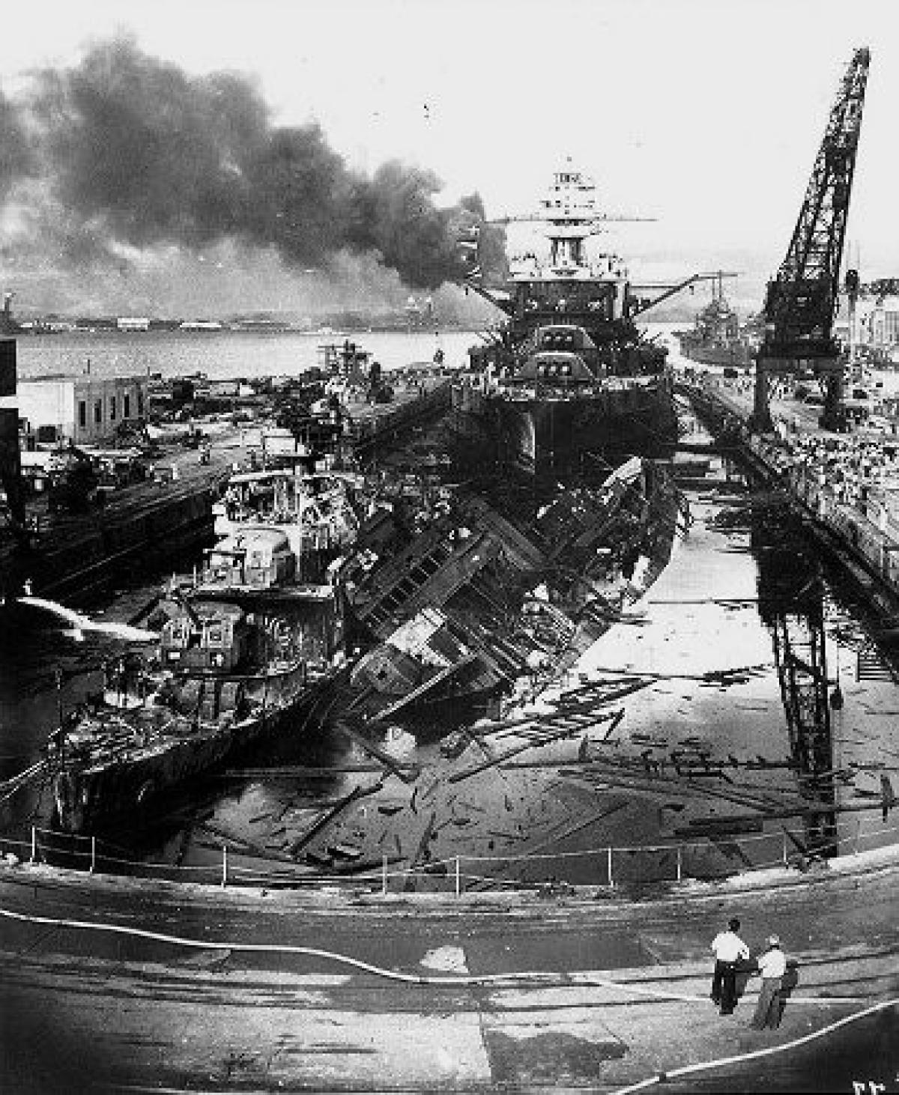
Declaring War
On December 7, 1941, Japanese warplanes bombed the naval base at Pearl Harbor in Hawaii
About 2,400 Americans die in the attack
On December 8, the U.S. declared war on Japan
On December 11, Germany and Italy declared war on the United States

