Slide 1
DO NOW
Define these terms:
Slave narrative
Dialect

Slide 2
The Abolitionist Movement and Compromises over Slavery
January 9, 2014

Slide 3
Learning Goals
EQ:
How can change and differences lead to violent conflict?
LT:
SWBAT predict the problems of growing sectionalism in the United States in the 1800s.
POUs:
I can summarize the viewpoints of abolitionists and how they contributed to sectionalism in the United States.
I can assess the effectiveness of compromises made over slavery in the United States.

Slide 4
Words to Know Today
Abolitionists
People who wanted to get rid of slavery and make it illegal
They tried to help slaves in many different ways
Compromise
An agreement between two sides where they both give up something they want to get something they want

Slide 5
Take out your iPads
Open Safari
Type this into the address bar at the top:
history8lgms.weebly.com
Scroll down to the Civil War notes.
Download:
04_abolition_and_compromise_notes.ppt

Slide 6
PART 1: ABOLITIONISTS

Slide 7
Abolitionist Issues
Abolitionists wanted…
to end slavery since they believed it was cruel and unfair.
to reunite the slaves and their families.
equality for African-Americans in order to give them their rightful place in society.
to change the Constitution since they believed it was pro-slavery.
Abolitionists didn’t want slavery to be allowed in the new states joining the union.

Slide 8
William Lloyd Garrison December 12, 1805-May 24, 1879
William Lloyd Garrison was an important abolitionist, journalist, and social reformer. He was best known as the editor of the abolitionist newspaper, The Liberator. He was also the founder of the American Anti-Slavery Society.

Slide 9
Frederick Douglass February 17, 1818-February 20, 1895
Frederick Douglas was an American social reformer, orator, writer, and statesman. After he escaped from slavery, he became a leader of the abolitionist movement. He was inspired by William Lloyd Garrison’s newspaper. After a speech that Douglass gave, Garrison hired Douglass as a traveling speaker. Frederick Douglass thought the constitution was a proslavery document because it allowed slavery.

Slide 10
Harriet Tubman c. 1820 or 1821 – March 10, 1913
Harriet Tubman escaped from slavery but returned to the South to get her sister and her sister’s family. Over the next 12 years she returned about 18 or 19 more times and brought over 300 slaves to the north. She was one of the individuals that was part of the Underground Railroad. Many people said that Harriet Tubman was fearless. She was known for carrying a gun around with her to threaten runaway slaves that were thinking of going back.

Slide 11
John Brown May 9, 1800-December 2, 1859
John Brown supported and practiced armed rebellion. His attempt to start a liberation movement for slaves in 1859 excited abolitionists. He believed that violence was necessary in order to end slavery. He wanted a lot of slaves to rise up against there masters in an armed rebellion. He led a raid on a U.S. armory before being captured.

Slide 12
EXIT TICKET
Go to the following website:
http://goo.gl/VWDaZn
In 2-3 sentences, summarize the goals of abolitionists before the Civil War.

Slide 13
DO NOW
Who were abolitionists?
Name two famous abolitionists.

Slide 14
PART 2: COMPROMISES OVER SLAVERY

Slide 15
Learning Goals
EQ:
How can change and differences lead to violent conflict?
LT:
SWBAT predict the problems of growing sectionalism in the United States in the 1800s.
POUs:
I can summarize the viewpoints of abolitionists and how they contributed to sectionalism in the United States.
I can assess the effectiveness of compromises made over slavery in the United States.

Slide 16
Words to Know Today
Abolitionists
People who wanted to get rid of slavery and make it illegal
They tried to help slaves in many different ways
Compromise
An agreement between two sides where they both give up something they want to get something they want

Slide 17
Missouri Compromise of 1820
After the U.S. bought Louisiana in 1803, it had to decide if states being made from this territory would be free or slave.
Missouri applied to become a slave state. Maine wanted to come in as a free state. This would keep the balance between slave and free in Congress.
To avoid future arguments, Congress decided that any territory that became a state would be slave or free depending on where it was on the map.

Slide 18
Missouri Compromise of 1820
Maine is admitted to the United States as a Free State
Missouri is admitted to the United States as a Slave State
Every new state South of 36°30’N latitude would be slave.
Every new state North of that line (except Missouri) would be free.
To make the Southern states happy, Congress added that slaves that had escaped to the North could be brought back if they were caught-even from non-slave states.

Slide 19
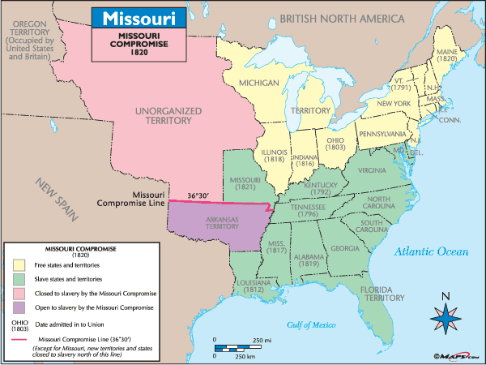

Slide 20
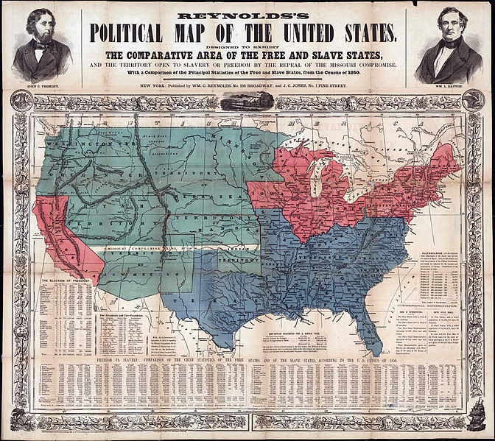
Compromise of 1850
After getting Texas and California, the U.S. re-examined the issue of slavery. They had to decide if new states would be slave or free.
When California asked to become a free state in 1849, people began arguing. The Missouri Compromise line cut right thru the middle of California.

Slide 21
Compromise of 1850
RESULTS
California would be admitted as a free state.
All other territories could decide when they applied for statehood if they wanted to be slave or free. This is called popular sovereignty.
The slave trade would be outlawed in D.C.
This compromise included the Fugitive Slave Act
It was now a CRIME to help runaway slaves even in the North! This made abolitionists very angry.

Slide 22
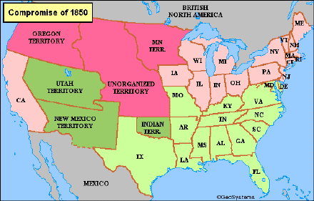

Slide 23
Kansas-Nebraska Act of 1854
By the 1850s the area north of Texas was ready to be recognized as a territory in preparation to becoming a state.
It was North of the Missouri Compromise line. The Compromise of 1850 had stated that these territories could decide for themselves if they were going to be free or slave.
In 1854 Congress created 2 territories, Kansas and Nebraska. It was hoped by many that one would be free and one would be slave. However, the decision was left up to the people in those territories=Popular Sovereignty.
People from surrounding states flooded into these territories to swing the vote the way they wanted it to go.

Slide 24
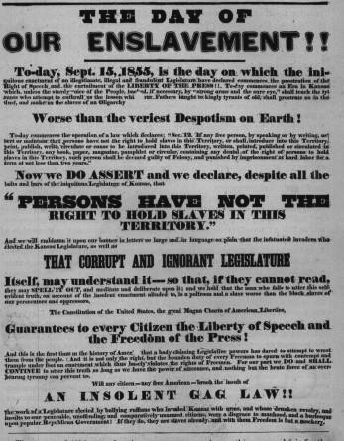
Kansas-Nebraska Act of 1854
Results:
Bleeding Kansas
Lots of violence
Many people were killed over the issue.
The Democratic Party lost support in the North but gained it in the South. Democrats were pro-slavery.
The Republican Party is created and it gained power among those against slavery.

Slide 25
