Slide 1
DO NOW
What were the two main reasons Woodrow Wilson asked Congress to declare war against Germany?

Slide 2
Life on the Home Front: America During World War I
March 25, 2014

Slide 3
Learning Goals
EQ:
How did Americans respond to war?
LT:
Examine the economic, political, social, and military impact of WWI on the U.S. home front.
POU:
I can describe the impact of WWI on the economic, political, social, and military U.S. home front.

Slide 4
Mobilizing for War
WWI cost the U.S. government $35.5 Billion
Most of this was paid for by war bonds (loans made by civilians to the government)
Everyone went to work
Women entered the workforce in huge numbers
Children even helped out at school!
The government regulated prices and materials to save for war

Slide 5
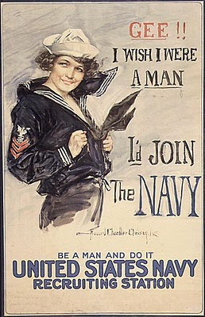
Propaganda
Propaganda Definition:
Opinions expressed for the purpose of influencing the actions of others
The U.S. produced movies, posters, photographs, magazines, and pamphlets to increase patriotism

Slide 6
Intolerance and Suspicion
Espionage Act (1917) and Sedition Act (1918)
Set heavy fines and long prison terms for antiwar activities
Made it illegal to criticize the war effort
Hundreds went to jail
Schenck vs. United States
The Supreme Court upheld these laws

Slide 7
Jobs, Migration, and Sickness
Women and African-Americans filled jobs left by white men who went to war
The Great Migration
Over 500,000 African-Americans moved away from the south to northern cities to work
The Flu Epidemic of 1918
Spread around the world by soldiers
In two years, it killed more than 20 million people around the world

Slide 8
DO NOW
What were two effects of World War I on the American home front?

Slide 9
Learning Goals
EQ:
How did Americans respond to war?
LT:
Examine the economic, political, social, and military impact of WWI on the U.S. home front.
POU:
I can describe the impact of WWI on the economic, political, social, and military U.S. home front.

Slide 10
Video
https://www.youtube.com/watch?v=ouNv9pluZxg

Slide 11
Assignment - Together
We will read the section “Mobilizing for War” together.
http://goo.gl/nXsalQ
Cite your answer with the page # and paragraph # where you found your answer.

Slide 12
Assignment – On Your Own
Read the remainder of the packet.
Answer the questions that are on the iPad using your book (pages 2 & 3).
http://goo.gl/nXsalQ
Cite your answer with the page # and paragraph # where you found your answer.
Page 4 is separate from your reading, so you will not need to cite your answer.

