Slide 1
DO NOW
Go to the following link:
http://goo.gl/GvtpRi
Answer the question on that page.

Slide 2
WEBQUEST ACTIVITY (CONTINUED)
February 12, 2014

Slide 3
Learning Goals
EQ:
How can technological and innovation change a country?
LT:
SWBAT research major topics that we will cover during our Industrial Revolution unit.
POU:
I can research major developments during the Industrial Revolution.

Slide 4
Assignment
Go to our class website:
history8LGMS.weebly.com
Use the links provided in the IR WebQuest Resources document.

Slide 5
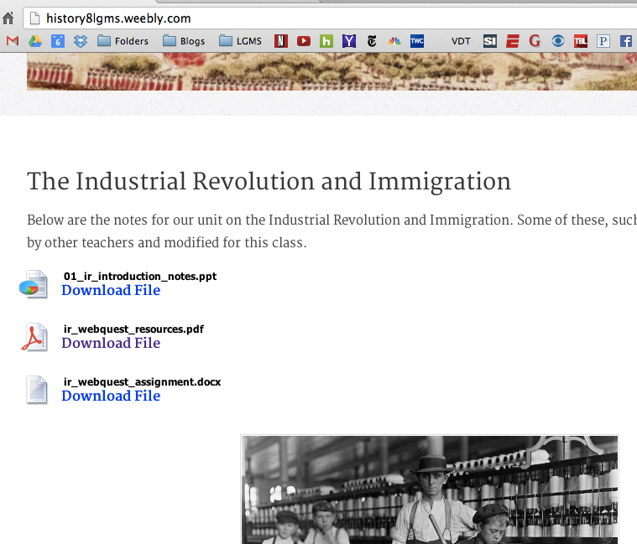

Slide 6
When/If you finish…
Go to the following link and follow the directions:
http://goo.gl/18Ww1W

