Slide 1
DO NOW
How did women contribute to the war effort during the Second World War?

Slide 2
LINKS FOR TODAY
PART ONE
http://goo.gl/q9sDT9
PART TWO
http://goo.gl/uJTgRF

Slide 3
The Home Front during the Second World War
April 25, 2014

Slide 4
Learning Goals
EQ
How did WWII impact Americans at home?
LTs
Describe wartime production during the war.
Explain the opportunities for women and minorities during the war.
Clearly define an argument for or against Japanese-American internment during the war.
POUs
I can describe the contributions to the war made by Americans on the home front.
I can defend an argument for or against Japanese-American internment during the war.

Slide 5
Wartime Production
The War Production Board (WPB) organized the effort to make supplies 24 hours a day
Factories made planes, tanks, weapons, parachutes, etc.
Due to the need for raw materials, some things became scarce for other Americans
No new cars were produced between 1942 and 1945
Gasoline, tires, shoes, meat, and sugar were rationed (limited to a fixed amount for each family)

Slide 6
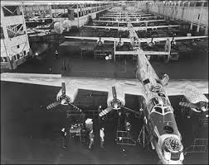
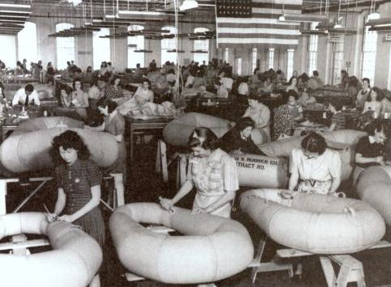
Wartime Production by the Numbers
By 1945:
300,000 aircraft
75,000 ships
60% of all Allied ammunition
Unemployment rates fell drastically
GDP rose from $90.5 billion to $212 billion

Slide 7
Opportunities for Women
Women entered the workforce by the millions
Made munitions, ships, planes, etc.
The U.S. promoted Rosie the Riveter, an image of a strong woman working
Rosie the Riveter

Slide 8
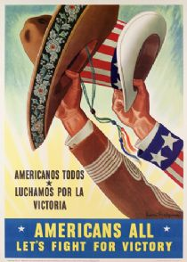
Opportunities for Minorities
Over 1 million African Americans left the south to work in war industries
Also led to racial tension in Northern cities
120,000 Mexican immigrants came to the U.S. to work temporarily as part of the bracero program
46,000 Native Americans left reservations to work in war industries

Slide 9
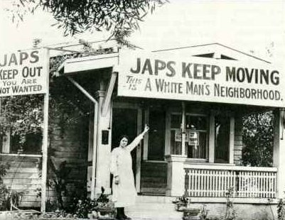
Japanese-American Internment
Executive Order 9066 ordered over110,000 Japanese Americans to be moved to internment camps
One-room housing, very little privacy
Kept under guard
Why?
The U.S. government was afraid that Japanese Americans were a threat to America

Slide 10
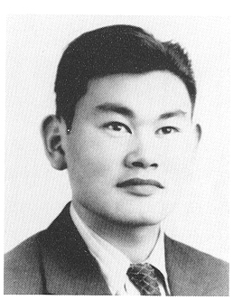
Korematsu v. the United States (1944)
Fred Korematsu was a Japanese-American who was forced to leave his home and move to an internment camp
He sued the U.S. government, saying it violated his rights
The Supreme Court said that need to protect Americans was greater than Korematsu’s rights
Do you agree with Korematsu or the U.S. government?
ASSIGNMENT: Read the arguments of both sides. We will discuss each. You will then present your own argument about this case!

