Slide 1
DO NOW
Read the article you were given as you entered.
What happened during the Royal Ice Cream Sit-in?
How do you think this fits into the Civil Rights Movement?

Slide 2
Learning Goals
EQ
What forms of protest did the Civil Rights Movement take?
LTs
I can define the terms “nonviolence” and “sit-in.”
I can explain how nonviolence created successes during the Civil Rights Movement.
I can identify Civil Rights protests in North Carolina.

Slide 3
The Nonviolent Civil Rights Movement
May 15, 2014

Slide 4
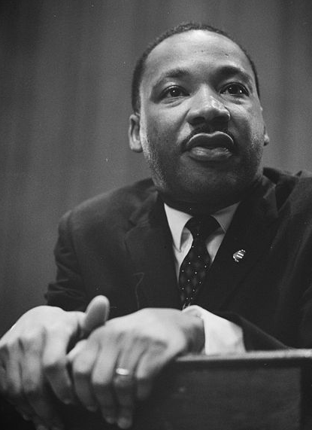
Nonviolence
Definition
the use of peaceful means (not force) to bring about political or social change
Some nonviolent organizations:
Montgomery Improvement Association (MIA)
Southern Christian Leadership Conference (SCLC)
Congress of Racial Equality (CORE)
Student Nonviolent Coordinating Committee (SNCC)

Slide 5
Martin Luther King, Jr.
Leader of the nonviolent CRM
Led the Montgomery Bus Boycott and later founded the SCLC
He was inspired by Mahatma Gandhi and believed in nonviolence
It was the nonviolent movement which would bring about Civil Rights legislation

Slide 6
Six Principles of Nonviolence
Nonviolence is not passive, but requires courage;
Nonviolence seeks reconciliation (compromise with), not defeat of an adversary;
Nonviolent action is directed at eliminating evil, not destroying an evil-doer;
A willingness to accept suffering for the cause, if necessary, but never to inflict it;
A rejection of hatred, animosity or violence of the spirit, as well as refusal to commit physical violence;
Faith that justice will prevail.

Slide 7
Montgomery Bus Boycott
Led by Rosa Parks, MLK, among others
Blacks refused to ride the buses in order to try to end segregation on them
Montgomery, AL
Dec. 5, 1955-Dec. 21, 1956
The boycott was successful

Slide 8
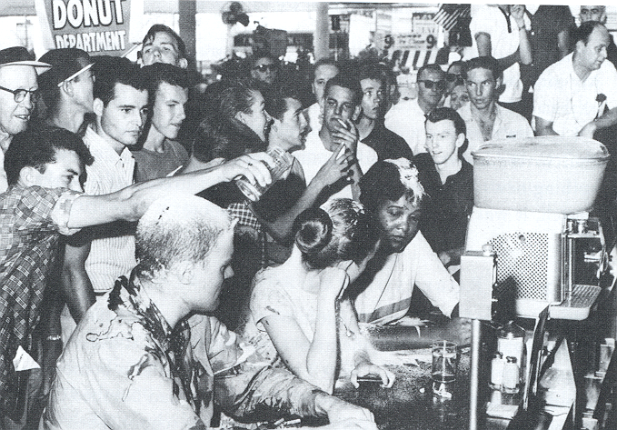
Sit-in
A form of nonviolent protest in which demonstrators occupy a place, refusing to leave until their demands are met

Slide 9
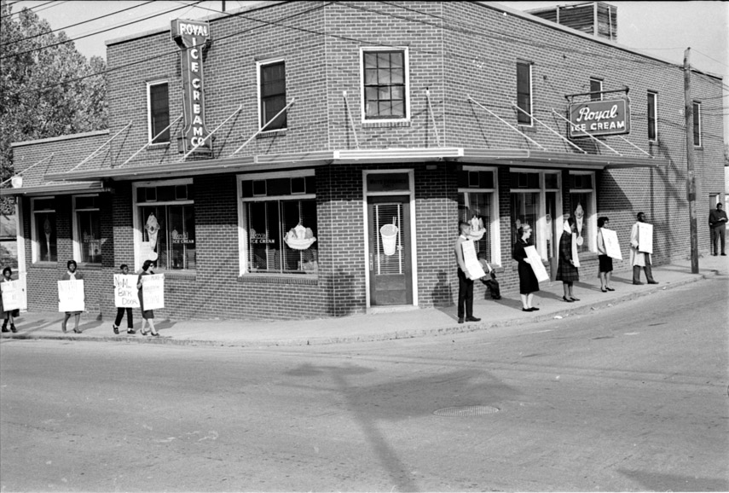
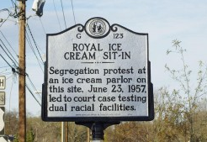
Royal Ice Cream Sit-in
1957
Protesters organized a sit-in to try and integrate the Royal Ice Cream Shop in Downtown Durham, NC
They were arrested and fined $10 each
They appealed their case all the way to the U.S. Supreme Court, but lost the case

Slide 10
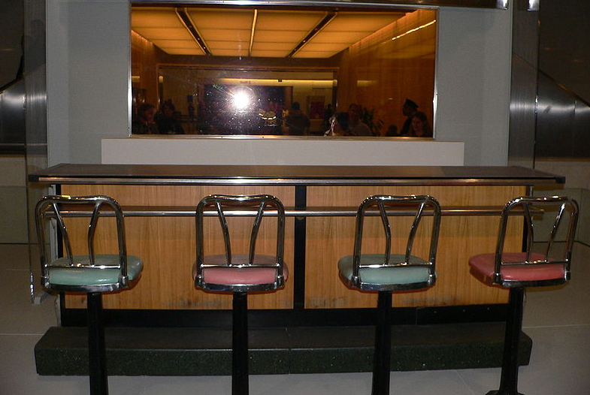
Greensboro, NC Sit-ins
On Feb. 1, 1960, four black college students sat down at a whites-only lunch counter at Woolworth’s
They refused to leave for the entire day and endured a lot of harassment
They came back every day with even more demonstrators which grew to over 300

Slide 11
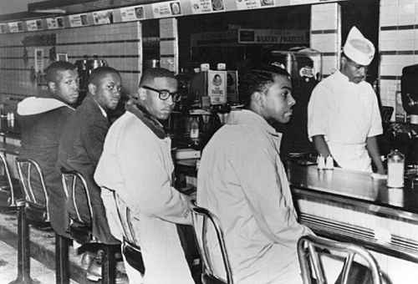
Sit-ins
Despite a bomb threat, Woolworth’s finally integrated
Sit-ins like those in Greensboro began to happen throughout the country

Slide 12
VIDEO
http://www.youtube.com/watch?v=Xbbcjn4d1cE

Slide 13
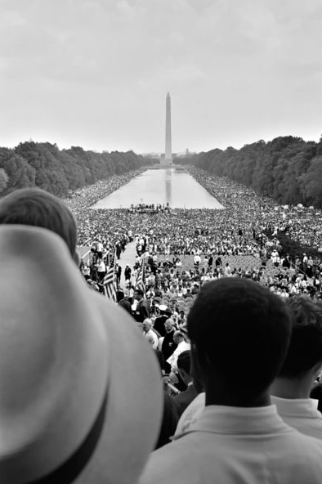
March on Washington
On August 28, 1963, over 300,000 people went to Washington, D.C. to march for “jobs, justice, and peace”
It was the largest Civil Rights demonstration in Washington, D.C.
Led by MLK, it is where he gave his famous “I Have A Dream” speech
The march helped finally bring about Civil Rights Legislation

Slide 14
Freedom Summer of 1964
In 1964, over 1000 college students, most of whom were white, traveled to MS to conduct schools for black children and to help blacks register to vote
This was called the Freedom Summer
The students faced a lot of hostility
80 were beaten
over 1000 were arrested
4 died (3 in Neshoba County)

Slide 15
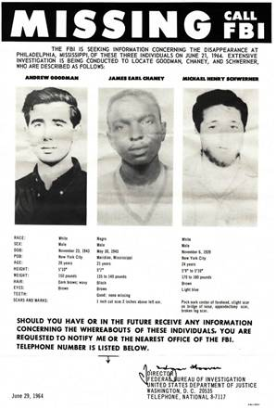
The men killed in Neshoba County had been investigating a church bombing
They were arrested and released to a mob who murdered them
Their murderers were only convicted of Civil Rights violations

