Slide 1
DO NOW
What were 3 goals of the Populist Party?

Slide 2
Learning Goals
EQ:
How did Progressives change our Constitution?
LT:
List the Progressive Amendments.
Describe the changes brought about by the Progressive Amendments.
POU:
I can describe the Progressive Amendments by completing modified Frayer models for each.

Slide 3
The Progressive Amendments
March 12, 2014

Slide 4
Amending the Constitution
To make their reforms permanent, Progressives pushed for amendments to the U.S. Constitution
The 16th-19th Amendments are referred to as the Progressive Amendments because they were passed and ratified during the Progressive Era

Slide 5
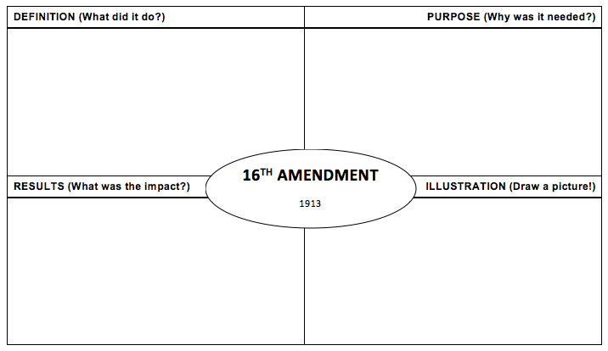
Assignment #1
You will complete 4 modified Frayer models (one for each amendment)
We will do the first completely together (even the picture)
Use these notes to complete part of each model

Slide 6
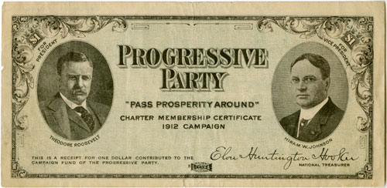
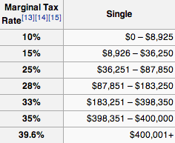
16th Amendment
Granted Congress the power to tax income
Designed to produce a steady source of money for the federal government
The federal government now uses a graduated income tax
This means that the more money you make, the higher percentage of taxes you pay ➔

Slide 8
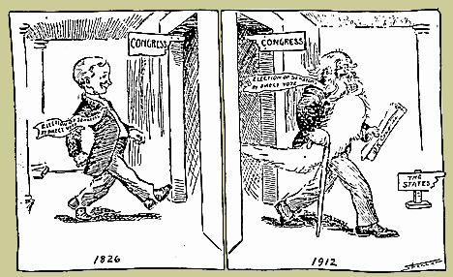
17th Amendment
Provided for the direct election of U.S. Senators to Congress
Voters would elect the Senators, not state legislatures
This kept corrupt politicians at the state level from choosing U.S. Senators
It gave voters more say in government and made Senators accountable to ALL people, rather than just other politicians

Slide 9
18th Amendment
Made it illegal to make, sell, or transport alcohol
The Temperance Movement, mostly led by conservative Christian women, pushed for the amendment
Drinking alcohol was seen as amoral to many people, mainly due to the growth of saloons, gambling, and prostitution
Also resulted in speakeasies (underground bars) and the bootlegging industry
Eventually repealed by the 21st Amendment

Slide 10
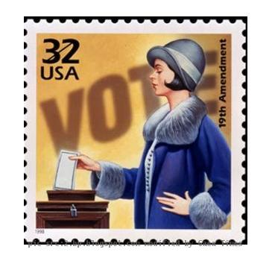
19th Amendment
Gave women the right to vote!
Why was it needed? Are you kidding me? Ok…
Women make up about 51% of the country
They could vote in some states, but not all
They could work, pay taxes, etc., but not vote
Women now vote at higher rates than men!

Slide 11
Assignment #2
Which Progressive Amendment do you think was the most important?
Defend your opinion with at least three supporting details.

