Slide 1
DO NOW
What were three types of propaganda produced by the U.S. during WWI?

Slide 2
Learning Goals
EQ:
How did Americans respond to war?
LT:
Examine the impact of the U.S. troops on the European war front.
POU:
I can describe the impact of the U.S. troops on the European war front..

Slide 3
Americans on the European Front
March 27, 2014

Slide 4
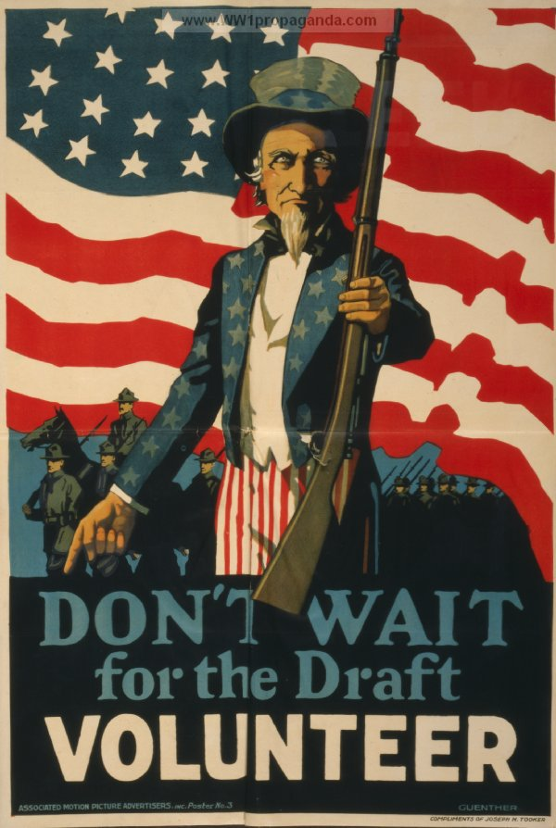
Raising an Army and a Navy
In 1917, U.S. was not ready for war
Armed Forces had less than 200,000 men
To increase troops, the U.S. passed the Selective Service Act of 1917, creating a draft
By 1918, 3 million men were chosen to serve

Slide 5
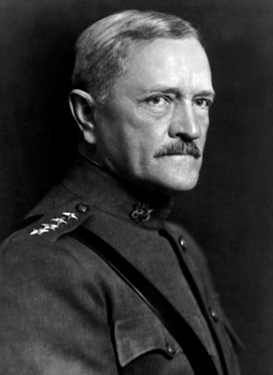
American Impact in the War
U.S. provided fresh troops to fatigued Allied Forces
U.S. troops help Allies halt the German advance
Under General John J. Pershing, U.S. “Doughboys” fought separately from British and French

Slide 6
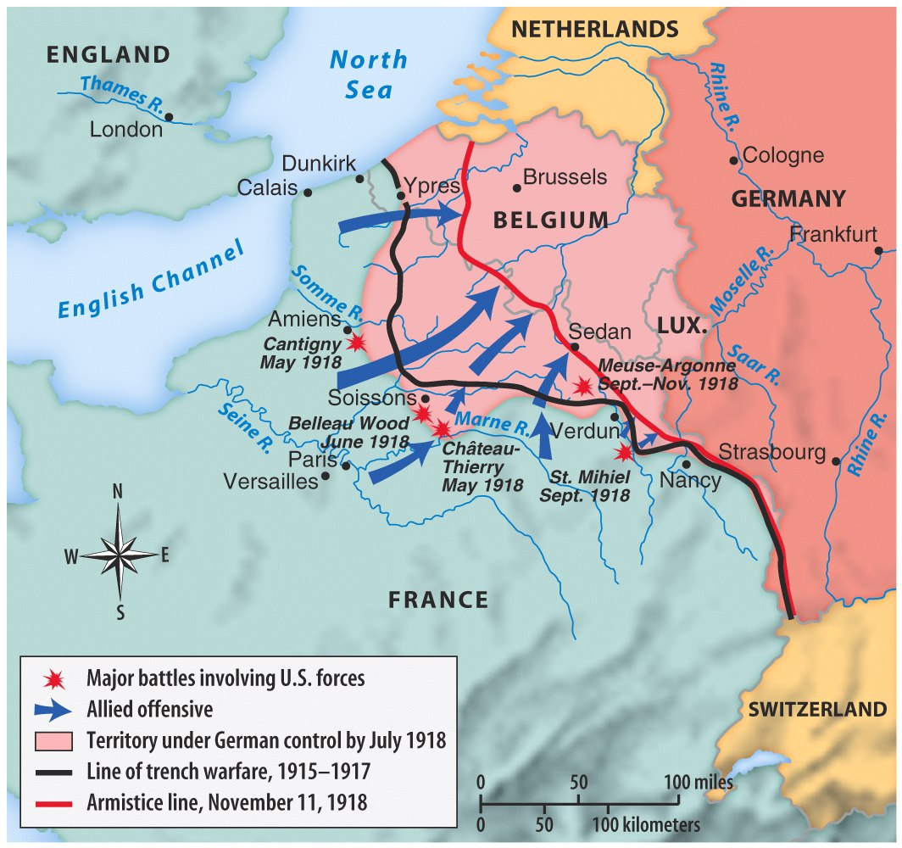

Slide 7
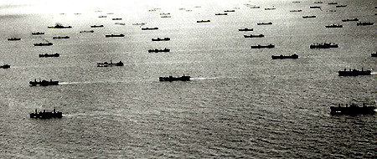
U.S. Navy Makes a Difference
The U.S. developed a system of protection for ships called the convoy system
U.S. destroyers escorted ships across the Atlantic
Also, the Allies laid a barrier of 70,000 mines to target U-boats

Slide 8
Convoy System

Slide 9
End of the War
Kaiser Wilhelm abdicates on November 9, 1918
No longer the leader of Germany
1918 Germany agrees to an armistice
11th hour of the 11th day of the 11th month
Toll of the War
8.5 million soldiers dead
21 million soldiers wounded
Total cost of $338 billion dollars

Slide 10
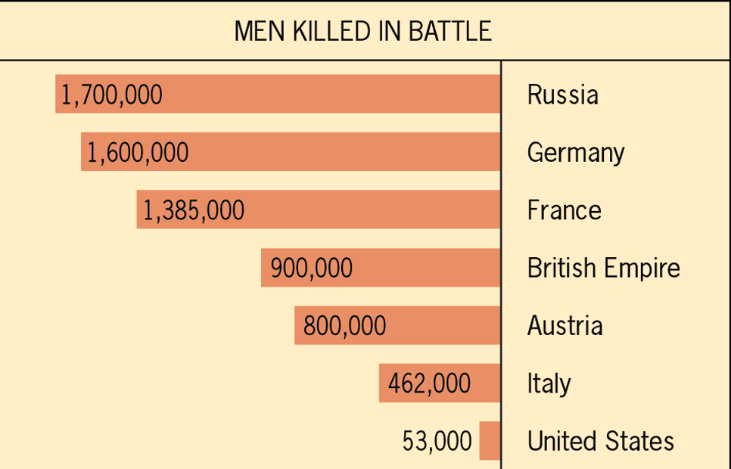

Slide 11
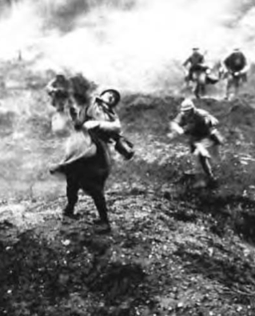
American Casualties
53,000 Americans died in combat
117,000 total American deaths (including from disease and wounds)
200,000 more wounded

Slide 12
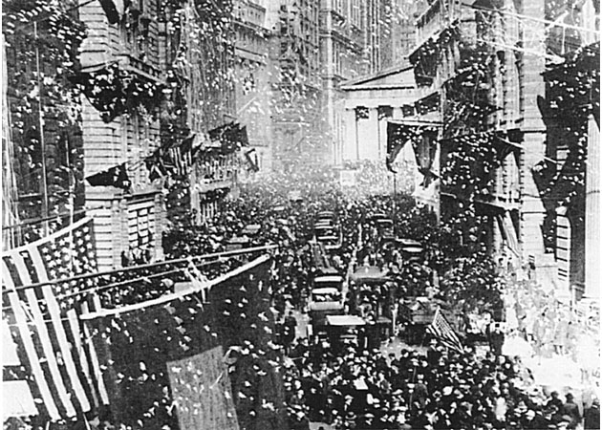
An Allied Victory!

Slide 13
If you have time…
www.ww1propaganda.com
OR
Extra Credit - Research this question:
HOW DID THE RED BARON DIE?
You must provide your internet source.

