Slide 1
DO NOW
What was the Dust Bowl?
How did it affect farmers in the Southwest?

Slide 2
The Response to the Great Depression
April 9, 2014

Slide 3
Learning Targets
EQ
What was life like during the Great Depression?
LT
Describe how the government responded to the Great Depression.
Compare & contrast the responses of Presidents Hoover and Roosevelt to the Great Depression.
POU (I’ll know I’ve got it when…)
I can contrast the policies of Herbert Hoover and Franklin Roosevelt in response to the Great Depression.

Slide 4
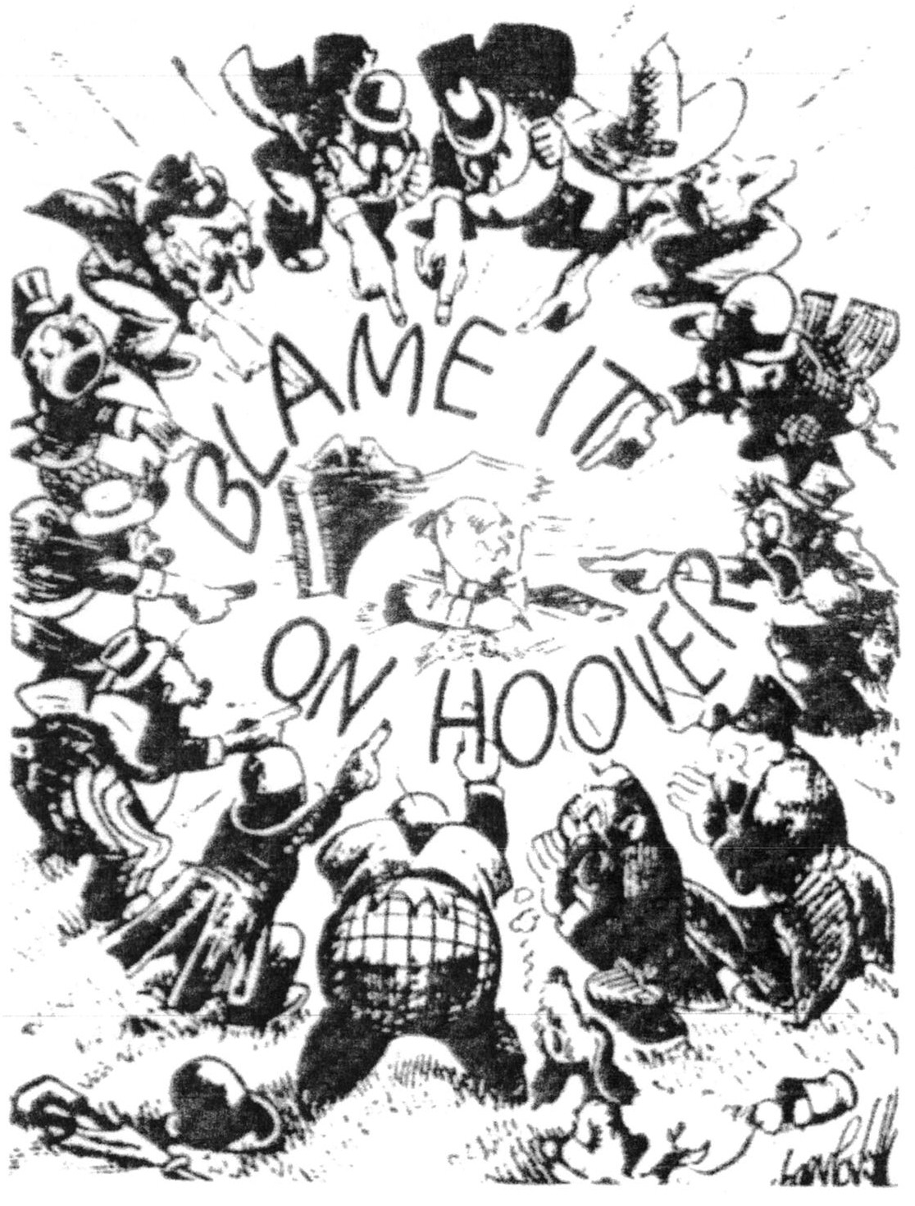
Herbert Hoover’s Response
Americans looked to the President to fix the problems of the depression
Hoover was a conservative
He believed that government involvement would make things worse
Believed that Americans would “work ourselves out” of the depression

Slide 5
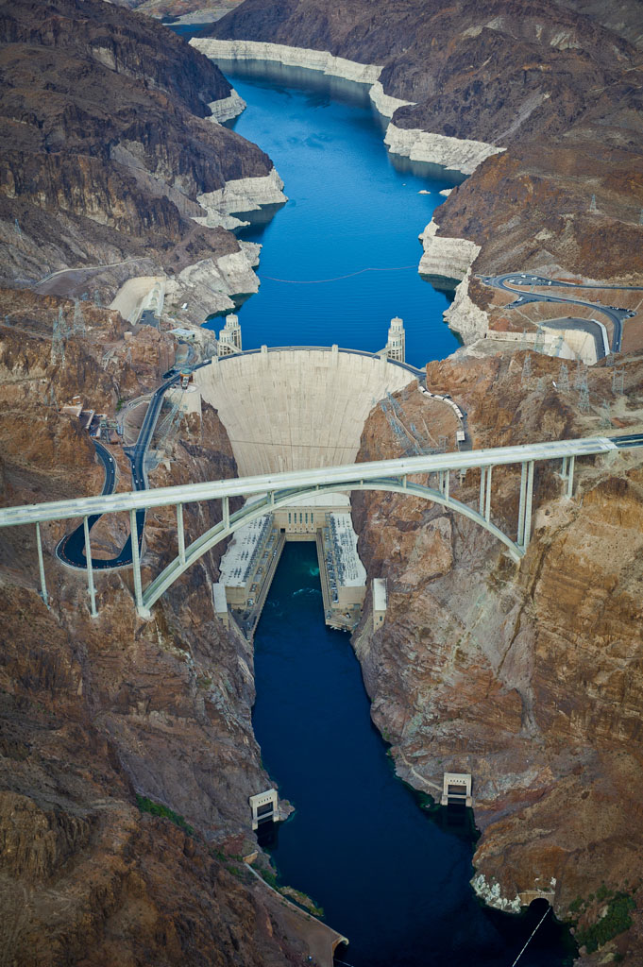
Hoover’s Response
Cut the federal budget to save money
Asked for volunteers to help the poor
When that didn’t work, he started public works projects, like the Hoover Dam
The project employed 21,000 people!
The Hoover Dam was originally called the “Boulder Dam.”

Slide 6
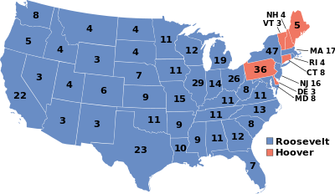
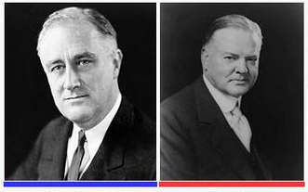
Election of 1932
Herbert Hoover vs. Franklin D. Roosevelt (FDR)
Hoover had lost a lot of support over the Depression
The Bonus Army incident makes him lose more
WWI veterans demand their bonuses early
The military forces them out of Washington, D.C.
FDR wins!

Slide 7
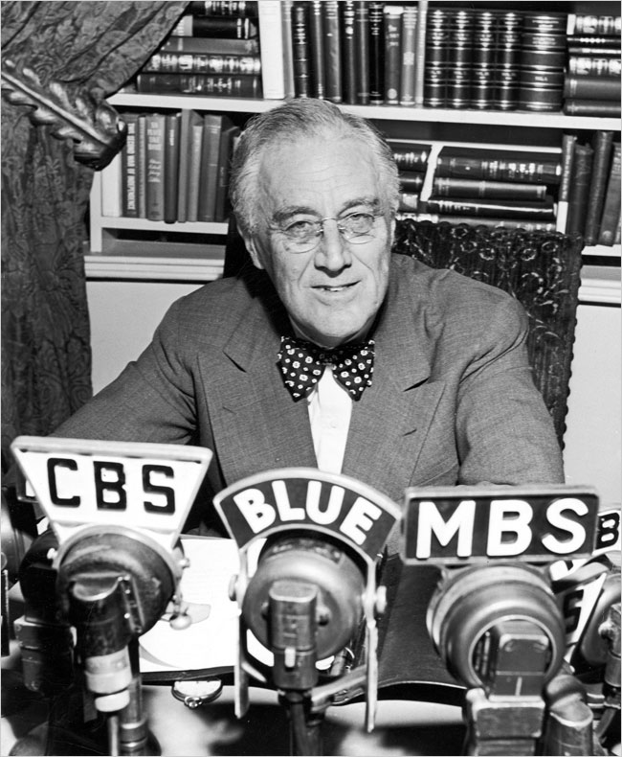
Franklin Roosevelt’s Response
FDR also tried to make Americans feel confident
“Let me assert my firm belief that the only thing we have to fear is fear itself.”
Fireside Chats
Each week Roosevelt addressed Americans on the radio
Bank Holiday
Temporary shutdown of all banks

Slide 8
Roosevelt’s Response
FDR had promised Americans a New Deal
the plan and programs to fight the Great Depression
programs put Americans to work across the country
The Hundred Days – 3 major goals:
Relief for the hungry and jobless
Recovery for agriculture and industry
Reforms to change how the economy worked

Slide 9
Compare & Contrast

