Slide 1
DO NOW
What would you do if slavery came back in North Carolina today and everyone under the age of 22 became a slave?

Slide 2
SLAVE RESISTANCE & REBELLION
January 13, 2014
Objective: 1. TSW research and report on slave rebellions.

Slide 3
Learning Goals
EQ: How can change and differences lead to violent conflict?
LT: I can predict the problems growing sectionalism will create in the territory acquired by the U.S.
POU: I can research and report on slave rebellions.

Slide 4
One Definition
Rebellion
An act of violent or open resistance against a ruler or government
Who were the rulers of the slaves?

Slide 5
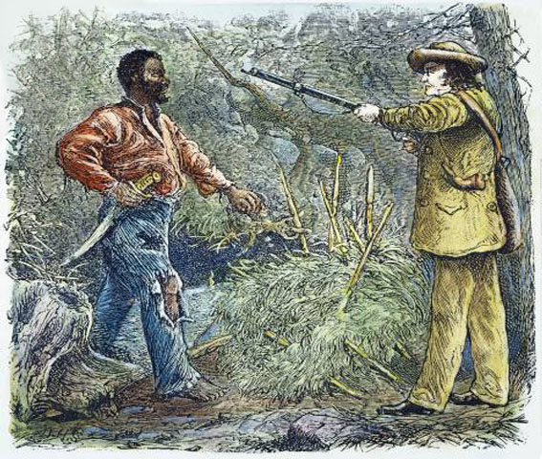
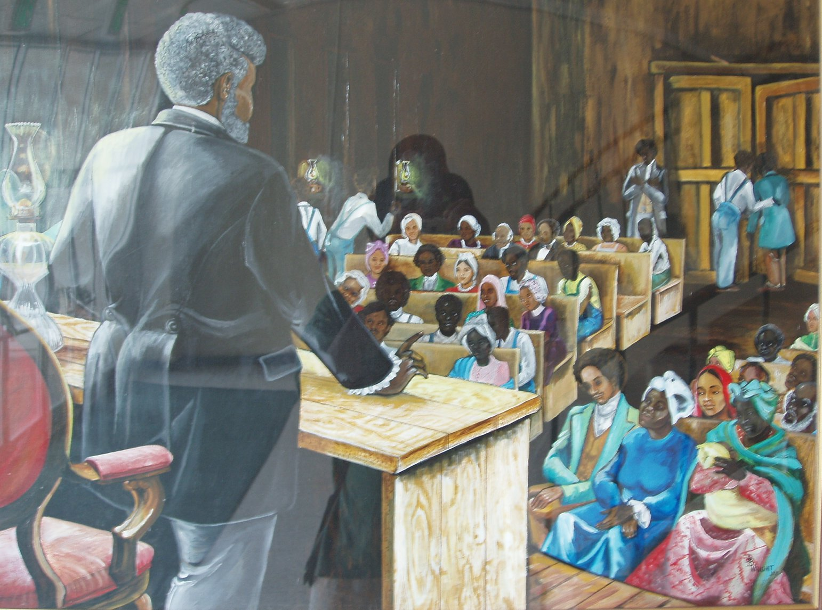
Slave Resistance
Ways that slaves resisted
Running away
Breaking machinery
Slowing down work
Fighting in Rebellions

Slide 6
Denmark Vesey’s Rebellion
1821
Vesey was a former slave who purchased his own freedom
The rebellion was stopped while he and others were planning the rebellion
Vesey and others involved were hanged

Slide 8
Nat Turner’s Rebellion
1831
Slave preacher from Virginia who led a rebellion of slaves
He believed he was destined by God to rebel
The rebellion killed sixty whites and a hundred blacks before it was stopped
Turner was hanged and skinned

