Slide 1
DO NOW
What was the 19th Amendment?
Also take out your Frayer Models from yesterday for me to check as I come by.

Slide 2
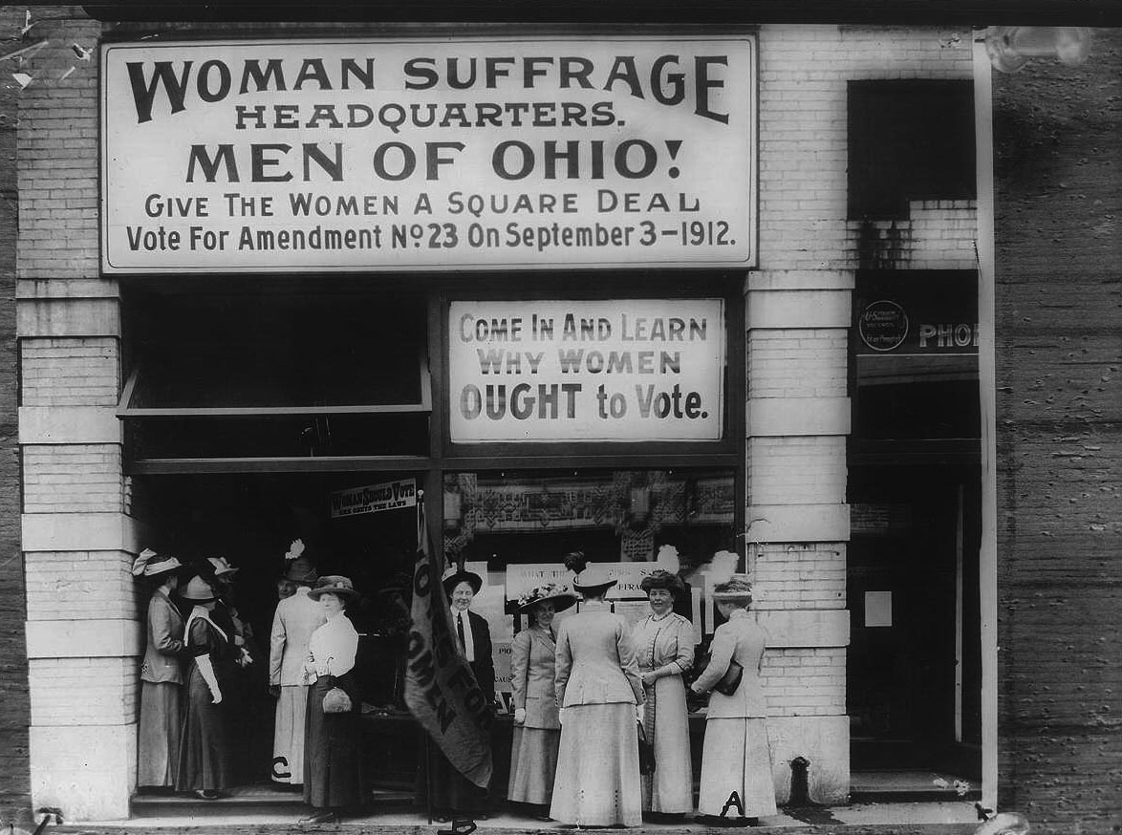
Women’s Suffrage Movement
March 13, 2014

Slide 3
Learning Goals
EQ:
How did women (finally) get the right to vote?
LT:
Define women’s suffrage.
Analyze primary source documents regarding women’s suffrage.
POU:
I can write a persuasive letter to President Wilson in order to influence him to support women’s suffrage.

Slide 4
Video
http://www.youtube.com/watch?v=6ebpa1YSns8

Slide 5
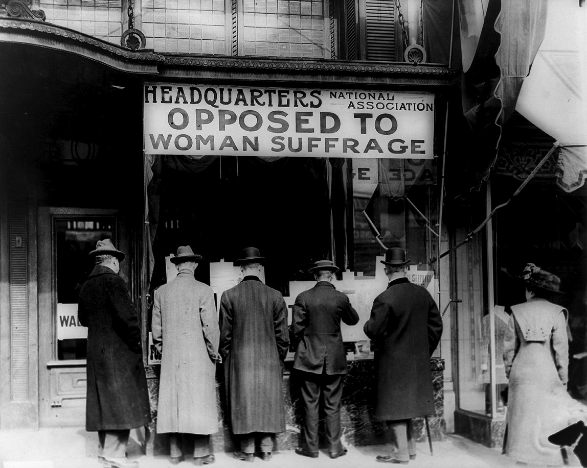
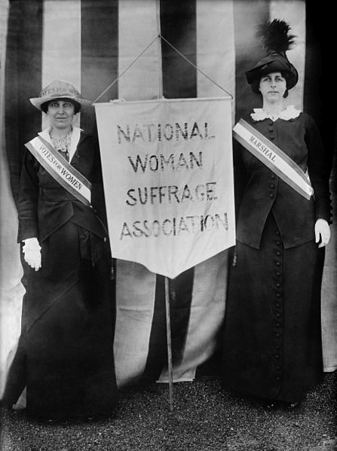
Suffrage
Suffrage means:
THE RIGHT TO VOTE

Slide 6
Expanding Democracy
White men with land at first
All white men – 1820s
All men (15th Amendment) – 1870
All men and women (19th Amendment) - 1919

Slide 7
Assignment – Part One
In pairs, examine 5 primary source documents.
Answer the questions that go with each source to the best of your abilities.
24 minutes

Slide 8
Assignment – Part Two
Go to the following link and type your letter to President Woodrow Wilson:
http://goo.gl/62X77I
Date your letter with the year 1918.
11 minutes

