Slide 1
DO NOW
Name TWO ways that Industrial Revolution inventions changed TRANSPORTATION in the United States.

Slide 2
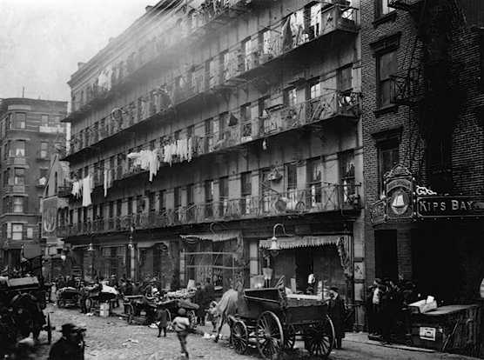
Industrial Revolution Effects: Urbanization
February 18, 2014

Slide 3
Learning Goals
EQ:
How did urbanization change the United States?
LT:
SWBAT examine the positive and negative changes urbanization made to cities in the United States.
POU:
I can define urbanization.
I can explain the positive and negative effects of urbanization.

Slide 4
Urban vs. Rural
Urban
Having to do with cities or large towns
Rural
Having to do with the countryside, rather than towns
During the 1800s, Americans and immigrants began moving to URBAN areas looking for jobs and housing.
The Industrial Revolution provided these jobs!

Slide 5
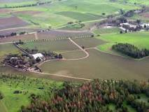
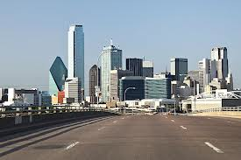
Urbanization
Urbanization occurs when the population shifts from rural to urban areas.
Rural
Urban

Slide 6
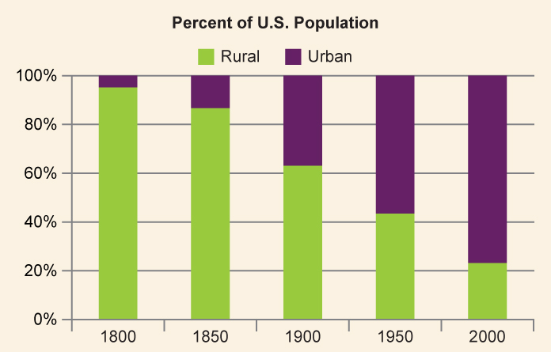
Movement to Cities
By 1920 (the end of the I.R.), over 50% of Americans lived in urban areas.

Slide 7
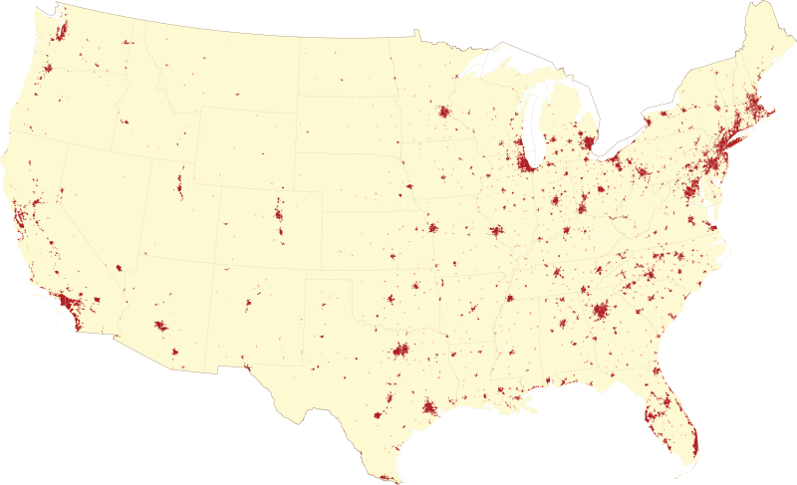
Where do Americans live today?
80% of Americans live in the red/urban areas today.

Slide 8
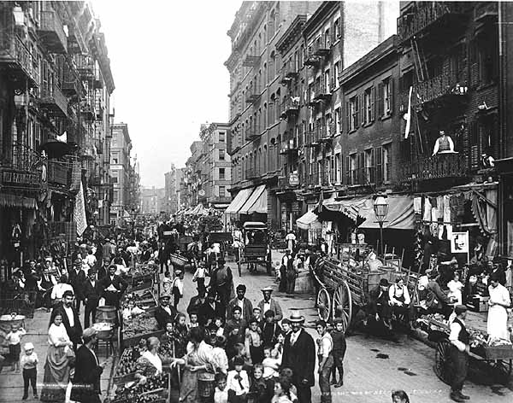
Consequences of Urbanization
Negative
Political corruption
Corrupt organizations would provide services in exchange for votes
Unsanitary conditions
Poor water
No sewage
Widespread disease
Crowded housing
Crime

Slide 9
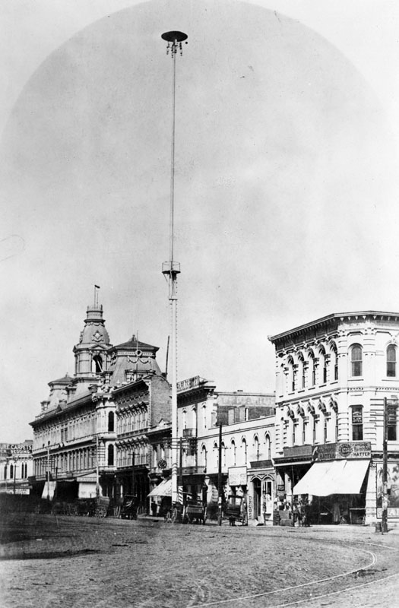
Consequences of Urbanization
Positive
Eventual community improvement
Cultural opportunities
Museums, libraries, schools
Parks, zoos, etc.
Technology
Elevators & skyscrapers
Mass transit (trolleys, subways)
Lighting made areas safer
Water and sewage systems improved health

Slide 10
Which leads us to…
The Gilded Age
An era of extreme economic growth in the United States, but also one of extreme poverty and poor conditions in urban areas
But let’s leave that for tomorrow…

