Slide 1
DO NOW
Define Manifest Destiny.

Slide 2
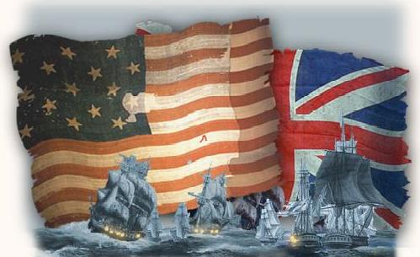
The War of 1812 America’s Second War for Independence
December 10, 2013

Slide 3
Learning Goals – War of 1812
Essential Question
What events led to the War of 1812 between the U.S. and England?
Learning Targets
SWBAT identify and explain the causes and effects of the War of 1812.
POU (I’ll know I’ve got it when…)
I can identify and explain the causes and effects of the War of 1812?

Slide 4
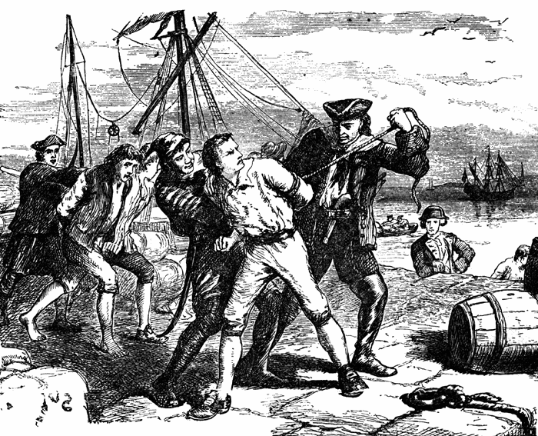
Causes of the War of 1812
Trade restrictions
Britain used their Navy to keep the United States from trading with France.
Impressment
The British were capturing Americans and forcing them to serve in the British Navy
Native Americans
The British was providing weapons to Indians to help them fight Americans

Slide 5
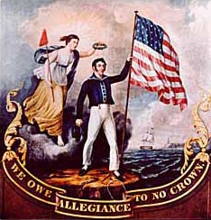
Causes of the War of 1812
4. Manifest Destiny
Was invading Canada meant to expand or protect the United States?
5. Politics
Some Americans liked France, others liked Britain. The people who liked France won out, and we declared war on Britain.
6. Poor Communication
The U.S. did not know that England had not lifted trade restrictions when they had declared war!

Slide 6
Major Events of the War
July 1812
U.S. declares war on England
1812-1814
British blockade the east coast
British land in Georgia and occupy islands there
British attack and burn Washington, D.C.
Americans win major battle in Baltimore Harbor
December 1814
U.S. & Britain sign Treaty of Ghent
January 1815
U.S. defeats Britain at Battle of New Orleans

Slide 7
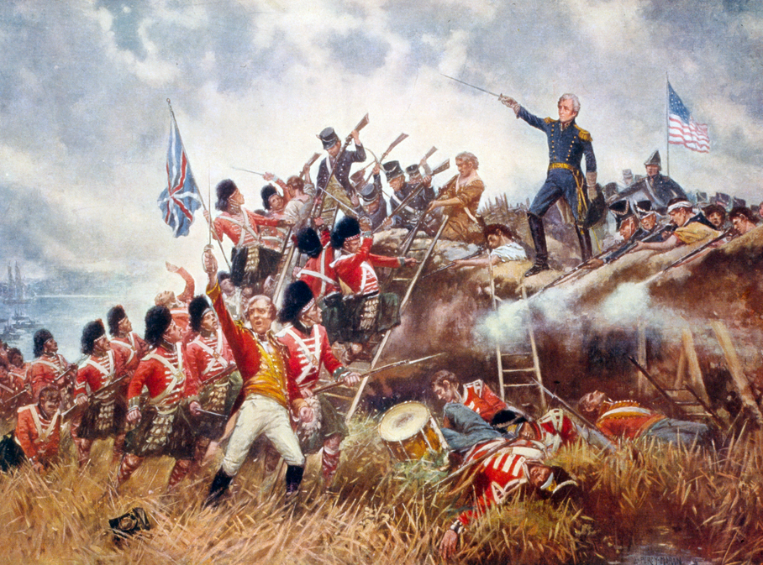
Battle of New Orleans
Fought after the war had ended due to slow communication
More than 2,000 British troops killed
Only 100 Americans lost
Andrew Jackson becomes legendary for his leadership
Americans considered the war a victory because of this battle

Slide 8
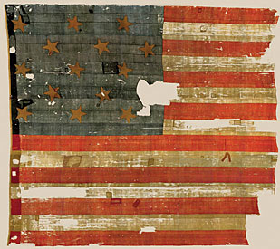
Outcomes of the War
Confirmed the status of the United States as a free and independent nation
Set boundaries for the country
Arranged some peace agreements with Natives
End of the Federalist Party (which opposed the war)

