Slide 1
Do Now
The fighting in World War I ended on the 11th hour of the 11th day of the 11th month in 1918. The celebration was originally called “Armistice Day.”
What do we now call this annual national holiday?

Slide 2
Learning Goals
EQ:
How did Americans impact the peace process at the end of WWI?
LT:
Analyze the goals of Wilson’s 14 Points
Describe the impact of the Treaty of Versailles on the post-war world.
POU:
I can justify which of Wilson’s 14 Points was the most important.
I can support my position on the Treaty of Versailles and League of Nations.

Slide 3
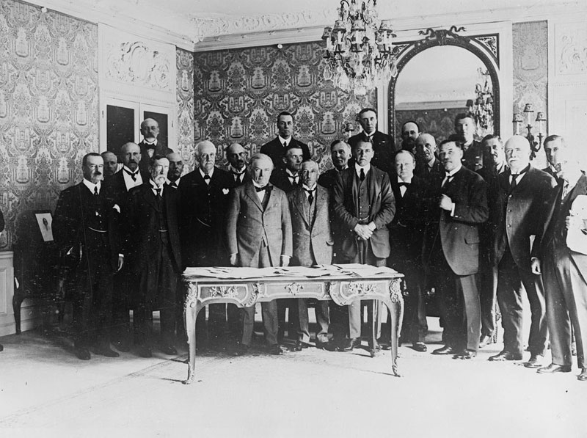
Ending World War I
March 28, 2014

Slide 4
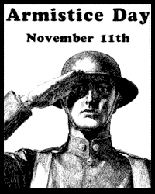
The Peace Process
After the armistice (ceasefire), the long peace process began
The overall goal was to prevent a great war from ever happening again
1. Predict: Will they achieve this goal? Why or why not?

Slide 5
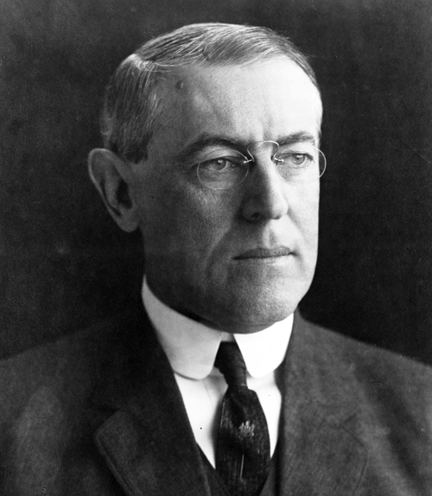
Wilson’s Fourteen Points
Wilson wanted “peace without victory”
2. Discuss: What did he mean by “peace without victory?”
Goals of the 14 Points:
Smaller armies
End of secret treaties
Freedom of the seas
Free trade
A “League of Nations” to peacefully settle disputes

Slide 6
14 Points Mid-Class Assignment
Let’s look at the Fourteen Points together!

Slide 7
Treaty of Versailles
The Big Four (England, France, Italy, & U.S.) planned for peace
E, F, & I wanted Germany to suffer
What the Treaty said…
Germany must pay reparations ($35 billion)
Germany’s military reduced
Reduced territories of Central Powers & created new countries
Created the League of Nations
3. Discuss: Why do you think E, F, & I wanted to punish Germany so harshly?

Slide 8
American Reaction
Many Americans did not want to approve the treaty
Republicans opposed the treaty and Wilson
Did not like the terms
Congress did not want to join the League of Nations unless changes were made
Congress does not ratify the treaty!
4. Predict: What might be the consequences of the U.S. not being involved in the peace process?
5. Discuss: Why didn’t the United States want to join the League of Nations?

Slide 9
Exit Ticket
Which of Wilson’s 14 Points do you think was the MOST important? Why?
2. Do you think the U.S. did the right or wrong thing by rejecting the Treaty of Versailles and the League of Nations? Why do you think this?

