Slide 1
DO NOW
What happened in the Supreme Court case Korematsu v. the United States?

Slide 2
Learning Goals
EQ:
How did propaganda influence World War II?
LT:
Analyze examples of propaganda in order to determine how governments promote particular ideas, doctrines, and practices.
POU:
I can analyze examples of propaganda that were used during World War II to increase support of the American war effort.

Slide 3
World War II Propaganda

Slide 4
Propaganda
The purpose of propaganda is to systematically promote particular ideas, doctrines, or practices
In WWII, propaganda was used more than any other time this world has seen. With new inventions such as photography, radio and film, manipulative messages bombarded every day life in an attempt to persuade a person to believe in a specific cause.

Slide 5
Propaganda in Figures
Since the beginning of the War, the RPL (Germany’s propaganda machine) produced:
more than 2 million brochures
more than 7 million posters
more than 60 million newspapers, wall posters, leaflets, etc.
It carried out:
about 30,000 slide shows
about 45,000 film evenings every month
about 200,000 meetings and public or factory mass meetings

Slide 6
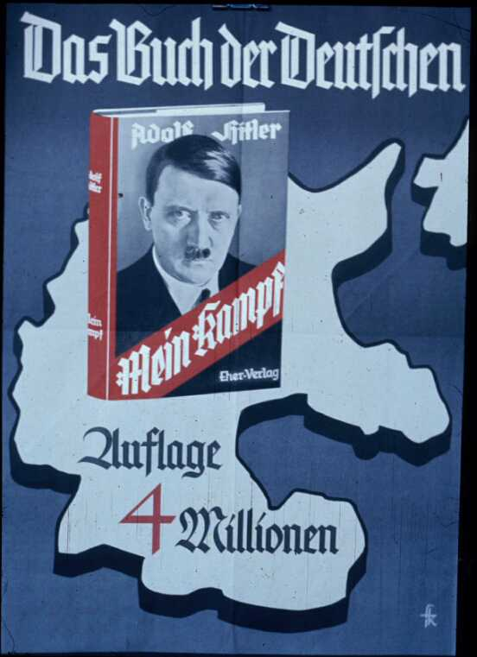
Mein Kampf
- This poster promotes Hitler's book Mein Kampf, announcing that four million copies have been sold.
This book is what really put Hitler on the map. After this, more political opportunities presented themselves.

Slide 7
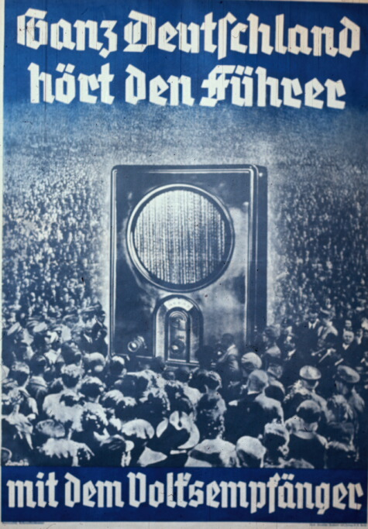
The Technical Team "Germany" assisted in about 50 major events and drove over 360,000 kilometers (nine times around the earth).
Radio Propaganda - The text translates: "All Germany hears the Führer on the People's Receiver." The Nazis, eager to encourage radio listening, developed an inexpensive radio receiver to make it possible for many people to hear Nazi propaganda.

Slide 8
Recruitment
Beginning early on in the war and continuing until its end, countries used propaganda to persuade young men to join the military. The various forms of propaganda glorified the war effort and used short catchy phrases that were easy to understand and hard to forget. Why?

Slide 9
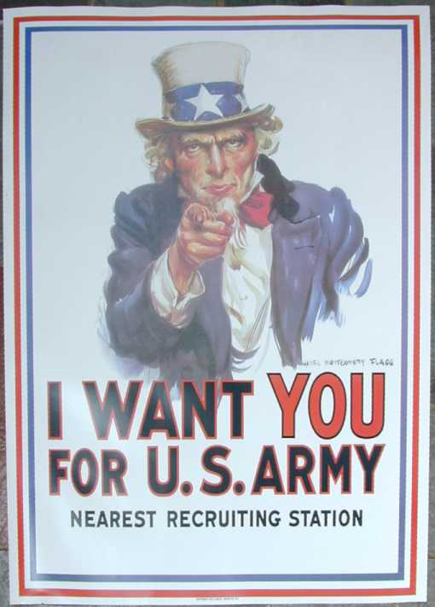
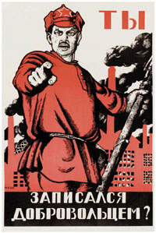
United States – Uncle Sam: I Want You!
Russia – Look familiar?

Slide 10
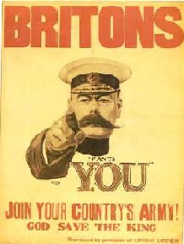
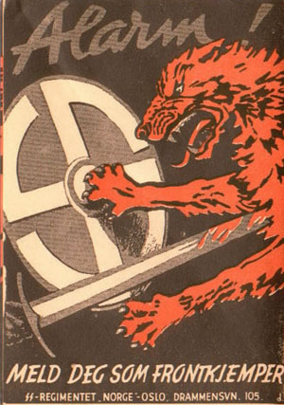
Britain – Join your country’s army…God save the King.
Norway - ALARM! The slogan at that time was: "Finland's fight is our fight." Whoever fights for Finland also fights for his own country"...Norway.

Slide 11
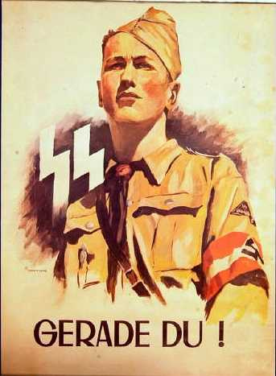
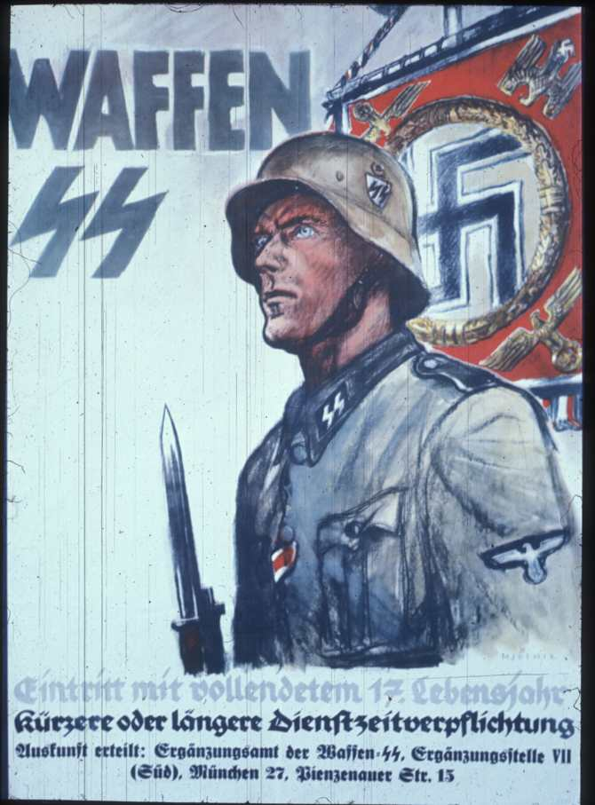
Germany - This is an SS recruiting poster. I'm not sure of the date. It says one can join at 18, and sign up for shorter or longer periods of service. It gives the address of the recruiting office in Munich.
Germany - This looks to be a late-war recruiting poster for the SS, a time at which the Nazis were recruiting younger and younger soldiers. The caption doesn't translate directly, but means: "Enlist now!"

Slide 12
United States Propaganda

Slide 13
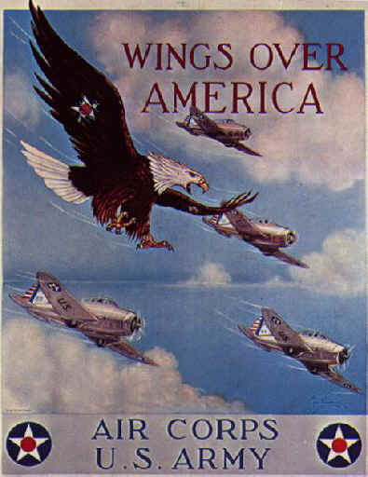
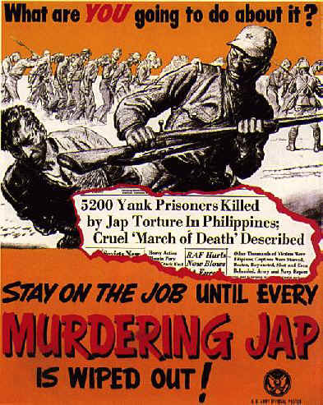

Slide 14
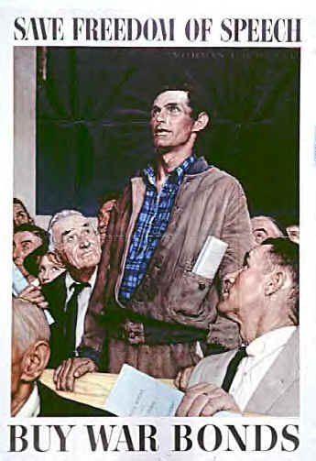
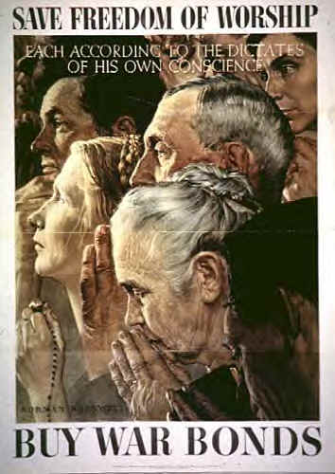
U.S. Homefront Propaganda
When the United States finally entered the war, it was Total War. Everyone was affected and as many resources possible went to the war effort.

Slide 15
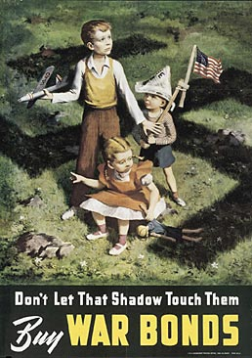
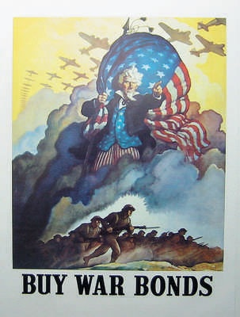
Buy War Bonds!
What is being symbolized here?
Think about how fear can be used in propaganda.
Notice the two unknowing kids and the oldest who seems to be looking at something up in the sky.

Slide 16
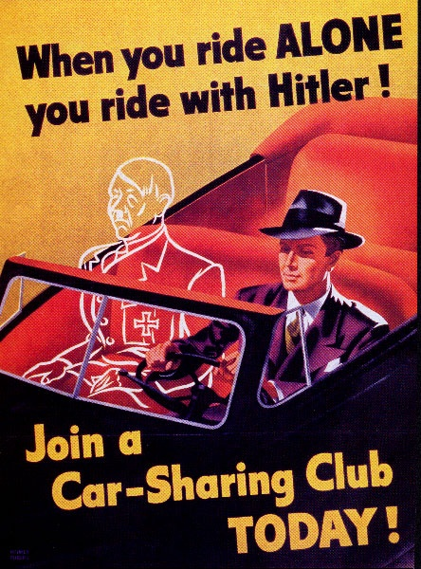
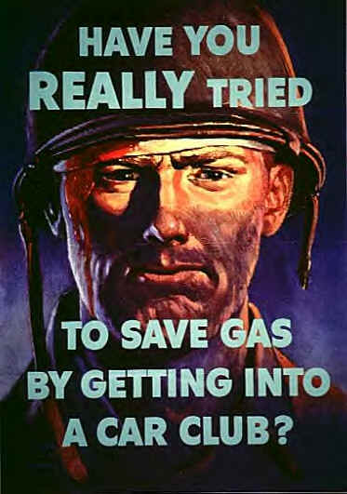
Saving Gas

Slide 17
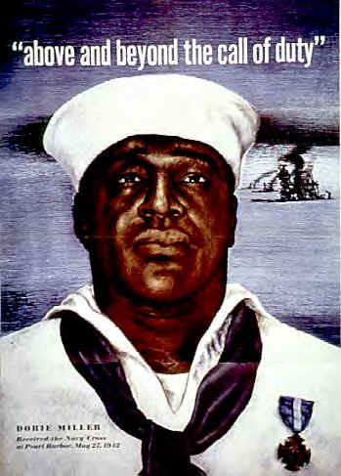
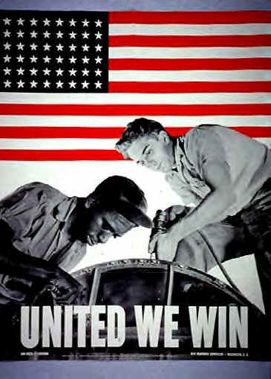
Unification
It is important for any government in war that all the people be united in the war effort. Even black people and women were targeted by propaganda in the United States. How might this create lasting effects after the war?

Slide 18
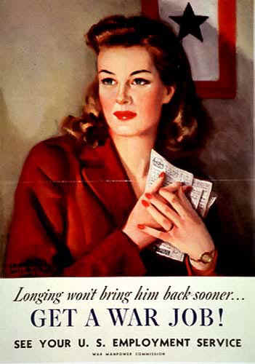
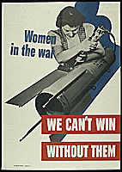
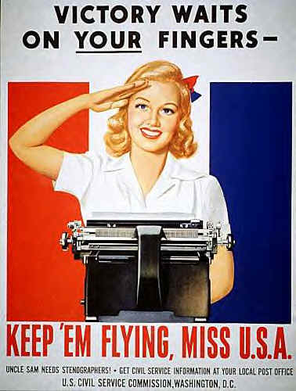

Slide 19
More Homefront Propaganda
War Bonds weren’t the only way a person could help in the effort. As men left to fight, women took over the jobs in the factories. Rosie Riveter is one of the most popular posters ever created in the United States.
Think about what the arm symbolizes. What about her facial appearance/expression?

Slide 20
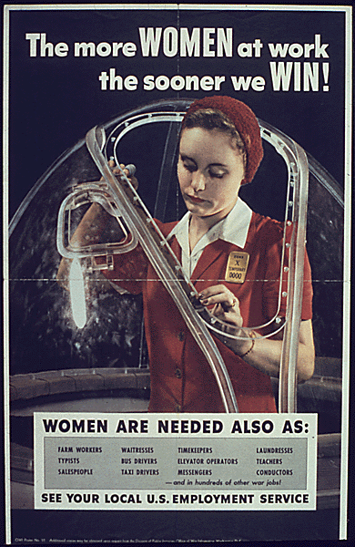
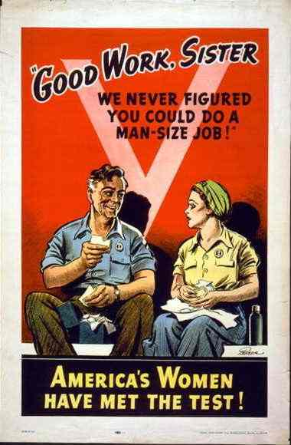
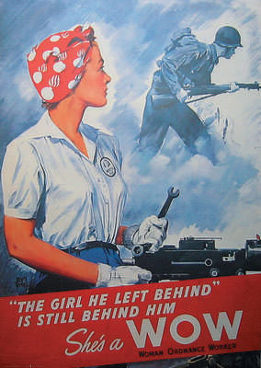

Slide 21
Nazi Propaganda
Women’s Roles in Germany
The Germans worked to gather as much old material for the war effort as possible. This poster is for a 1943 clothing drive. The text translates as: "Get rid of old cloth and shoes!”
Any similarities between German and American propaganda?
What does her appearance suggest about what Germans value?

Slide 22
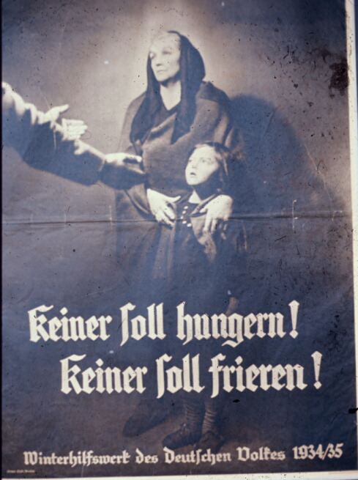
Religion in Propaganda
Religion can be a very powerful and persuasive tool used for propaganda. Examine the following pictures and think about how each country portrays God on their side.
No One Shall Go Hungry
The Winter Aid was the Nazi Party charity. Each year there was a drive to solicit donations to help the needy. Contributions were not entirely "voluntary." The text translates as: "No one shall go hungry! No one shall be cold!“
Does anything seem religious about this?

Slide 23
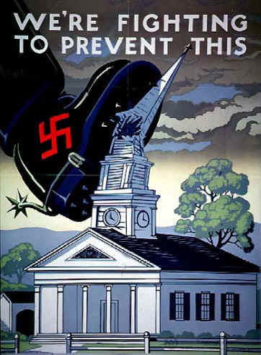
Interesting how every side says God is on our side. In Germany, Hitler is shown ordained by God, but in America, the portrayal is quite different. Who is right?

Slide 24
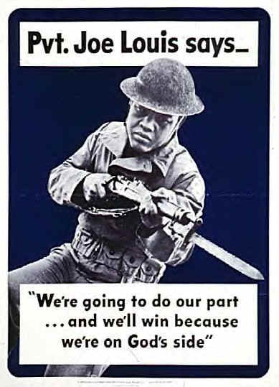
More American Religious Propaganda
Would you be more likely to fight – or even die - for a cause if you were taught to believe God was on your side?

Slide 25
Germany Propaganda Late in War
During the late years of the war, the Nazi’s propaganda becomes more desperate and aggressive. This is when the Concentration Camps become Death Camps. Jews were specifically targeted early on, but the Holocaust expanded more and more as the war waged on.
Movie Against Jews
- This 1940 poster advertises the worst of the Nazi anti-Semitic films, "The Eternal Jew."

Slide 26
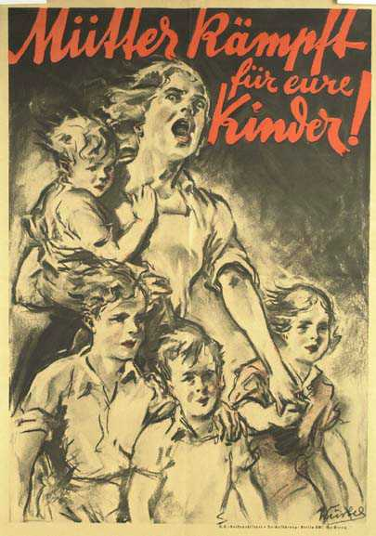
More Desperate Propaganda
Women
- Late in the war. The text translates as: "Mothers! Fight for your children!" Note that the mother portrayed has four children, consistent with the Nazi goal of encouraging as many births as possible.

Slide 27
ASSIGNMENT INFORMATION
You will analyze propaganda posters.
Choose two of the four options.
Answer the questions that go with each poster and be ready to discuss with the class.

