Slide 1
DO NOW
List one similarity and two differences between MLK and Malcolm X.

Slide 2
Civil Rights Legislation
May 19, 2014

Slide 3
Learning Goals
EQ
What did the Civil Rights Movement achieve?
LT
Identify the legislation of the Civil Rights Movement.
POU
I can identify and describe the effects of the Civil Rights Movement.

Slide 4
Civil Rights Legislation
Why was it needed?
The laws were passed to give the federal government more authority to end segregation
How many laws were made?
We will look at four different Civil Rights laws

Slide 5
Civil Rights Act of 1964
The first major piece of Civil Rights legislation, signed by President Lyndon Johnson
Outlawed segregation in schools & public places
Created the Equal Employment Opportunity Commission (EEOC)
Protected blacks from discrimination
Invalidated Jim Crow Laws

Slide 6
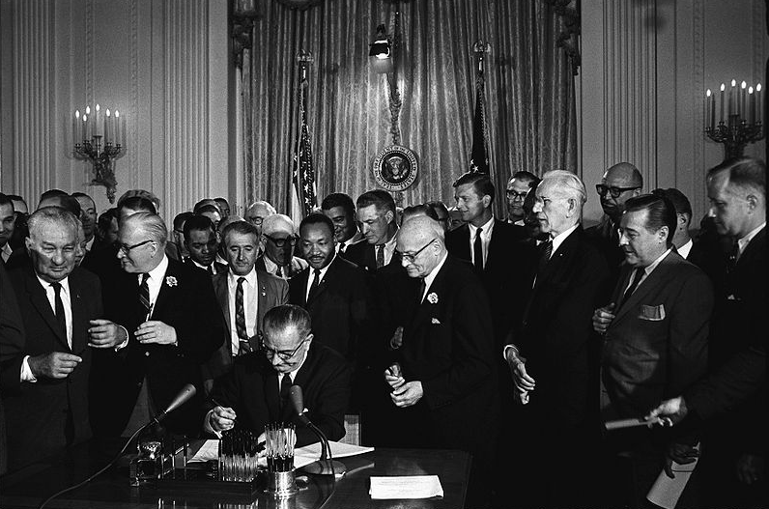
President Lyndon Johnson signed the CRA of 1964 into law on July 2, 1964

Slide 7
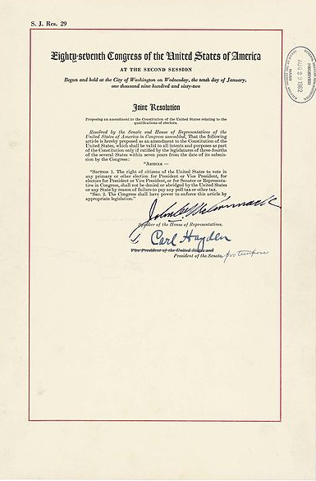
24th Amendment (1964)
Outlawed poll taxes or any other voting taxes
Brought an end to the unfair practice of taxing voters
Ratified in 1964

Slide 8
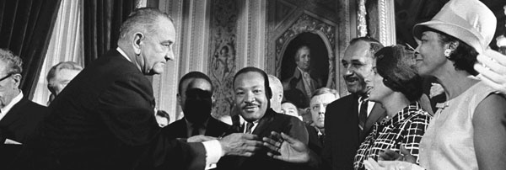
Voting Rights Act of 1965
Outlawed voter discrimination by enforcing the 15th Amendment
Outlawed literacy tests
Allowed the federal government to monitor elections

Slide 9
Civil Rights Act of 1968
Also called the “Fair Housing Act of 1968”
Prohibited discrimination in buying, selling, or renting housing
This kept neighborhoods from keeping blacks or other minorities out
Outlawed discrimination based on race, religion, nationality, or sex

