Slide 1
DO NOW
Define URBANIZATION.
Give one POSITIVE and one NEGATIVE consequence of urbanization.

Slide 2
Learning Goals
EQ:
How did the I.R. affect American business and society?
LT:
SWBAT describe the impacts of the I.R. on American business and society.
POU:
I can describe the impacts of the I.R. on American business and society.

Slide 3
The Gilded Age
February 19, 2014

Slide 4
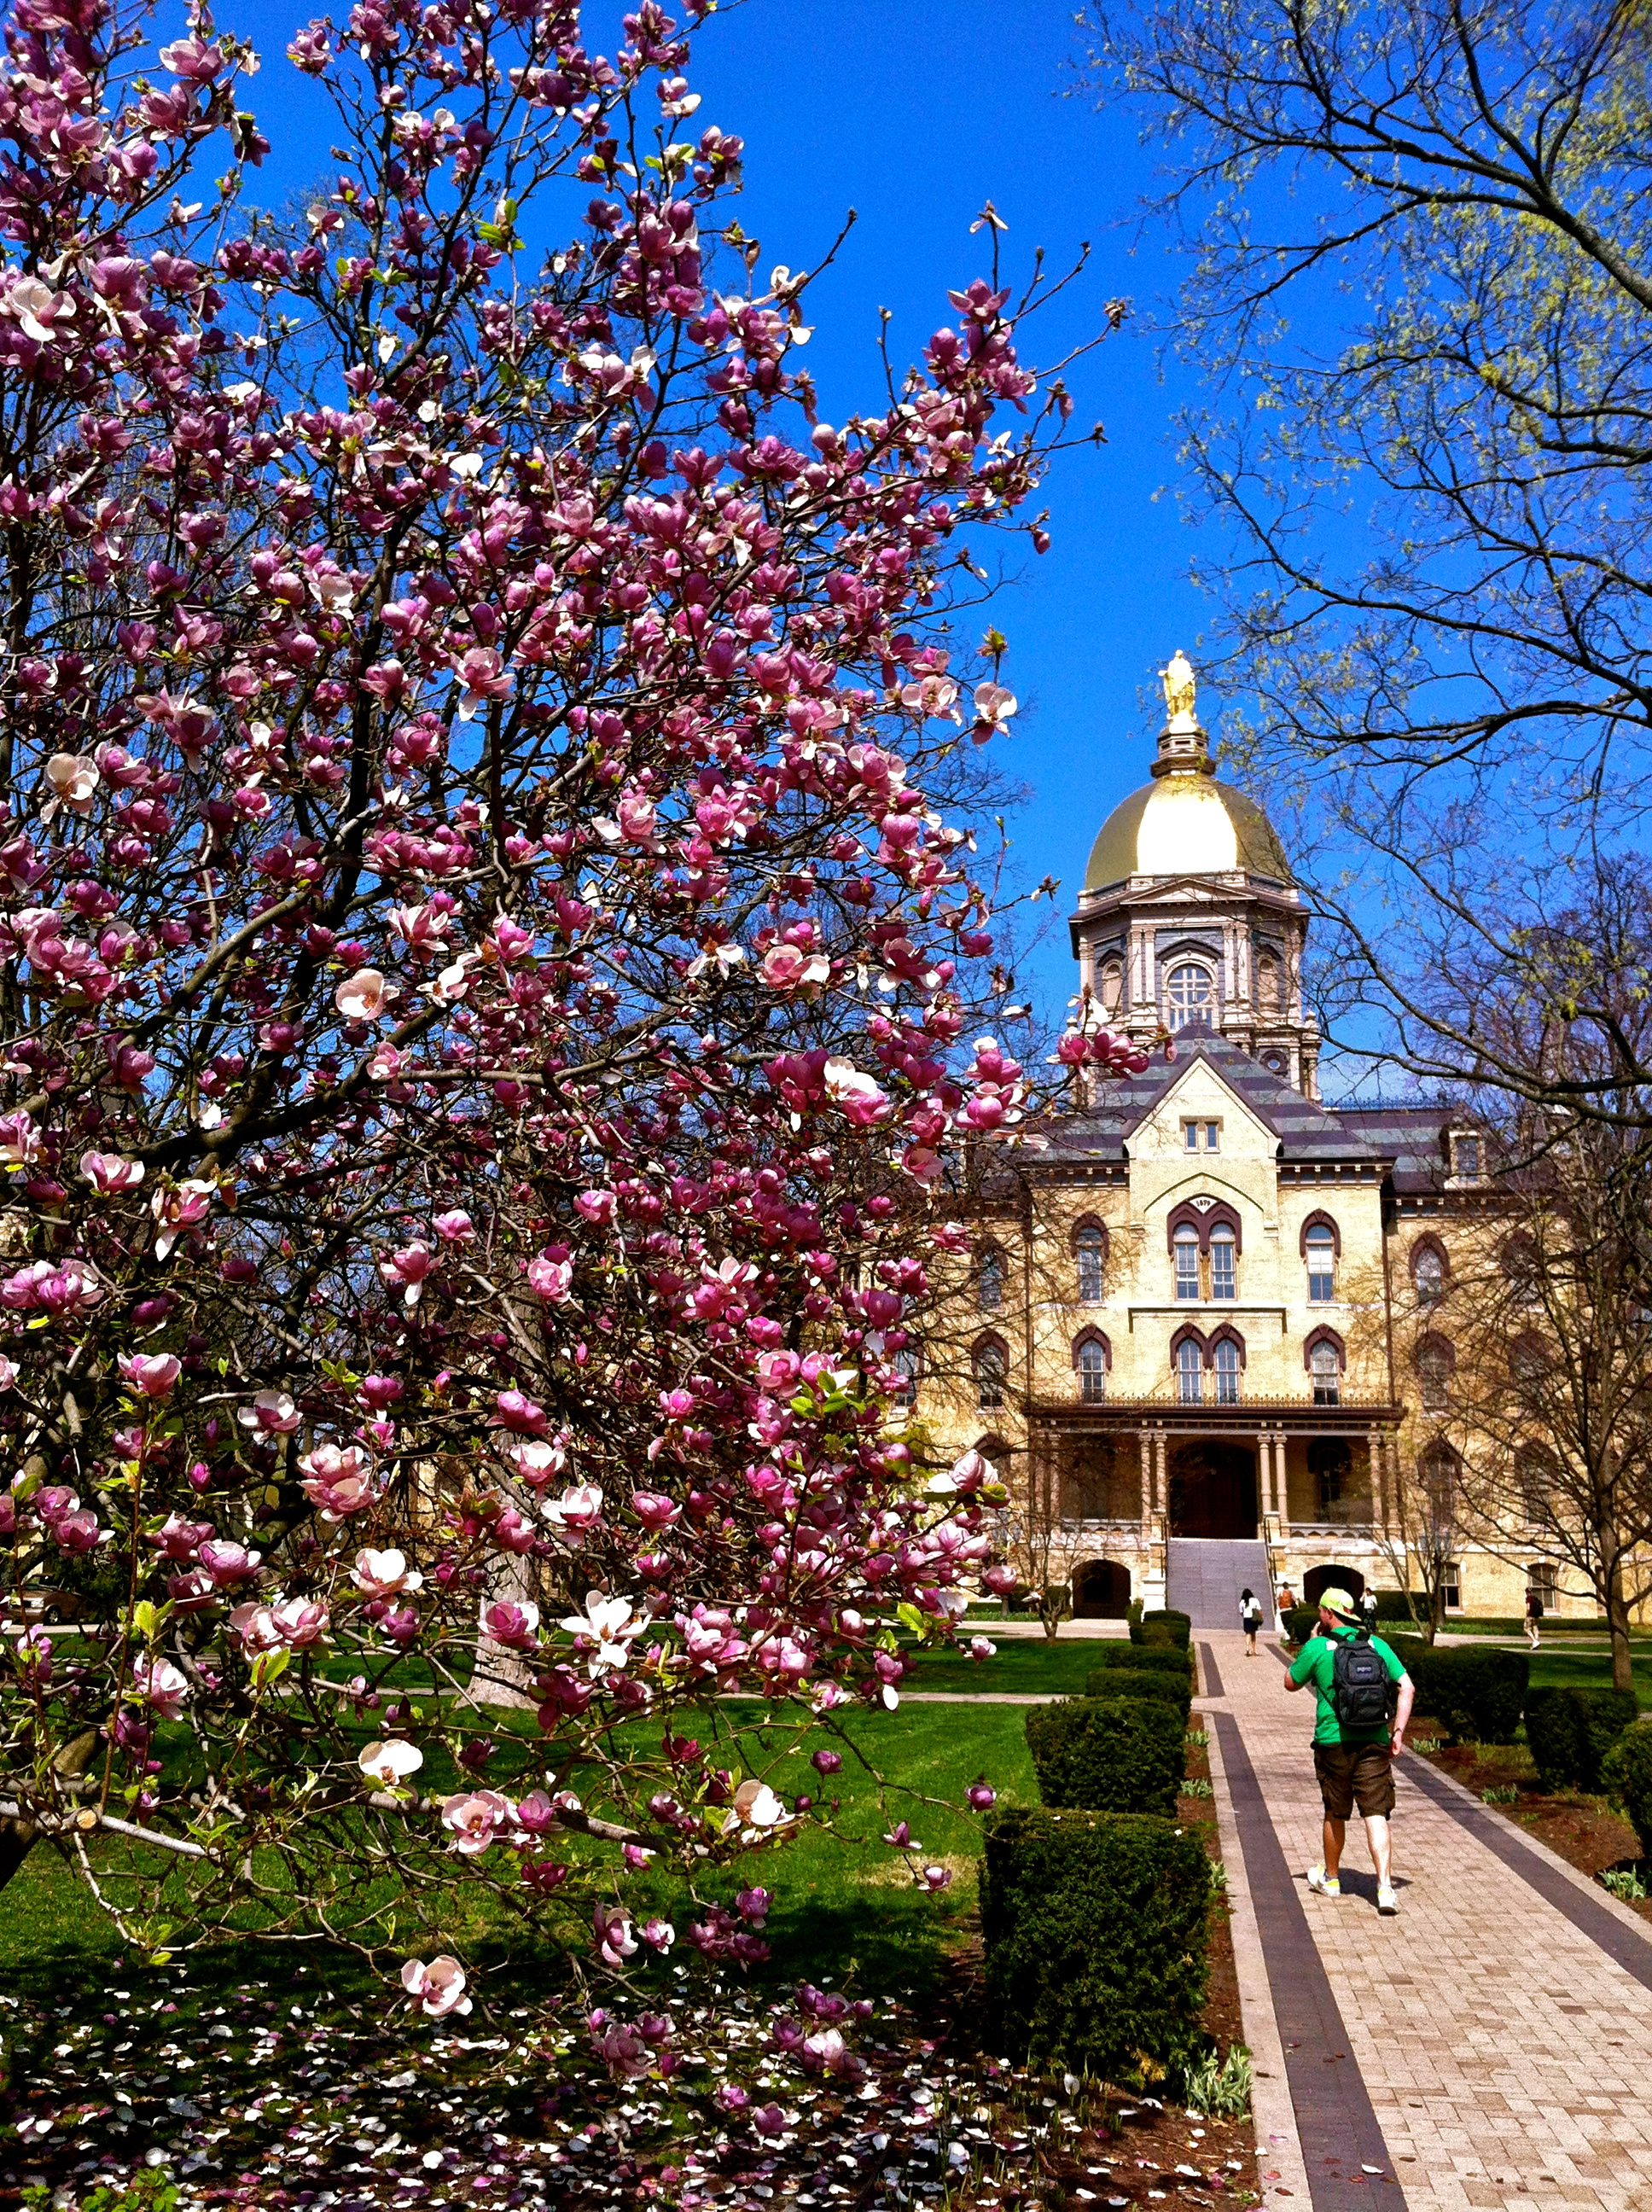

Slide 5
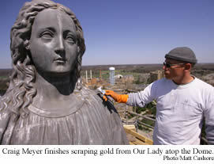
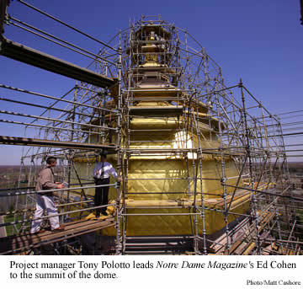
What does it mean to be “gilded?”
Gilded means “covered in a thin layer of gold.”

Slide 6
Gilded Age
An era of extreme economic growth in the United States, but also one of extreme poverty, corruption, and greed
Mark Twain coined the term “Gilded Age” to describe America at the time.

Slide 7
Gilded Age Society
Society was affected in the following ways:
Urbanization
Urban slums and poor conditions caused problems for Americans in poverty
Mass immigration
People came to America from other countries looking for work
This also causes a lot of conflicts as nativists were against allowing immigration
Civil Rights
The issues of African Americans were mostly ignored
Segregation was allowed by law

Slide 8
Gilded Age Industry
Industry was affected in the following ways:
Captains of Industry
Big business leaders were able to make huge profits, sometimes illegally, without any government involvement
Monopolies
Some businesses became rich by eliminating competition
Social Darwinism and the Gospel of Wealth
Most wealthy businessmen saw their wealth as an example of their superiority to others or as a gift from God

Slide 9
Assignment
You will now read more detailed information about Gilded Age society and industry.
As you read, answer the 10 questions that guide your reading.

