Slide 1
DO NOW
List three examples of how slaves resisted their owners.

Slide 2
The Reasons for Secession
January 14, 2013
Building up to the Civil War

Slide 3
Learning Goals
EQ: Could the Civil War have been avoided?
LT: SWBAT identify the fundamental causes of the Civil War.
POU: I can identify the fundamental causes for the secession of the Confederate States.

Slide 4
SECESSION
Secession
Definition: Withdrawal from the Union
When states seceded, they broke away from the United States to become self-governing
Eleven states seceded and formed the Confederate States of America (Confederacy)
There were 4 major causes of secession

Slide 5
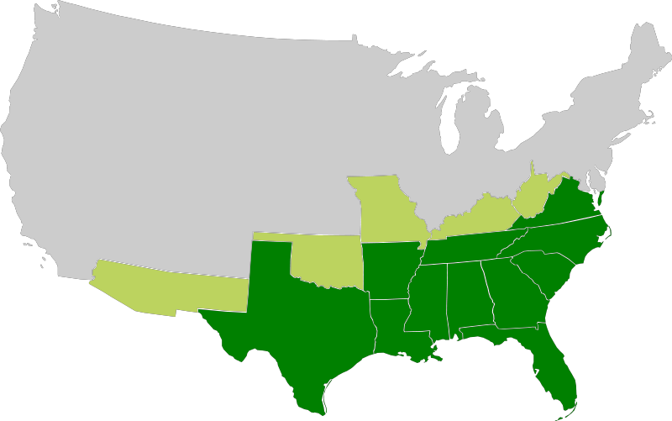
Who seceded?
Texas, Arkansas, Louisiana, Mississippi, Alabama, Tennessee, Georgia, Florida, South Carolina, North Carolina, and Virginia

Slide 6
I. SLAVERY
Slavery was the biggest issue in the 1800s
Abolitionists were trying to bring slavery to an end in order to emancipate (free) the slaves
Slave states relied on slavery because it provided cheap labor for growing crops
Most of the farms in the U.S. were in the Southern states

Slide 7
Cotton Production & Slavery
Left: The black dots represent 2,000 bales of cotton. The darker the area, the more cotton production. Where was the most cotton produced in the South?
Right: The darker shading shows the higher populations of slaves. The highest populations are along the Mississippi River (in the Delta) and along the Atlantic Ocean. Why might this be?

Slide 8
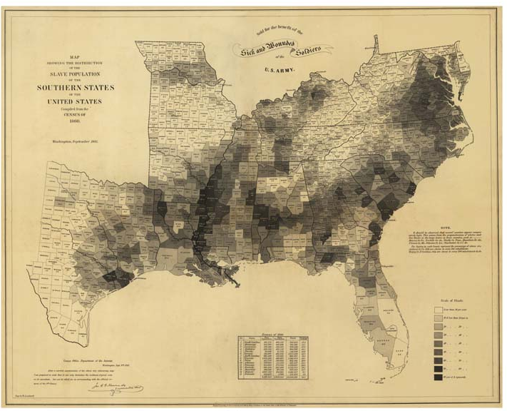

Slide 9
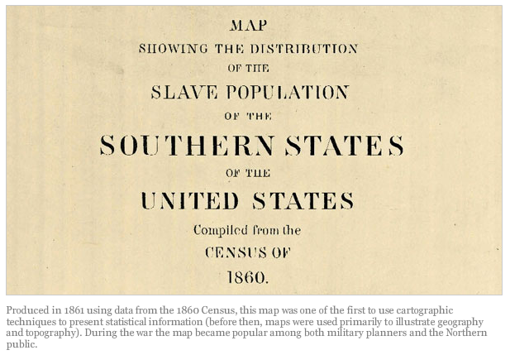
Text by Susan Schulten (NYT); Map Courtesy of Geography and Map Division, Library of Congress

Slide 10
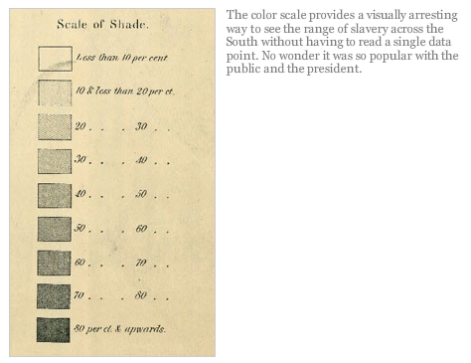
Text by Susan Schulten (NYT); Map Courtesy of Geography and Map Division, Library of Congress

Slide 11
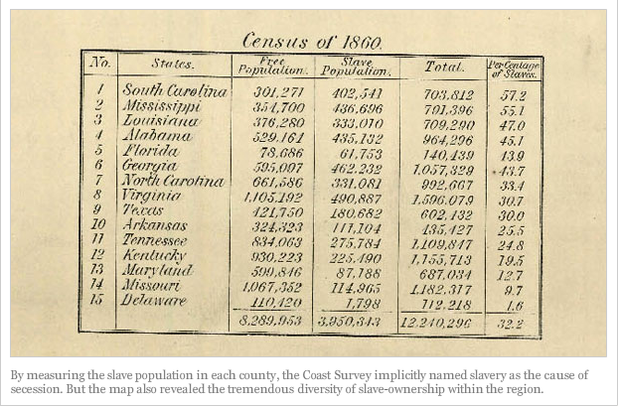
Text by Susan Schulten (NYT); Map Courtesy of Geography and Map Division, Library of Congress

Slide 12
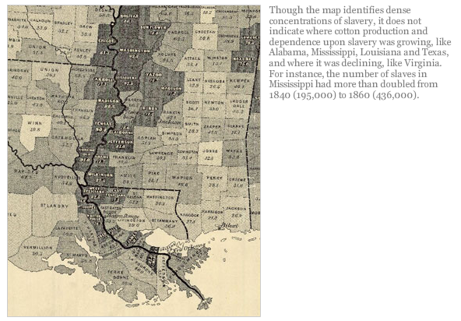
Text by Susan Schulten (NYT); Map Courtesy of Geography and Map Division, Library of Congress

Slide 13
Compromises Over Slavery
The Missouri Compromise (1820)
There were 11 slave states and 11 free states
Missouri wanted to become a state, but the balance would be thrown off
Solution
Missouri became a slave state
Maine became a free state
No more slave states north of Missouri/Arkansas border
The Compromise of 1850
When the country expanded again, another compromise was needed
Solution
California would become a free state
New states would decide on slavery (popular sovereignty)
The South would also get a stronger Fugitive Slave Law

Slide 14
II. STATES’ RIGHTS
States’ rights refers to the idea that states should have more power than the federal government
Until the Civil War, this had been a debated issue
Nowadays, the federal government the most power →

Slide 15
Nullification Crisis
The issue of states’ rights was at a high point when South Carolina tried to nullify a federal law that raised tariffs (taxes on imports)
By nullifying the law, South Carolina was preventing the enforcement of the law
The Supreme Court and Congress said they could not do this

Slide 16
III. AGRICULTURE vs. INDUSTRY
The economy of Northern states was based on industry and manufacturing which used raw materials from the South
The South produced the raw materials (e.g., cotton) through farming with slave labor
The South realized that they needed slavery and that the North was also benefiting from it
If slavery ended, the South would be hurt most of all because they relied completely on farming

Slide 17
IV. THE ELECTION OF 1860
Tensions between the North & South were very high in 1860
Abraham Lincoln was the only nominee of the new Republican Party
Democrats split up and nominated multiple candidates because Southerners did not trust Stephen Douglas
John Breckinridge ran as a Southern Democrat

Slide 18
Election Results
Who won Mississippi and most of the slave states?
Who won most of the free states?
Why did Lincoln win overall?

Slide 19
The Secession of North Carolina
South Carolina was the first state to secede
North Carolina seceded from the Union on May 20, 1861
NC was the last state to secede

Slide 20
The Secession of North Carolina
Excerpts from the Ordinance of Secession Document:
“AN ORDINANCE to dissolve the union between the State of North Carolina and the other States united with her, under the compact of government entitled ‘The Constitution of the United States...’
"We do further declare and ordain, that the union now subsisting between the State of North Carolina and the other States under the title of the United States of America, is hereby dissolved, and that the State of North Carolina is in the full possession and exercise of all those rights of sovereignty which belong and appertain to a free and independent State.”

Slide 21
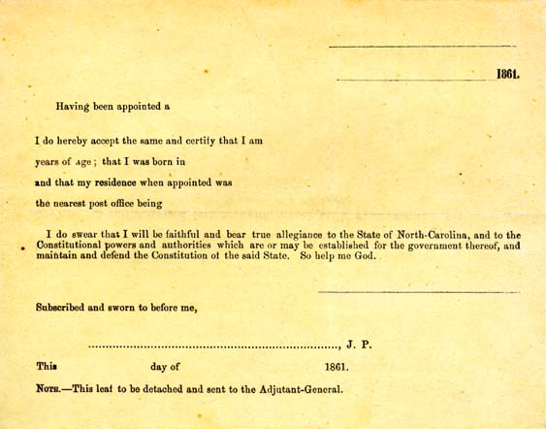
North Carolina Oath of Allegiance

