Slide 1
DO NOW
List two outcomes of the War of 1812.

Slide 2
PRESIDENT ANDREW JACKSON
December 12, 2013

Slide 3
Learning Goals
EQ: Was Andrew Jackson a hero or villain?
LT: SWBAT explain the positive and negative impacts of Jackson’s Presidency.
POU: I can describe how Andrew Jackson’s popularity led to him becoming president.

Slide 4
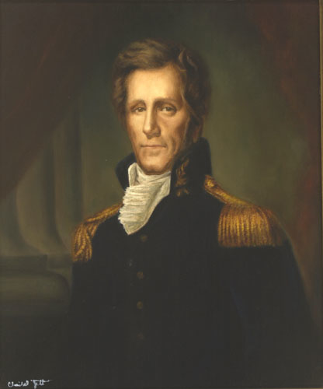
Early Life
Self-made man
Lawyer
War hero
Led U.S. troops at the Battle of New Orleans
“Old Hickory”

Slide 5
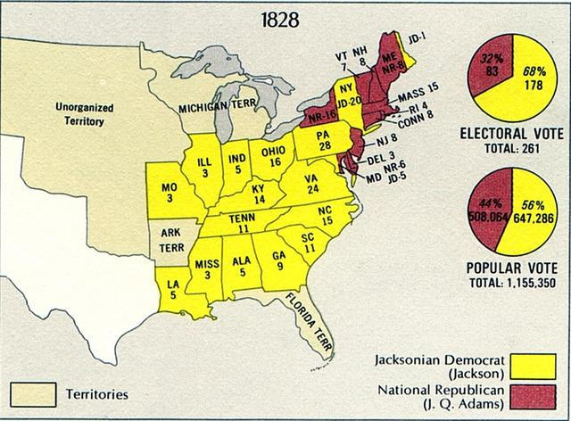
Political Life
Andrew Jackson loses the Election of 1824
Actually wins the popular vote, but not enough electoral votes
John Quincy Adams becomes president
Andrew Jackson begins his campaign for 1828 immediately after
Wins the Election of 1828

Slide 6
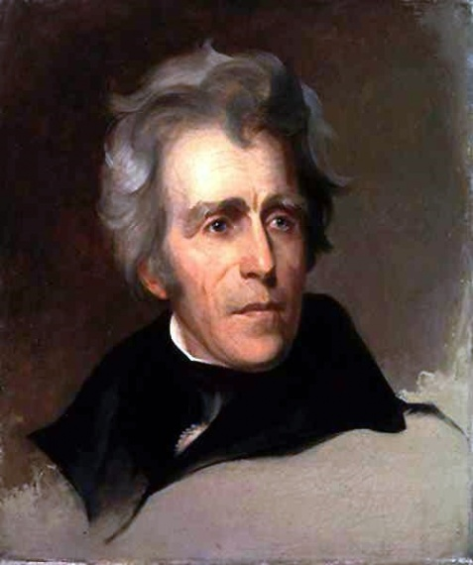
As President
VERY CONTROVERSIAL!
Deals with three major issues:
Status of Native Americans
The rights of states
The role of the national bank

Slide 7
DO NOW
In what way was President Andrew Jackson considered a “common man?”

Slide 8
President Andrew Jackson: Hero or Villain?
December 13, 2013

Slide 9
Learning Goals
EQ: Was Andrew Jackson a hero or villain?
LT: SWBAT explain the positive and negative impacts of Jackson’s Presidency.
POU: I make an argument about whether Jackson was a hero or villain.

Slide 10
Today’s Topics
States’ Rights
Jackson struggled to keep Southern states from breaking away from the Union over the issue of tariffs.
Bank Wars
Jackson’s policies caused the economy to collapse after he left office and affected the next election.
Indian Removal
During Jackson’s presidency, Native Americans were forced to move west of the Mississippi River.

Slide 11
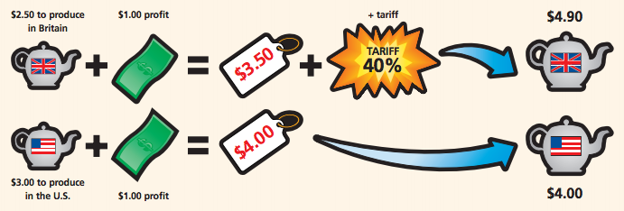
Nullification Crisis
Fight over tariffs (taxes on imports)
Southern states were AGAINST tariffs, while northern states liked them
South Carolina tried to nullify the law
By nullifying the law, SC was preventing its enforcement
SC threatened to secede (break away from the U.S.)
Even discussed forming an army

Slide 12
Ending the Crisis
Andrew Jackson was outraged by South Carolina
Jackson threatens to send in the U.S. Army
He got rid of his Vice President, who was from South Carolina
Eventually, a compromise tariff is passed
These actions would preserve the country for another 30 years

Slide 13
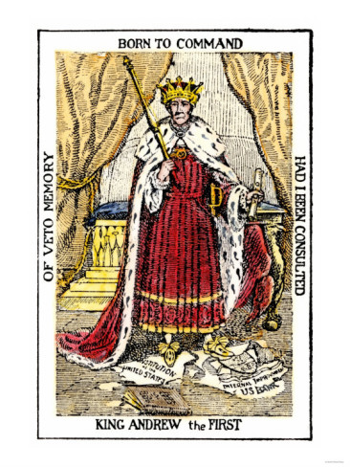
The Second Bank of the U.S.
The Second Bank of the United States was the most powerful bank in the country
It held the government’s funds and issued money
Even though it was run well, Jackson did not trust it
Jackson thought it had too much power
He also believed the bank favored the rich

Slide 14
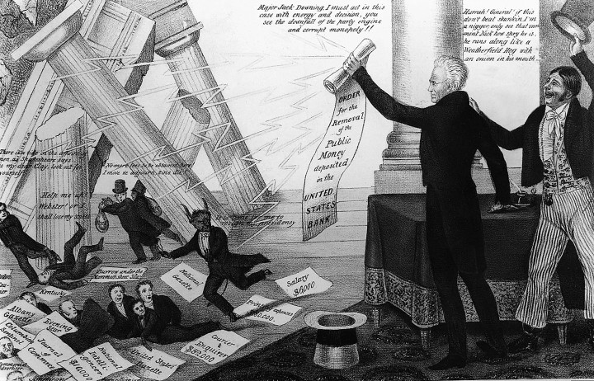
Declaring War on the Bank
Jackson refused to renew the bank’s charter
He deposited money in smaller state banks called “pet banks”
People supported Jackson, and he succeeded to putting the Second Bank out of business
Jackson won, but the economy suffered

Slide 16
Panic of 1837
For a time, the economy did very well under Jackson, but it didn’t last
Pet banks began issuing too much paper money, causing inflation
Inflation: an increase in prices and decrease in the value of money
Jackson ordered that all public land had to be paid for in gold or silver
When people rushed the banks to get gold & silver from the banks, the banks ran out!
Banks went out of business because they had issued more money than they had in gold and silver
The Result: The Panic of 1837 and an economic depression

Slide 17
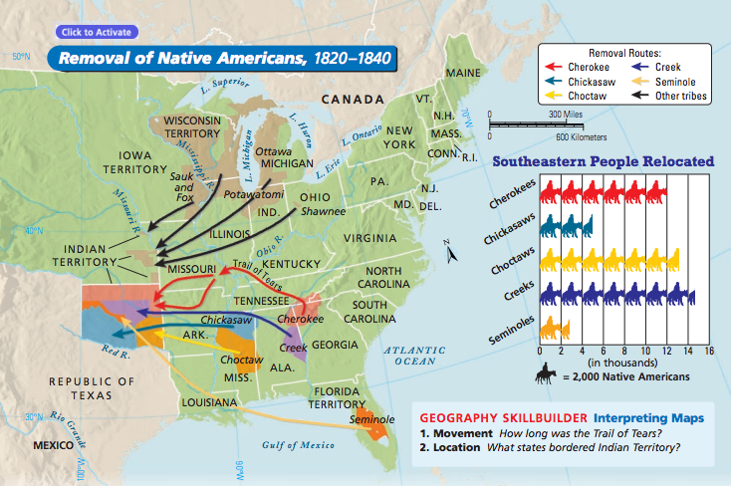
Indian Removal
Andrew Jackson wanted to open land up to white settlers
He saw that Native Americans were “in the way”
He asked Congress to pass a law that would make Natives move west of the Mississippi River
The Indian Removal Act passed in 1830
The forced removal of Native Americans would come to be known as the Trail of Tears

Slide 18
EXIT TICKET
So, HERO or VILLAIN?

