Slide 1
DO NOW
What were the 4 causes for the secession of the Confederate States?
Put the iPad face-down on the desk.

Slide 2
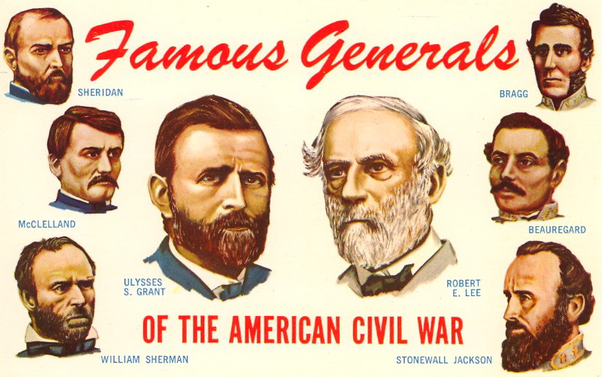
Important Players in the Civil War Era
January 16, 2014

Slide 3
Learning Goals
EQ: Is war a necessary evil?
LT: Research the Major “players” during the Civil War, including political, social, and military figures.
POU: I can research the major figures of the Civil War and identify their significance to history.

Slide 4
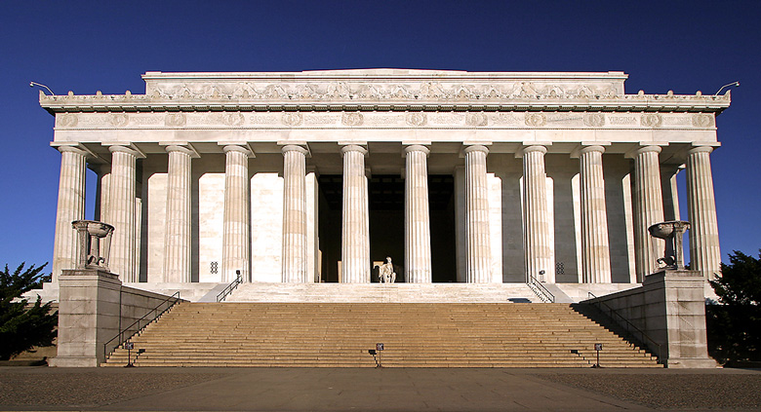
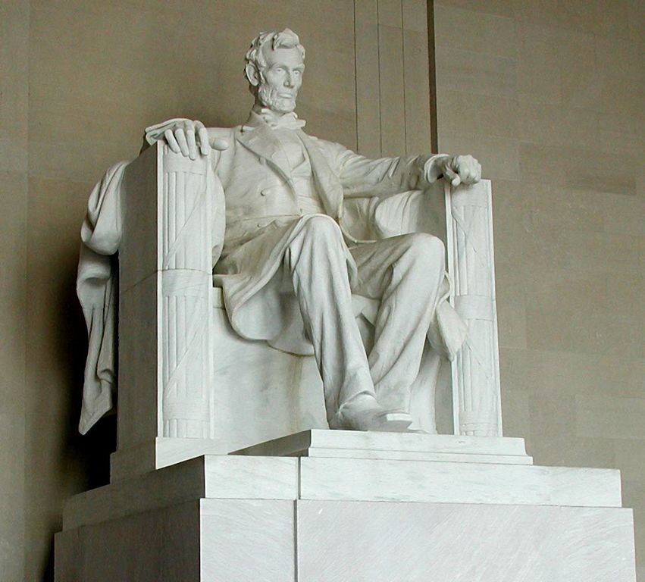
Lincoln Memorial

Slide 5
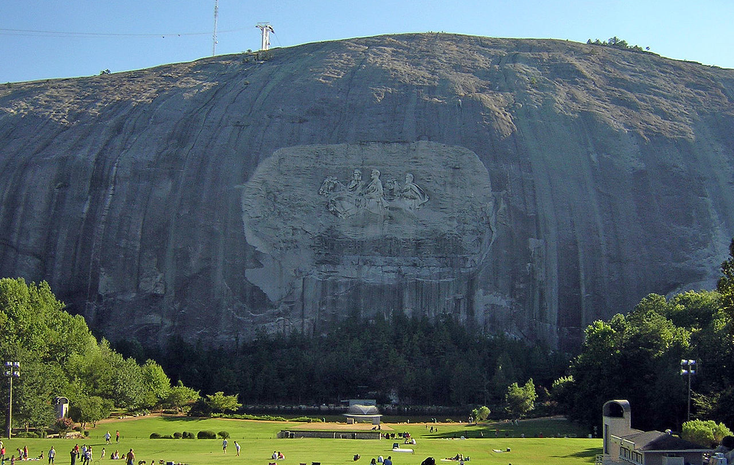
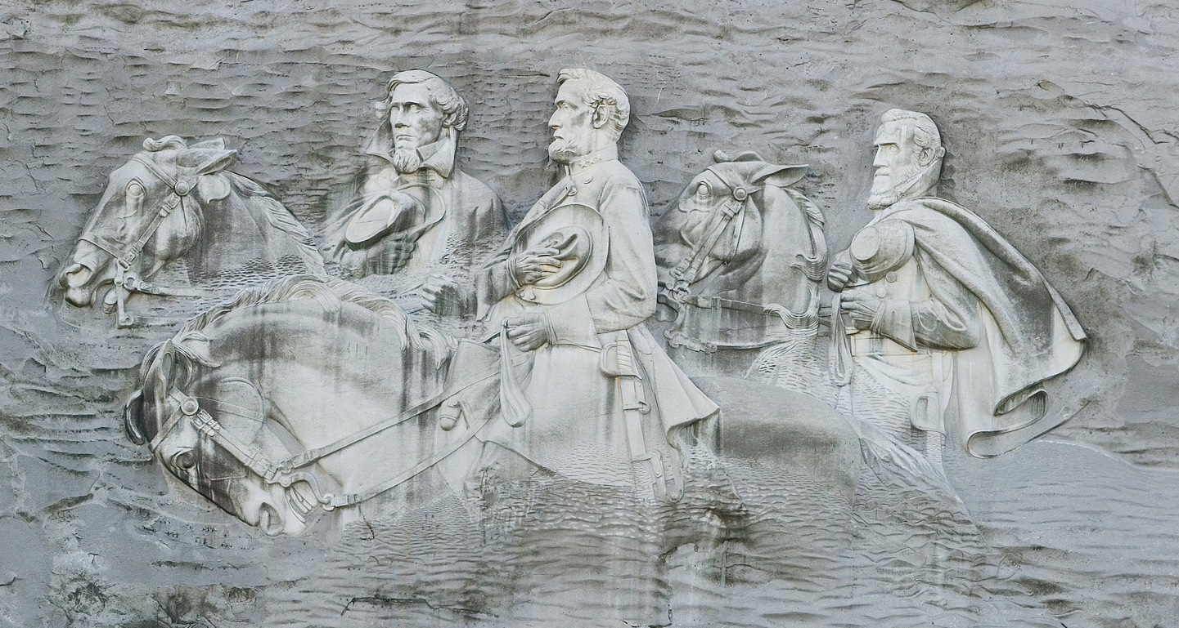
Stone Mountain, Georgia

Slide 6
Other Monuments

Slide 7
Question:
Why do we remember these people?

Slide 8
Instructions
In this assignment, you will use iPads to research important people from the 1850's through the Civil War.
Your job is to find the reason why each person is important to the Civil War era.
Do not just copy from the Internet. You must write in your own words. If you do not know what something means, look it up, or don't write it.
The first 4 people are MANDATORY. You may choose any 6 of the other names on the list.
Use the following website or Google to search for information:
http://mrkash.com/activities/civilwar.html

