Slide 1
DO NOW
Describe the Gilded Age using EXACTLY 9 words.

Slide 2
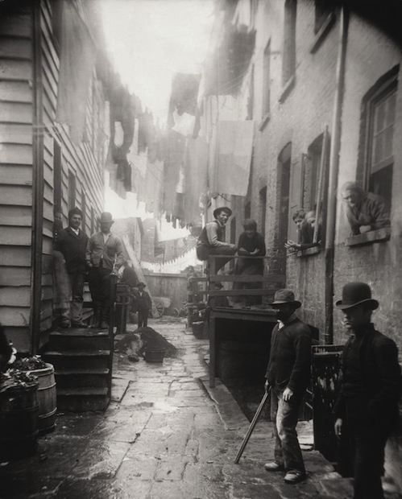
IMMIGRATION
February 20, 2013

Slide 3
Learning Goals
EQ:
How do immigrants contribute to American life?
LT:
SWBAT compare and contrast “new” and “old” immigration in the U.S.
POU:
I can complete a Venn diagram comparing and contrasting “new” and “old” immigration.

Slide 4
Immigration
The action of coming to live permanently in a foreign country
Usually for political, economic, or social reasons

Slide 5
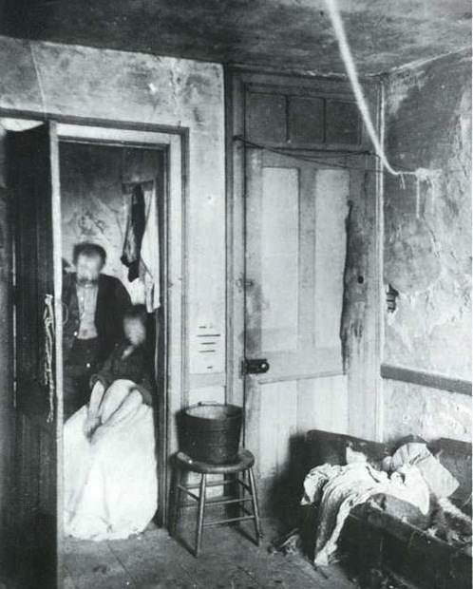
“Old” vs. “New” Immigration
Old Immigration
Immigrants who came to America from the colonial period through the Civil War
New Immigration
Immigrants who came to America mostly during the Gilded Age through the 1920s

Slide 6
Assignment Directions
We will begin your Venn diagram together
Years
Who came?
You will complete your Venn diagram by reading each section for both old and new immigration
Why did they come?
What issues did they face?
What impact did they have?
We will then come back together and review some of the information

Slide 7
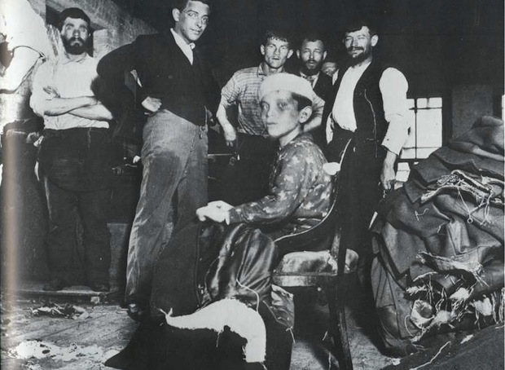
Who came?
OLD
NEW
English and those who were from English territories
Some Western Europeans
Africans came as slaves
Southern & Eastern Europeans
Italy, Russia, Poland, Greece, etc.
Asians
Mostly from China & Japan

Slide 8
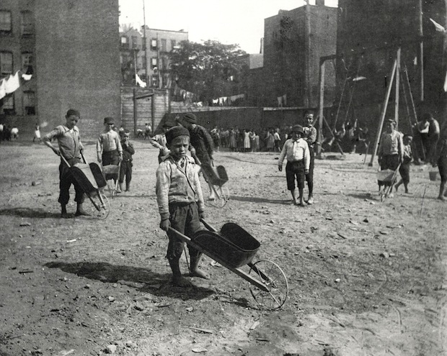
Why did they come?
OLD
NEW
To have more say in their government
Religious freedom
LAND! They wanted to make money.
African slaves brought for economic reasons against their will
JOBS! They wanted to make money.
Some fleeing political unrest
“Rags to riches” opportunity

Slide 9
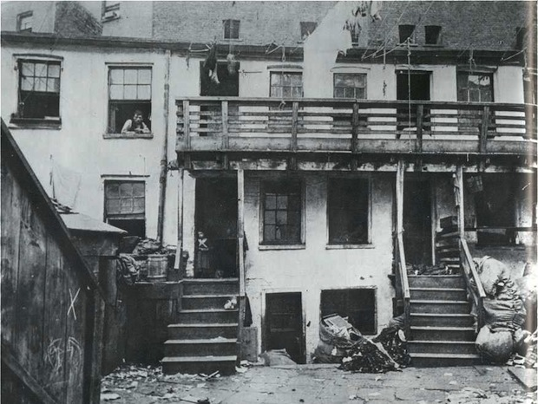
What issues did they face?
OLD
NEW
Some anti-immigration feelings, but not as much as “new” immigration
This is called NATIVISM.
Political Corruption
Discrimination from nativists because of religion, language, and other traditions
Laws that restricted immigration

Slide 10
What impact did they have?
OLD
NEW
Formed the government ideas
Language
Cultural traditions
Built transportation routes
Education
Farming techniques
Ethnic diversity in America
Varied language
Art
Food
Music
Provided much of the workforce for factories and industry during I.R.
Built railroads

