Slide 1
DO NOW
Identify the following:
Grass roots movement
Cesar Chavez
United Farm Workers
Get your homework out and ready to turn in.

Slide 2
Learning Targets
EQ
How did Americans respond to crises at home and abroad?
LT
Identify crises at home and abroad during the 1970s.
Examine the responses of the U.S. to these crises.
POU
I can explain the responses of the United States to crises at home and abroad in the late 1970s.

Slide 3
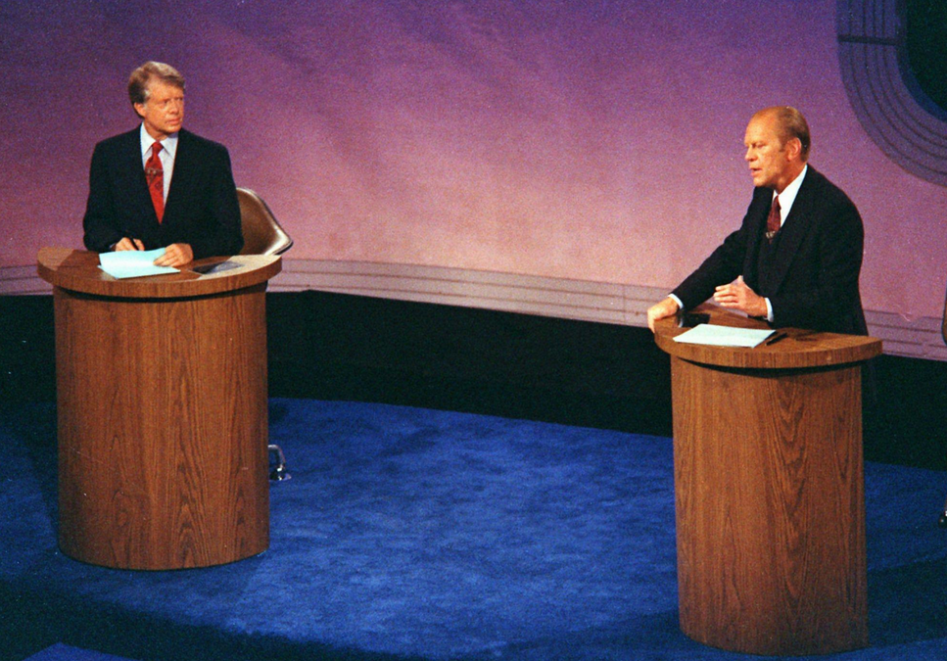
Ford & Carter: America from 1974-1981
May 21, 2014

Slide 4
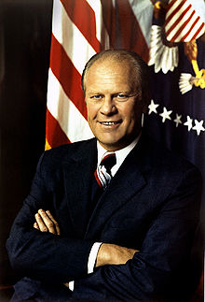
President Gerald Ford
1974-1977
Former college athlete and congressman
Becomes president when Richard Nixon resigns due to the Watergate Scandal
Ford pardons Nixon of any crime
This was VERY unpopular

Slide 5
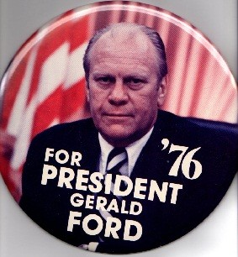
President Gerald Ford
End of Vietnam War
Ford pulls remaining troops and funds from Vietnam
Economy
Under Ford, inflation and unemployment rise
Poor economy and pardon of Nixon are main reasons he is not re-elected

Slide 6
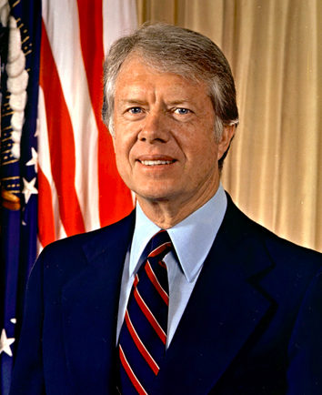
President Jimmy Carter
1977-1981
Former governor of Georgia
Considered an “outsider,” which helped him win
Wanted to change the image of the presidency
Generally seen as a failure as president, but as a great ex-president

Slide 7
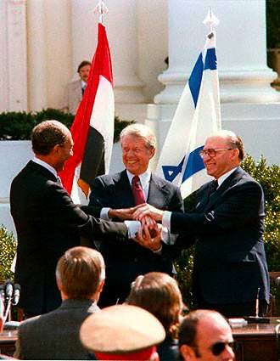
International Crises
Camp David Accords
After Israel & Egypt fight a short war, Carter invites their leaders to Camp David to negotiate peace
Meeting results in improved relations between Israel and Egypt

Slide 8
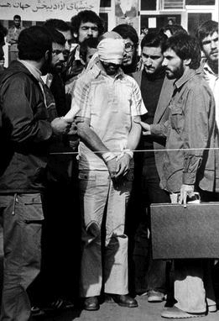
International Crises
Iran Hostage Crisis
After a revolution in Iran, militants take over 50 American hostages in November of 1979
One rescue operation saves a few Americans, but another fails
Carter refuses to go to war
Hostages are not released until Carter leaves office in 1981

Slide 9
International Crises
Soviets invade Afghanistan
Carter orders trade embargo against Soviet Union
U.S. does not send grain or technology to USSR
U.S. boycotts the 1980 Olympics in Moscow

Slide 10
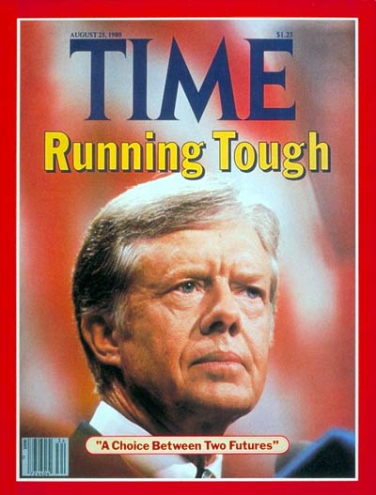
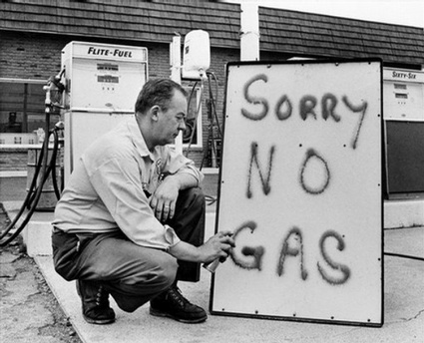
Domestic Crises
Stagflation
High inflation, stagnant economy, high unemployment
By the election of 1980, Carter’s approval rating had fallen to 23%
Energy Crisis
Problems in Iran resulted in an oil shortage
Gas prices rose
Carter urges conservation

Slide 11
EXIT TICKET
Go to the following link to complete your exit ticket:
goo.gl/d827iM

