Slide 1
DO NOW
List three similarities between OLD and NEW immigration.

Slide 2
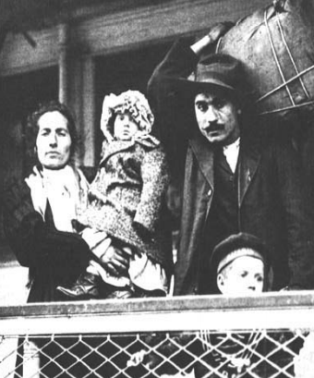
Immigration During the Gilded Age
February 21, 2014

Slide 3
Learning Goals
EQ:
How do immigrants contribute to American life?
LT:
Describe the condition of immigrants in the Gilded Age/I.R.
POU:
I can create a post card describing the experience of an immigrant during the Gilded Age/I.R.

Slide 4
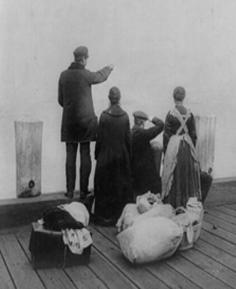
Immigration
Between 1865-1915, more than 13.5 Million immigrants came to the United States

Slide 5
Why did they come?
PUSH FACTORS
PULL FACTORS
Population growth
Agricultural changes
Crop failures (Irish)
Religious and political problems in their own countries
Freedom
Economic opportunity
Industrial Revolution jobs
“Rags to riches” possibilities
Abundant land

Slide 6
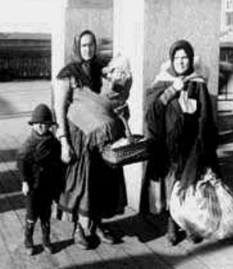
How did they get here?
Passage to the U.S. often cost a life’s savings
Entire families would save enough to send one or two people to America
Travel was by ship, often extremely crowded and full of diverse people

Slide 7
Travel Dangers
Read the following quote from a U.S. Immigration agent:
“During the 12 days in the steerage I lived in…surroundings that offended every sense. Only a fresh breeze from the sea overcame the sickening odors. Everything was dirty, sticky, and disagreeable to the touch.”
Disease and even death were not uncommon.

Slide 8
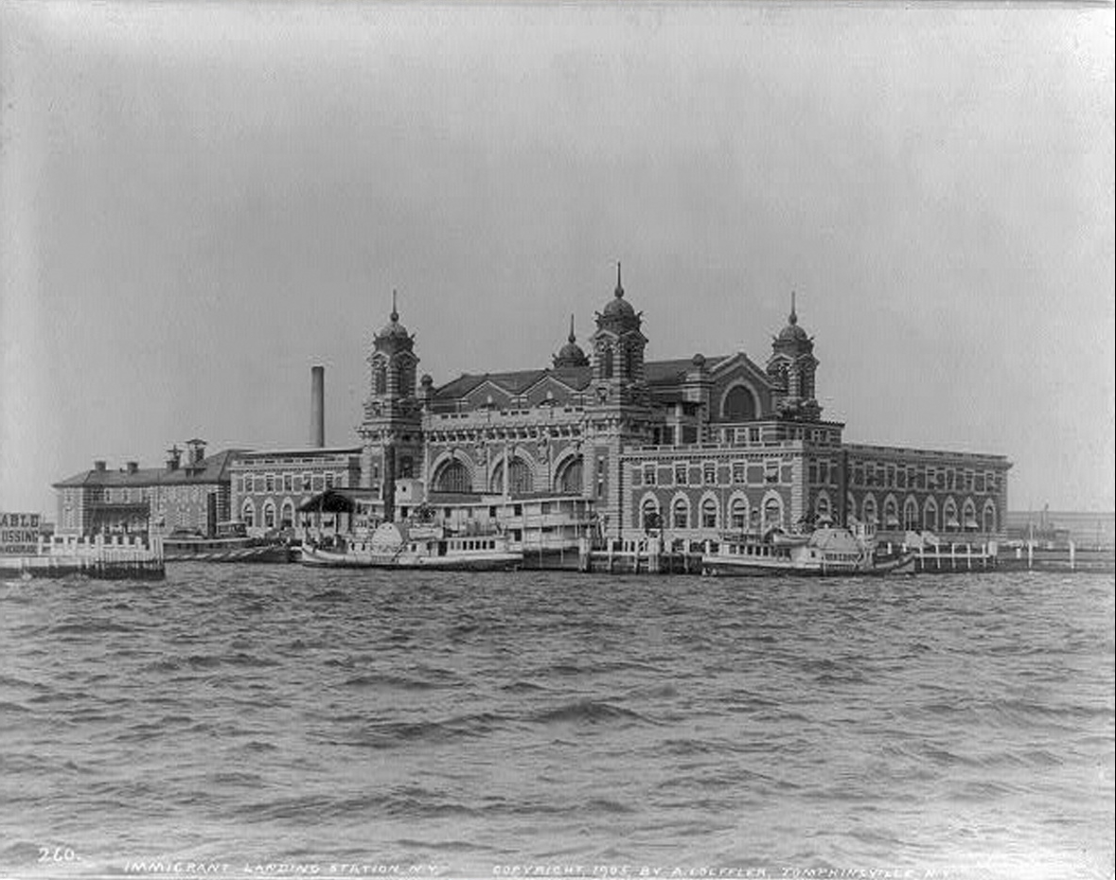
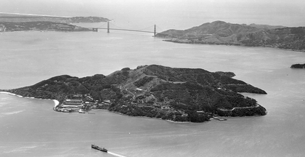
When people arrived…
Ellis Island – New York
Angel Island – San Francisco
Served as an immigration station on the east coast
In its first 20 years, 6 Million immigrants had come through Ellis Island
Immigration station on the west coast
Mostly Chinese and Japanese immigrants passed through
Served about 1 Million immigrants

Slide 9
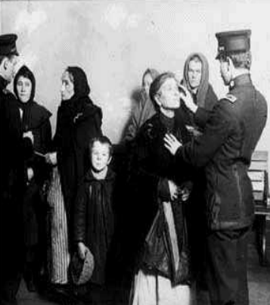
Inspection
Medical exam
32 background questions
Immigrants with contagious diseases were sent back home
Many immigrants had their last names changed at the inspection stations

Slide 10
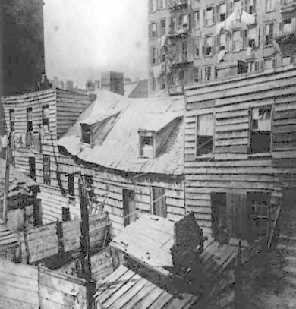
What was life like?
Many nativists (people who were anti-immigration) disliked immigrants
Immigrants often had to accept low-paying jobs with poor working conditions
Most immigrants lived in areas with people from a similar ethnic background, separated from the rest of the city
Chinatown
Little Italy

Slide 11
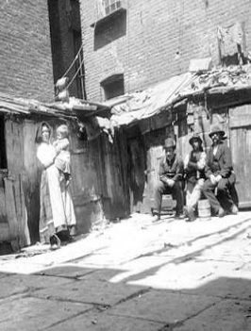
Living Conditions
Many immigrants lived in crowded tenements
Tenements were crowded apartments usually with poor conditions
Uncomfortable, crowded, and dirty
1,231 people in 120 rooms in one part of NYC
In Chicago, 40% of infants never reached their first birthday
Some people paid for “Five Cents a Spot” rooms (a nickel for a one-night stay next to strangers)

Slide 12
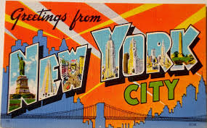
Assignment
You will pretend that you are an immigrant to America.
On the front, you will draw a picture that represents the place that you have come to, America.
On the back, you will write a message home describing what it is really like for you as an immigrant in America.

