Slide 1
DO NOW
What happened at the Yalta and Potsdam Conferences?

Slide 2
Roots of the Cold War
May 1, 2014

Slide 3
Learning Goals
EQ
How did the Cold War begin?
LT
Define the term “Cold War.”
Identify the root causes of the Cold War.
POU
I can define the term “Cold War” and identify its root causes.

Slide 4
Cold War
The state of political hostility that existed between the Soviet bloc countries and the U.S.-led Western powers from 1945 to 1990
Two superpowers:
United States vs.
Union of Soviet Socialist Republics
Mainly a conflict between capitalist nations and communist nations

Slide 5
Cold War (cont’d)
Why is it called the “Cold” War?
No direct conflict on the battlefield
The U.S. and Soviet Union did engage in espionage (spying), propaganda, athletic, and political “battles” around the world.

Slide 6
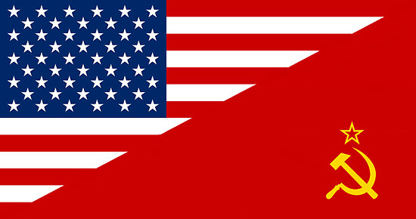
Learning Target #1 Recap
Cold War begins as WW2 ends
Between capitalist nations (led by U.S.) and communist nations (led by U.S.S.R.)
No direct fighting between U.S. and Soviets
Ends in 1990s

Slide 7
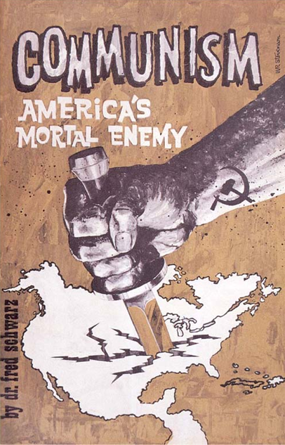
Causes
Competition between superpowers
Nuclear weapons
Disagreements/distrust over end of WW2
U.S. policies toward communism
Alliances

Slide 8
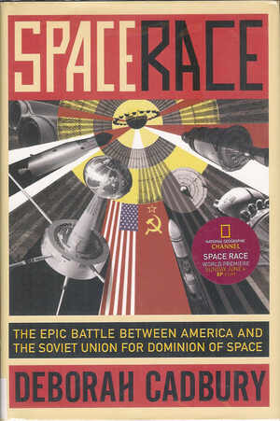
Competition
The U.S. and Soviet Union competed in nearly everything
Military
Economics
International influence
Education
Space
Sports

Slide 9
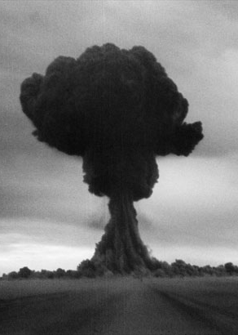
Nuclear Weapons
The U.S. and Soviet Union began building up their nuclear arsenal, just in case the countries went to war.
Nuclear annihilation was the BIGGEST THREAT of the Cold War
August 29, 1949: U.S.S.R.’s first atomic bomb test.

Slide 10
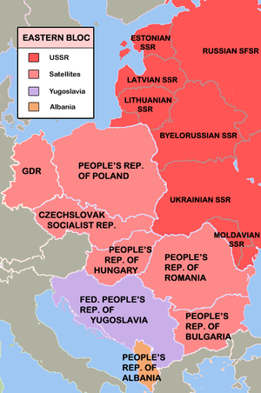
Disagreements & Distrust
The Western nations (U.S., France, & Britain) wanted free elections in Eastern European elections after WWII
Soviet Union would not allow; instead, they set up communist governments in places like Poland and East Germany
These nations were called satellites of the USSR

Slide 11
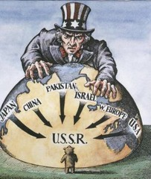
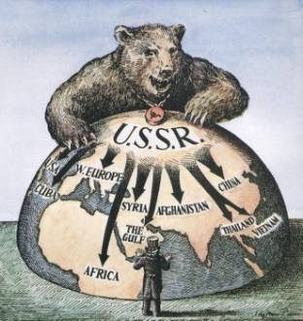
U.S. Policies
Containment
U.S. tries to keep communism from spreading to more countries
Marshall Plan
U.S. gives money to countries to keep them from turning to communism

Slide 12
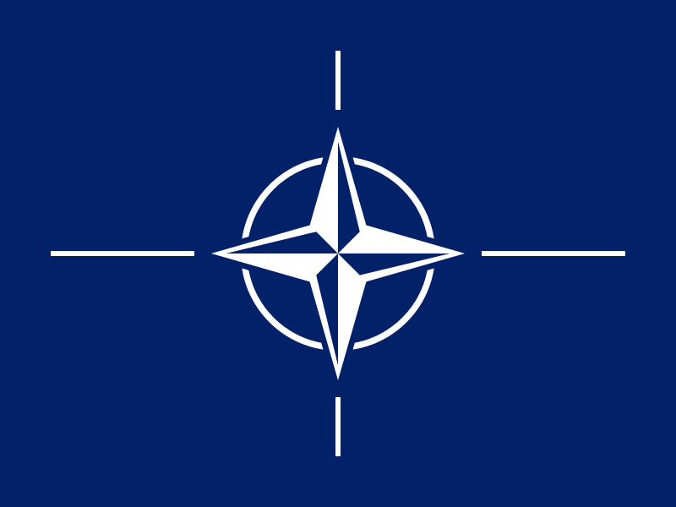
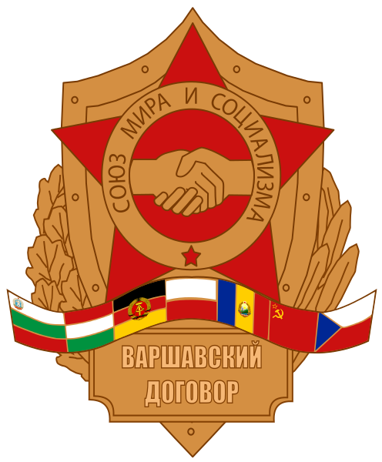
Alliances
North Atlantic Treaty Organization (NATO)
U.S.-led alliance between democratic nations
Warsaw Pact
Soviet-led alliance between communist nations and Soviet satellite nations
These were military, as well as political, alliances

Slide 13
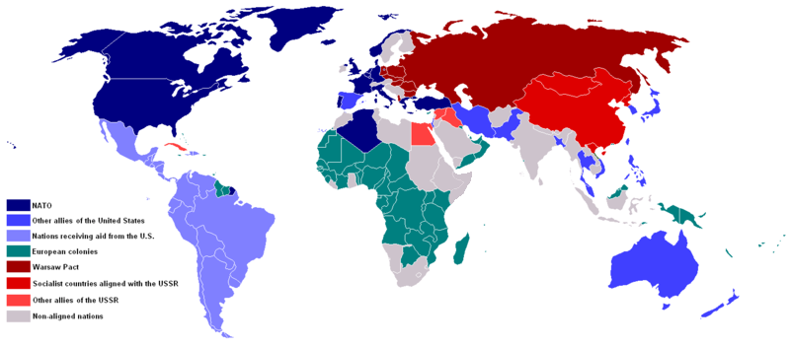

Slide 14
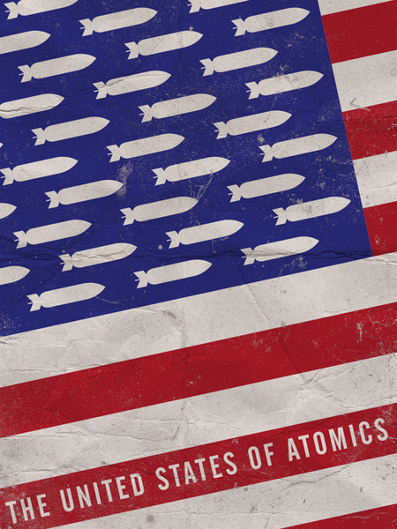
Learning Target #2 Recap
The Cold War was caused by competition between the two superpowers—U.S. and U.S.S.R.
Each side tried to get more power and influence around the world
Nuclear war was a real possibility

