Slide 1
DO NOW
Describe ONE of the following two events:
Bank Wars
OR
Nullification Crisis

Slide 2
THE TRAIL OF TEARS

Slide 3
Learning Goals
Essential Question
Was Andrew Jackson a hero or villain?
Learning Target
SWBAT evaluate reasons for Native American removal and critique the outcome of the Indian Removal Act.
POU (I’ll know I’ve got it when…)
I can evaluate the reasons for Indian Removal in the Age of Jackson.

Slide 4
Indian Removal – Why was it “needed?”
By 1800, white settlers were moving farther west in the U.S. looking for land
They wanted Native Americans moved to reservations
To do this, the U.S. began forcing Native Americans off of the land

Slide 5
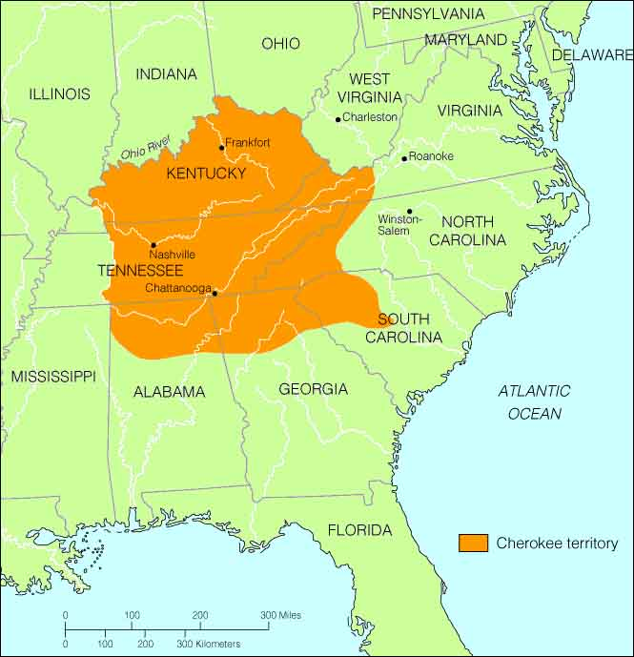
North Carolina & the Cherokee
In the early 1800s, about 4,000 Cherokee Indians lived in the mountains of North Carolina
16,000 more lived in Tennessee and Georgia
Cherokee removal begins in 1830

Slide 6
THE TRAIL OF TEARS
The Indian Removal Act of 1830 authorized the relocation of Native Americans to the far west (what is now Oklahoma)
Signed by President Andrew Jackson
Named “The Trail of Tears” by the Choctaw Indians because of the thousands who died along the journey

Slide 7
Where did Native Americans move?

Slide 8
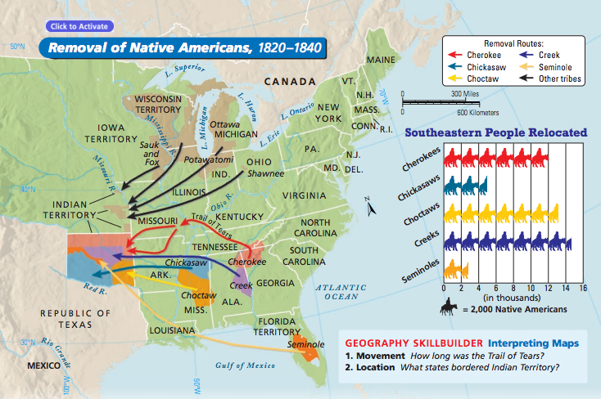

Slide 9
Numbers
By 1837, over 46,000 Native Americans had been forced to leave their land
Over 25 million acres opened up for Americans to settle
More than 15,000 Cherokee forced to move
Between 4,000-8,000 Cherokee died on the Trail

Slide 10
DO NOW
What was the Indian Removal Act of 1830 and what did it do?

Slide 11
THE TRAIL OF TEARS
Day 2

Slide 12
Day 2 Learning Goals
Essential Question
Was Andrew Jackson a hero or villain?
Learning Target
SWBAT evaluate reasons for Native American removal and critique the outcome of the Indian Removal Act.
POU (I’ll know I’ve got it when…)
I can critique the outcome of the Indian Removal Act.

Slide 13
Day 2 Assignment Directions
Together, we will read the beginning of each primary source together as a class.
You will choose ONE of the two primary sources to finish reading in class.
Answer the 8 questions that accompany your reading.
We will discuss each source when our time is up.

