Slide 1
North Carolina in the Civil War
January 23, 2014

Slide 2
Learning Goals
EQ
Is war a necessary evil?
LTs (SWBAT…)
Identify major battles of the Civil War (NC specific).
Describe North Carolina’s role in the Civil War.
POUs (I’ll know I’ve got it when…)
I can identify major battles of the Civil War in NC.
I can describe NC’s contributions to the Civil War effort of the South.

Slide 4
The Soldiers of North Carolina
More than 125,000 North Carolinians fought for the Confederacy during the Civil War
About 20,000 were conscripted, or drafted, and forced to serve in the military
About 20,000 North Carolinians died in fighting
Another 20,000 died of disease during the war
During the war, North Carolinians earned the nickname Tar Heels, though its origin is debated

Slide 5
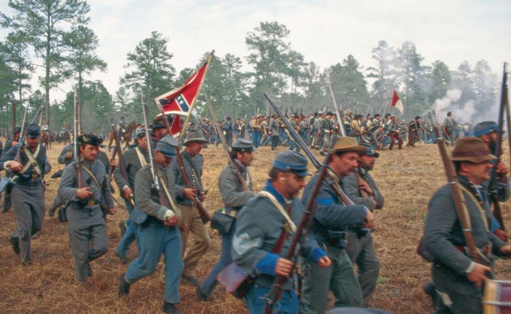
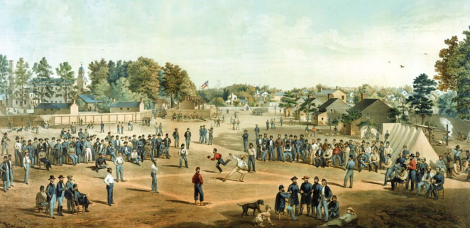

Slide 6
Overview of the State’s Role
Very little major fighting took place in North Carolina
North Carolina soldiers fought mainly in Virginia
Port cities, such as Wilmington, NC, became very important to the Confederacy
Blockade runners helped to move supplies past the ships of the North
“The Lifeline of the Confederacy”: refers to the railroad between Wilmington and Virginia cities
Ultimately, the North took over NC’s coastline and railroads

Slide 7
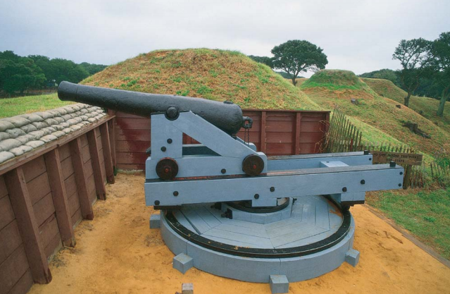
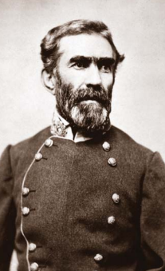
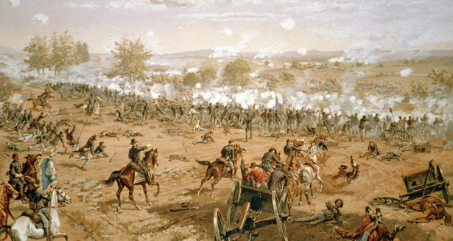

Slide 8
NC Soldiers on the Virginia Front
“First at Bethel, farthest at Gettysburg, and last at Appomattox.”
Henry L. Wyatt was the first North Carolinian killed in battle (at Bethel, VA in 1861)
North Carolinians formed a large portion of the army at Gettysburg, which pushed through Union lines
NC soldiers made up 1/4 of the soldiers who surrendered at Appomattox in 1865

Slide 9
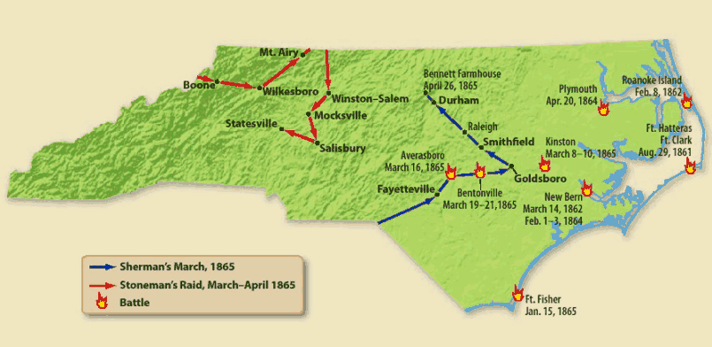
So did the war come to NC? Yes.

Slide 10
End of the War in NC
By 1865, NC was under attack from all directions
General Sherman marched through the state, taking control of central NC and cutting off vital supply lines
The Battle of Bentonville
The last major battle in the war (March 19-21, 1865)
Also the largest battle fought in NC during the war
After three days of fighting, the NC soldiers retreated

Slide 11
Surrender
On April 9, 1865, General Lee surrendered at Appomattox (1/4 of the soldiers were from NC)
Soon after Appomattox, the last remnants of Confederate troops surrendered in a ceremony at Bennett Farm, located near Durham

Slide 12
Exit Ticket
http://goo.gl/sv3NBv
How did North Carolina and its citizens help the Confederacy’s Civil War effort?
Give at least three examples to support your answer.

