Slide 1
DO NOW
What problems were Americans facing during the presidency of Jimmy Carter?

Slide 2
Learning Goals
EQ
What was the “Reagan Revolution?”
LT
Examine the presidency of Ronald Reagan.
Identify successes and failures of the Reagan presidency.
POU
I can describe the major events and policies of the “Reagan Revolution.”

Slide 3
The Reagan Revolution
May 22, 2014

Slide 4
1980 Election
Jimmy Carter (D) vs. Ronald Reagan (R)
Pollsters predicted a close election, but it was a blowout
Reagan wins by an overwhelmingly majority in the electoral vote (489-49)
In 1984, he wins by an even bigger majority! (525-13)

Slide 5
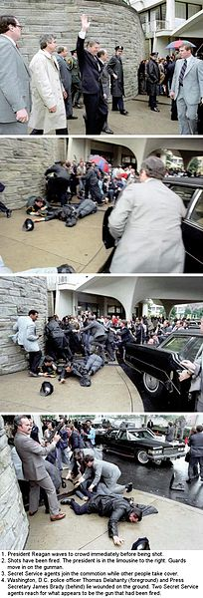
Attempted Assassination
In 1981, there was an assassination attempt on President Reagan, but it failed.
The would-be-assassin said he was trying to impress a Hollywood actress

Slide 6
Supply-side Economics
Also called “Trickle Down Economics”
Cuts in spending, lower taxes
Idea was that the money would “trickle down” from the rich to all areas of the economy

Slide 7
Foreign Policy
Congress increased military spending and expanded the nation’s nuclear arsenal.
Reagan also pushed a new space-based defense system which was officially named the Strategic Defense Initiative, but was commonly referred to as Star Wars

Slide 8
Soviet Union
Reagan took a hard line against the Soviet Union, calling it an “evil empire”
Tensions eased after Mikhail Gorbachev took over as Soviet leader in 1985.

Slide 9
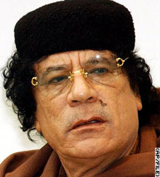
Middle East
1983: US Marines were sent to Lebanon, but over 200 killed in a suicide bombing
1986: US bombed Libya in retaliation for alleged Libyan sponsorship of terrorist attacks.

Slide 10
Central America
US tried to prevent the expansion of Communism into Central America.
Sent support to El Salvador
Invaded Grenada to kick out communists
Provided illegal arms to “Contra” rebels in Nicaragua

Slide 11
Iran-Contra Affair
Congress would not allow Reagan to give support to Contras in Nicaragua
Reagan’s employees sells arms to Iran, then funnel the money to the Contras
Congress finds out, Reagan says he didn’t know about it
After hearings, two men found guilty
These revelations hurt President Reagan’s credibility.

