Slide 1
DO NOW
ANSWER THE FOLLOWING (SILENTLY):
Make a list of five things that you own and cannot live without.
Materials for today:
Pen or pencil

Slide 2
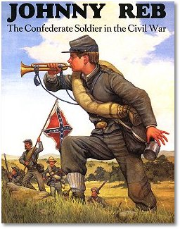
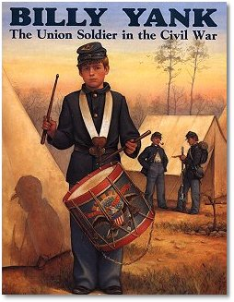
Soldiers of the Civil War
January 24, 2014

Slide 3
LEARNING GOALS
EQ: Is war a necessary evil?
LT: SWBAT investigate the lives of soldiers in the Civil War.
POU: I can construct a modern-day profile of a Civil War soldier.

Slide 4
Uniforms
“Johnny Reb”:
The Confederate Soldier
“Billy Yank”:
The Union Soldier
Grey wool hat, grey uniform coat, and white shirt
Few soldiers had well-fitting shoes
Union soldiers' uniforms were dark blue
Union soldiers also wore wool caps and coats
Union soldiers usually had better uniforms

Slide 5
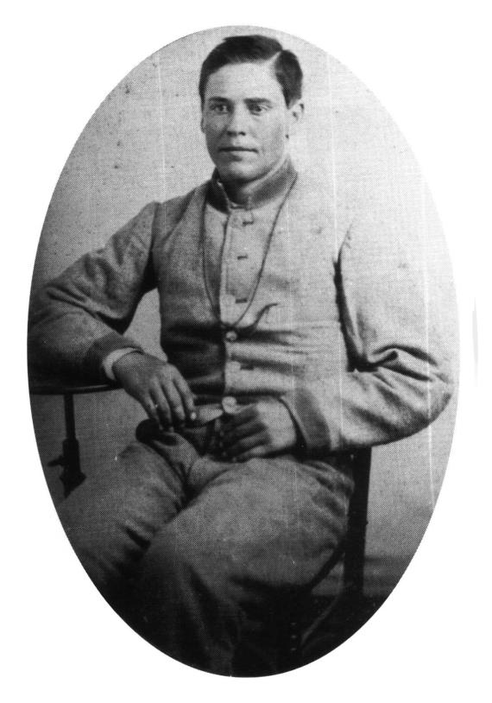
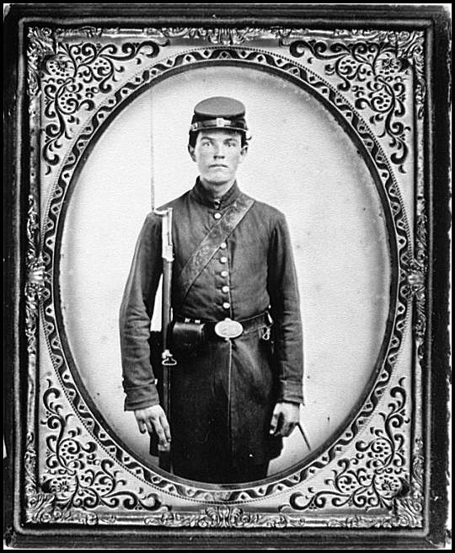

Slide 6
Weapons
“Johnny Reb”:
The Confederate Soldier
“Billy Yank”:
The Union Soldier
Carried a “Confederate Springfield” gun
Some Confederates carried Union guns picked up in battle
Carried an Enfield Rifle made in Britain
The most accurate of all Civil War guns on the battlefield

Slide 7
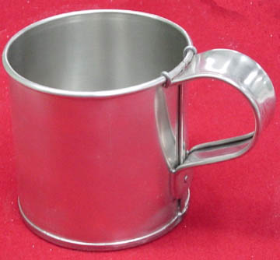
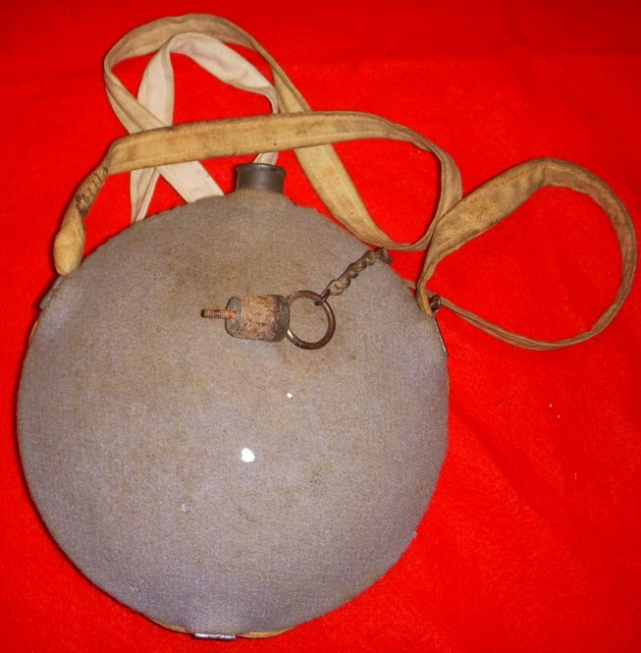
In the Backpack
“Johnny Reb”:
The Confederate Soldier
“Billy Yank”:
The Union Soldier
Small rolled-up blanket
A haversack
A cloth-covered canteen
A tin cup
A small frying pan.
A heavy knapsack or haversack
A blanket
A small protective cover called a "dog tent”
A canteen, cup, & frying pan
Union soldiers had to maintain a proper appearance, so they also carried a comb, a razor, and other personal hygiene products.

Slide 8
Pay & Supplies
Union privates received $13 per month
Confederate privates earned $11 per month
Pay was supposed to be given every two months, but was often irregular (more like every four to six months)
The Northern armies had many more supplies because of the industrial North
The Southern supply lines were under attack by the Union
As the war went on, Southern soldiers had fewer supplies

Slide 9
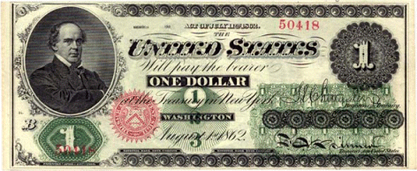
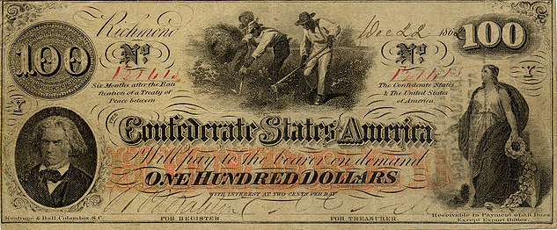
U.S. One Dollar Bill – 1862 (Front)
C.S.A. One Hundred Dollar Bill - 1862

Slide 10
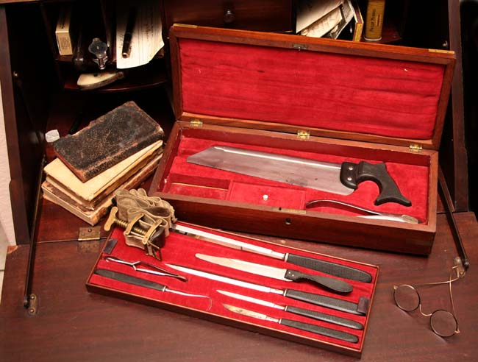
Medical Care
Medical care was primitive—diseases killed many soldiers
Union battle deaths: 110,070
Union disease deaths: 250,152
Confederate battle deaths: 94,000
Confederate disease: 164,000
Amputations (removing limbs) were common in the war
There was no anesthesia!
Post-Civil War medicine improved partly due to lessons learned in war

Slide 11
Assignment Directions
Using the cell phone WS and the blank screens, fill in what a Civil War soldier’s cell phone might have looked like.
Complete the information on his Facebook profile
Make 3 tweets he sent from his Twitter account
Describe 5 pages he would have “liked”
Illustrate apps he would have used on his phone,
Draw a picture that he took and used as his wallpaper.

Slide 12
“I don’t see how we could have an army without music.”
-- C.S.A. General Robert E. Lee

