Slide 1
Schedule
Do Now/Turn in HW
Discuss Do Now
Learning Goals
Cold War 1955-1965 Introduction
Preview events
Cold War Notes at Stations
Space Race, Berlin Crisis, Bay of Pigs, Cuban Missile Crisis
Cold War Notes w/ large group
Exit Ticket

Slide 2
DO NOW
Define brinkmanship.
How did it relate to the United States’ policy of containment?

Slide 3
Learning Goals
EQ
How did the United States respond to crises during the Cold War?
LT
Identify and describe major events of the Cold War
Explain how conflicts and compromises shaped the U.S. in the Cold War Era
POU
I can identify and describe major events of the Cold War.
I can explain how conflicts and compromises shaped the U.S. in the Cold War Era.

Slide 4
The Cold War: 1955-1965
May 5, 2014

Slide 5
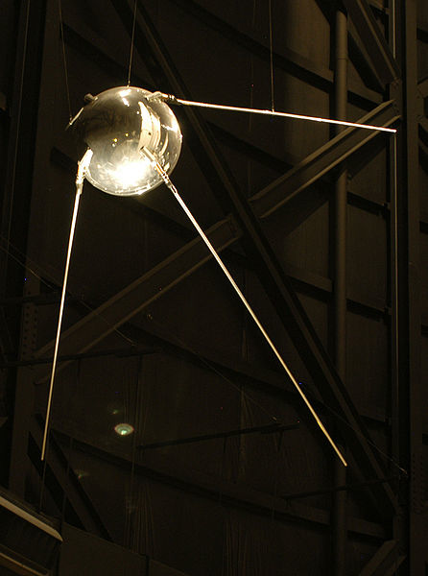
The Space Race Begins
1957
USSR sends Sputnik I, the first man-made satellite, into space
1958
United States launches its first satellite, Explorer, into space
1961
April 12: USSR puts first man in space
May 5: United States sends its first man into space
May 25: President John F. Kennedy issues intention to go to the moon

Slide 6
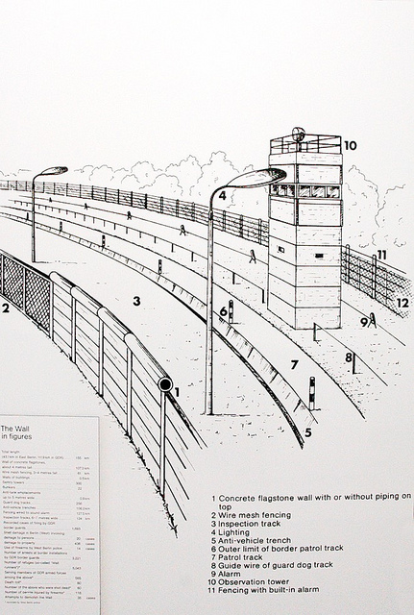
1961 – Berlin Crisis
Newly elected President John F. Kennedy meets with USSR leader, Nikita Khrushchev
Khrushchev demands the U.S. leave Berlin; U.S. refuses
Crisis deescalates, but USSR builds Berlin Wall, separating East & West Berlin

Slide 7
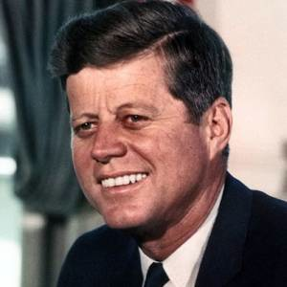
Cuba
1953-1959: Cuban Revolution results in a communist government led by Fidel Castro
Major Events in U.S./Cuba relations:
Bay of Pigs Invasion
Cuban Missile Crisis
Top: Fidel Castro; Bottom: President John F. Kennedy

Slide 8
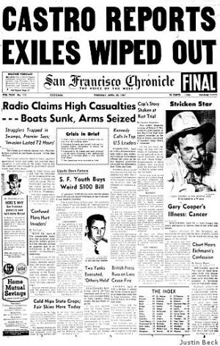
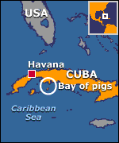
1961 - Bay of Pigs Invasion
U.S. develops secret plan to overthrow Castro
CIA trains Cuban exiles to invade the country
U.S. supposed to provide air support, but does not at the last minute
Invasion fails miserably!

Slide 9
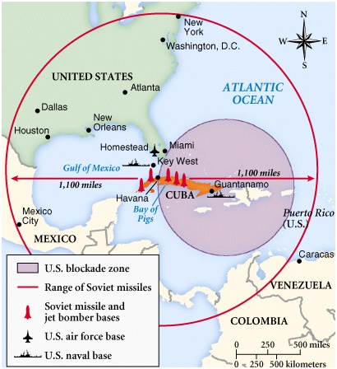
1962 – Cuban Missile Crisis
U.S. discovers that the U.S.S.R. is putting long-range nuclear missiles in Cuba
U.S. sets up blockade to keep missiles out of Cuba
Crisis ends when U.S. agrees to take missiles out of Turkey in exchange for missiles out of Cuba
Closest the U.S./U.S.S.R. ever came to nuclear war!

Slide 10
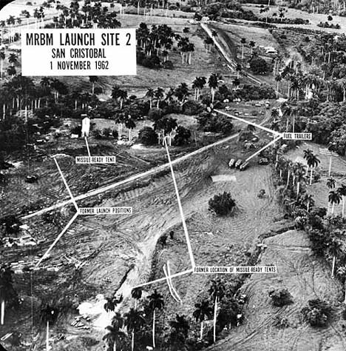
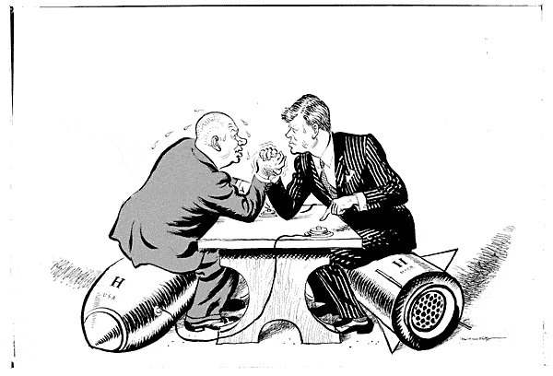
Cuban Missile Crisis (1962)

Slide 11
Consequences
US-Soviet relations improved after the crisis
Both Kennedy and Khrushchev initiated a period of détente
Détente is the easing of hostilities between the U.S. and U.S.S.R. during the Cold War
Set up a “hot line” between Moscow and Washington
The most significant breakthrough, however, was the Nuclear Test Ban Treaty of 1963

