Slide 1
DO NOW
JOURNALING:
How did you feel about yesterday’s discussion?
If you do not want to answer this question or are finished, journal about anything else you want for 5 minutes.

Slide 2
North Carolina During the Industrial Revolution
February 26, 2014

Slide 3
Learning Goals
EQ:
What did the Industrial Revolution look like in North Carolina?
LT
SWBAT explain how the Industrial Revolution impacted the state of North Carolina
POU
I can explain what the Industrial Revolution looked like in North Carolina.

Slide 4
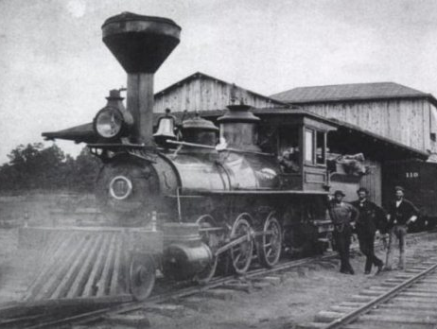
Introduction
By 1890, NC towns were growing rapidly thanks to the growth of railroads
Over 3,600 miles of track had been laid
It was an age of “industrial transition” for the state

Slide 5
Trains, Trains, Trains
Railroads opened trade between NC farmers and their markets inside and outside of the state
NC entrepreneurs build factories to convert their raw materials to finished products
Examples:
Cotton to cloth
Tobacco to cigarettes
By 1900, NC was the most industrial state in the South!

Slide 6
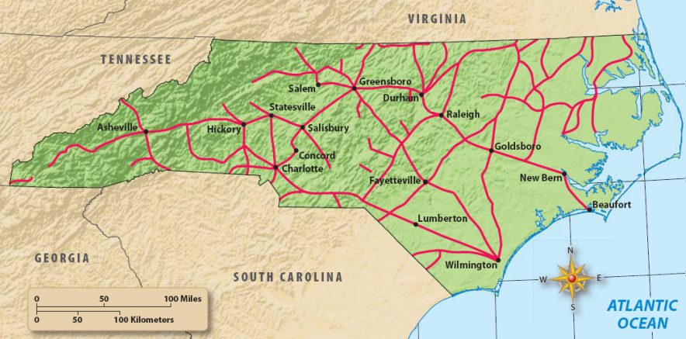
Railroads in NC, 1890

Slide 7
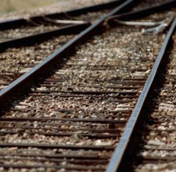
NC Railroad Towns
By 1900, Charlotte was the intersection of 6 railroads and had a population of 18,000 people
Durham, Hickory, and Burlington developed around railroads

Slide 8
Tobacco & Textiles
After the Civil War, NC became the center of tobacco production
Bright leaf tobacco was the grown, cured, and rolled into cigars and cigarettes in factories
Bull Durham Tobacco became one of the most famous brands
Cotton mills also opened to make cloth here in NC

Slide 9
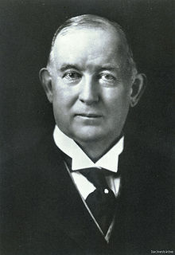
The Duke Family
James Duke established the American Tobacco Company
The company used machines to make their products which was much faster
The Dukes controlled most of the tobacco production in the United States

Slide 10
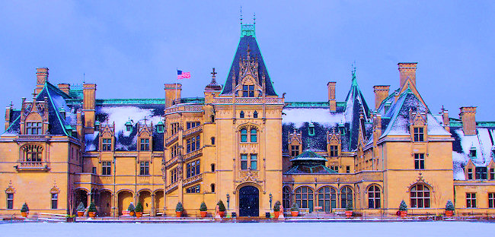
Biltmore

Slide 11
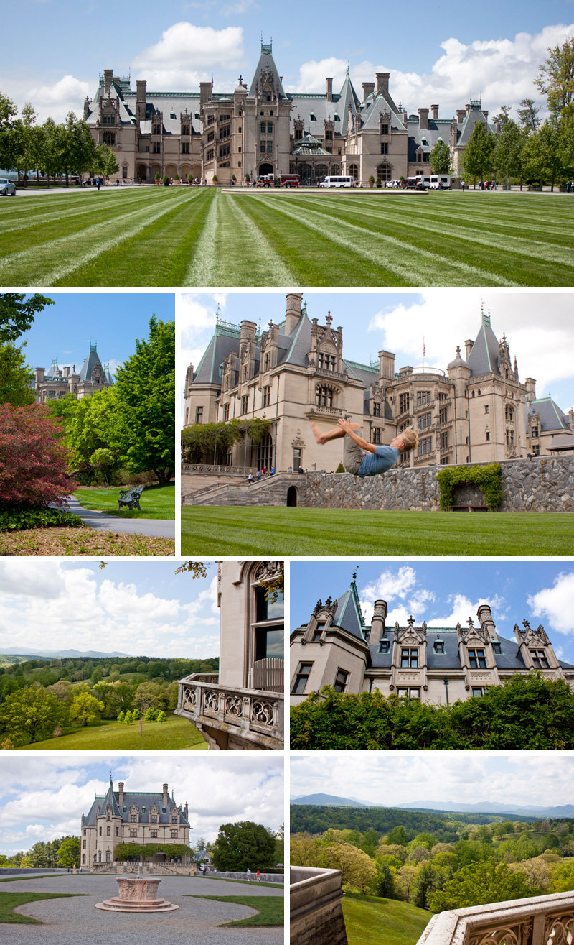
The Gilded Age Seen in NC
The Vanderbilts, one of the richest families in the U.S., would vacation in the NC mountains near Asheville
Built in the 1890s as a VACATION home
It was is the largest private home in the United States with over 250 rooms!
Estate includes farms, mills, forests, and dairy

Slide 12
EXIT ASSIGNMENT
goo.gl/A02z1d
A Zero Two z One d

