Slide 1
Last Day Before Break: Final Activity!
December 20, 2013

Slide 2
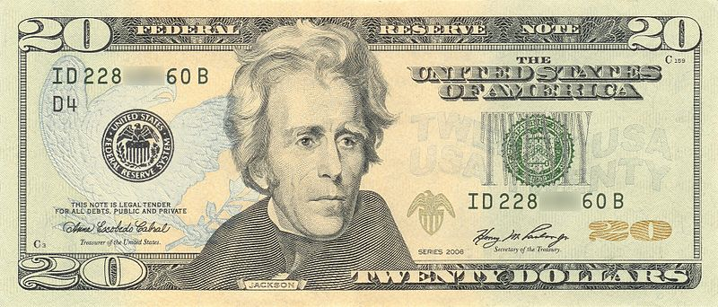
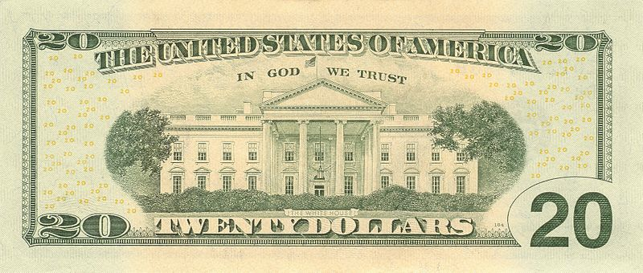
$20 Bill

Slide 3
Arguments For & Against Andrew Jackson on the $20 Bill
FOR
AGAINST
He was a strong president
Jackson made the Office of the President much stronger than it had been before
He was the first “self-made man” who became president
He represented common Americans
Why change it now?
He had a horrible economic policy
He didn’t even like the national bank printing money!
His policies caused the Panic of 1837!
He was a controversial president
He is considered evil to many Native Americans

Slide 4
ASSIGNMENT
REDESIGN THE $20 BILL!
Choose the American you would like to put on the bill (May I suggest Mr. Lasseter or James K. Polk?)
Make sure to indicate that the bill is worth $20
Must include:
“The United States of America”
“Twenty Dollars”
“THIS NOTE IS LEGAL TENDER FOR ALL DEBTS, PUBLIC AND PRIVATE”
“Federal Reserve Note”
“In God We Trust”

