Slide 1
DO NOW
Read the scenario you were handed as you entered.
Answer the questions on your paper.

Slide 2
Modern-day Comparison
Child Runaway
Secession, Civil War, and Reconstruction
Child was upset about parent’s rules, etc.
Parents try to compromise with child
Child becomes upset and runs away
While away from home, child is at a loss for resources and winds up broke and hungry
The child asks to return home
Parents must outline certain conditions for return
Southern states upset over slavery, tariffs, etc.
Congress attempts to compromise repeatedly
Slave owning states secede when not satisfied
During war the Union had superior resources; the southern states were mostly destroyed during the war
Southern states must return to the Union
Congress and the president outline the plan for Reconstruction

Slide 3
Reconstruction: Rebuilding the South
January 27, 2014

Slide 4
Learning Goals
EQ
Was Reconstruction a success or a failure?
LT
Assess the impact of the Civil War and Reconstruction on the United States.
POU (I’ll know I’ve got it when…)
I can identify the state of the country after the Civil War.
I can create a plan for Reconstruction with a partner.

Slide 5
Reconstruction
the plan to restore southern states to the Union and rebuild the South after the Civil War

Slide 6
Why was it needed? Look at the photos in the following slides to help you answer this question.

Slide 7
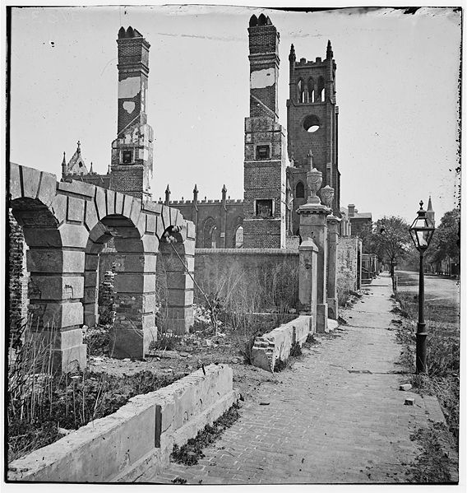

Slide 8
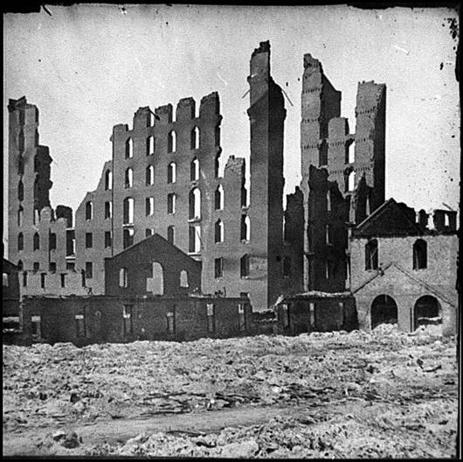

Slide 9
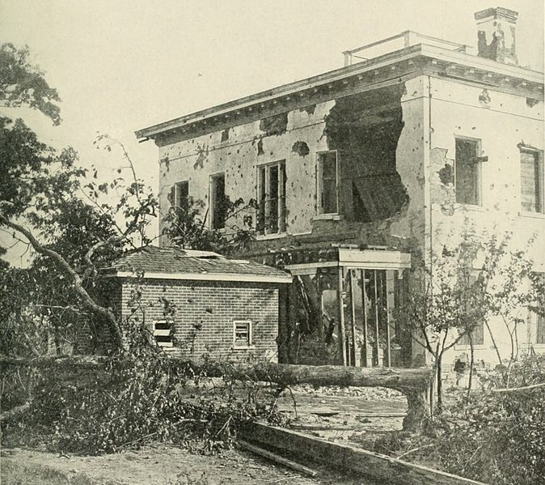

Slide 10
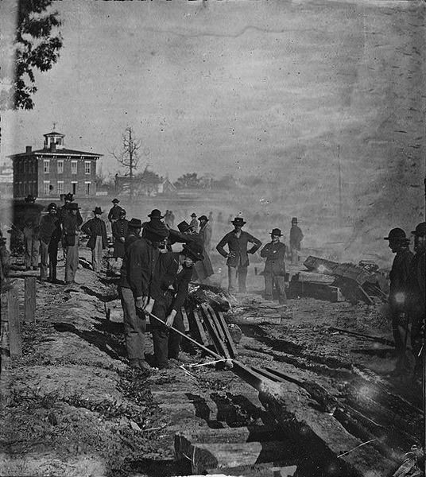

Slide 11
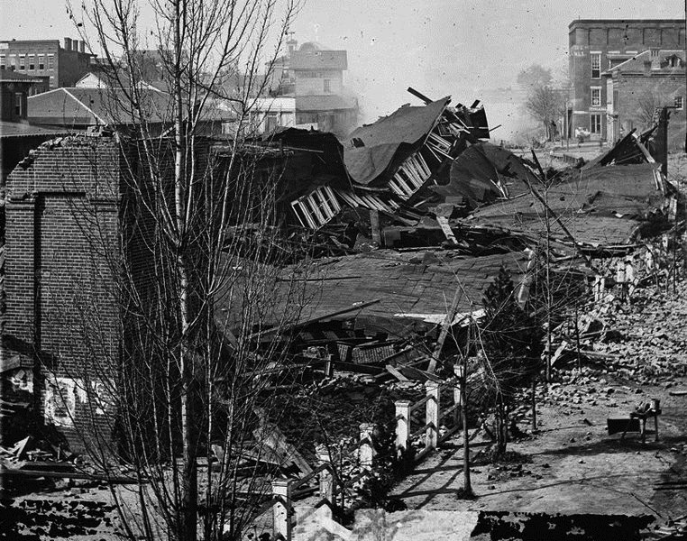

Slide 12
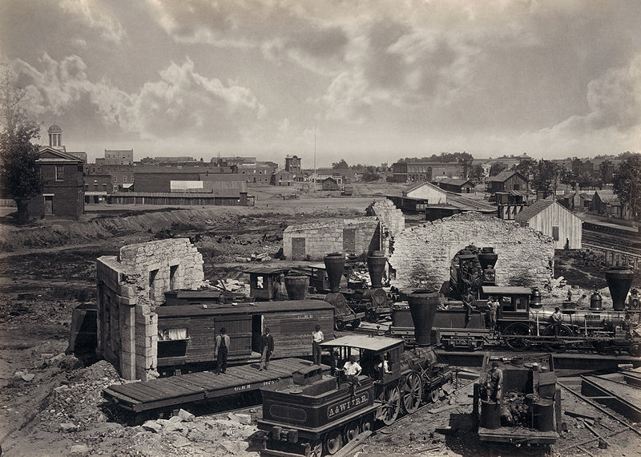

Slide 13
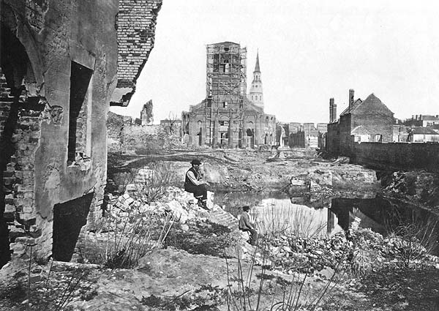

Slide 14
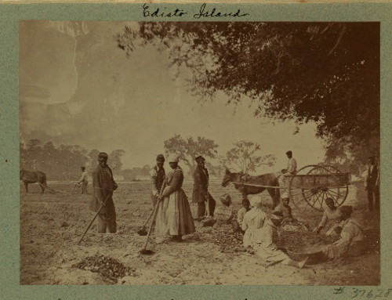

Slide 15
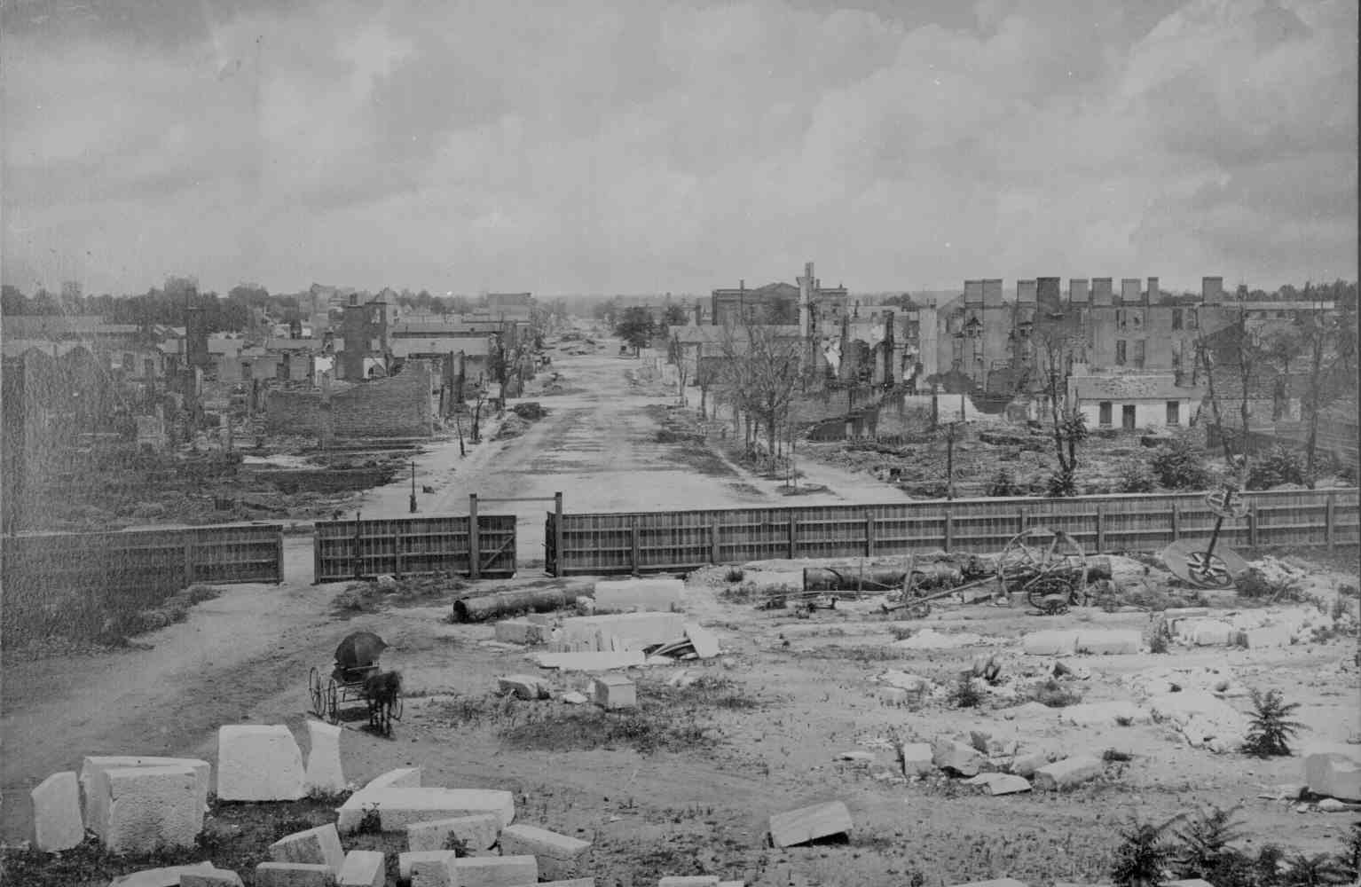

Slide 16
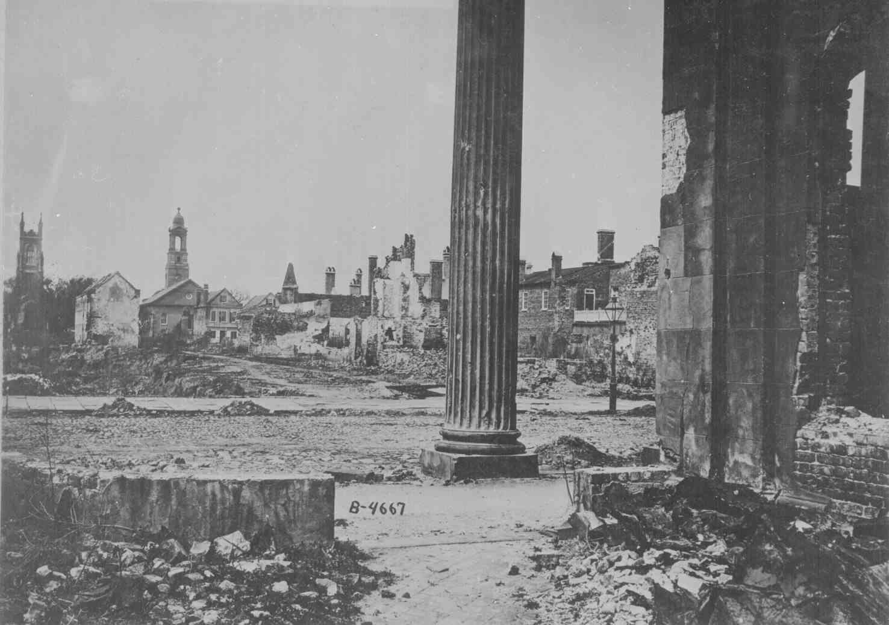

Slide 17
Simulation Activity
With a partner, you will make a plan for the Reconstruction of the South.
We will read together.
With your partner, plan your Reconstruction by answering the questions in each section.
Number each part of Reconstruction based on what you think should be done first.
YOU ONLY NEED TO COMPLETE 4 SECTIONS (YOU CHOOSE THE MOST IMPORTANT ONES!)

