Slide 1
DO NOW
How did Durham get the nickname “Bull City?”

Slide 2
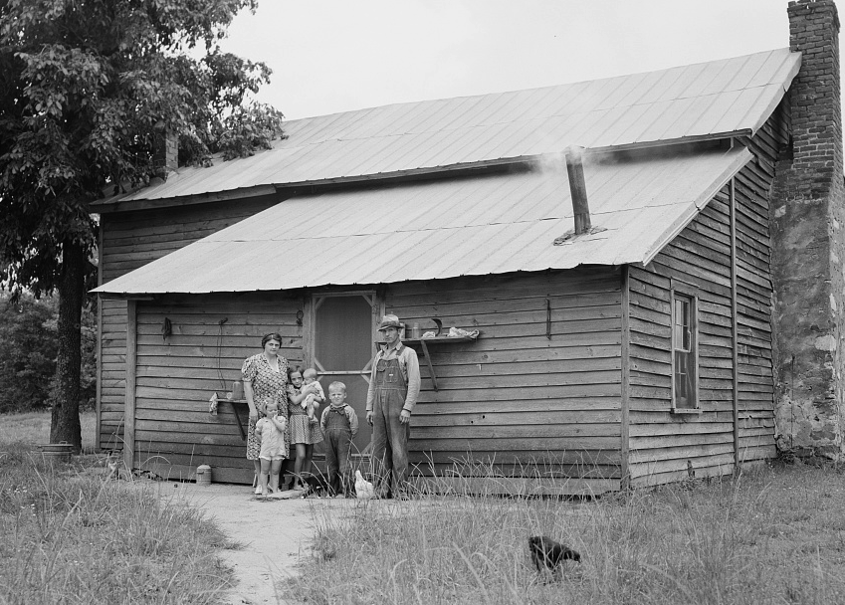
Sharecropping & Segregation in North Carolina
February 27, 2014

Slide 3
LEARNING GOALS
EQ:
How did the “other half” live in North Carolina?
LT:
SWBAT explain the condition of farmers and African-Americans in NC.
POU:
I can describe the condition of farmers and African-Americans in North Carolina in the late 1800s and early 1900s.

Slide 4
Agriculture in NC
Farming continued in NC during the Industrial Revolution
Because the prices of cotton and tobacco dropped after the Civil War, many farmers went into debt
Many farmers turned to political organizations for help (We’ll talk about that in our next unit!)

Slide 5
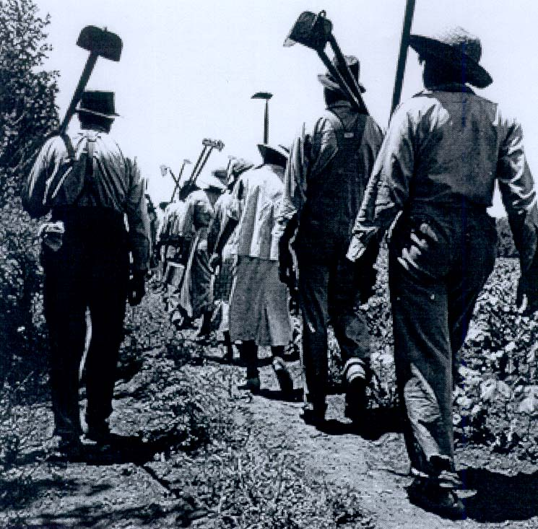
Sharecropping
From 1880 to 1900, thousands of white and black farmers became sharecroppers
Sharecroppers did not own the land, the house, or the machinery
They had to pay rent in the form of a portion of the yearly crop

Slide 6
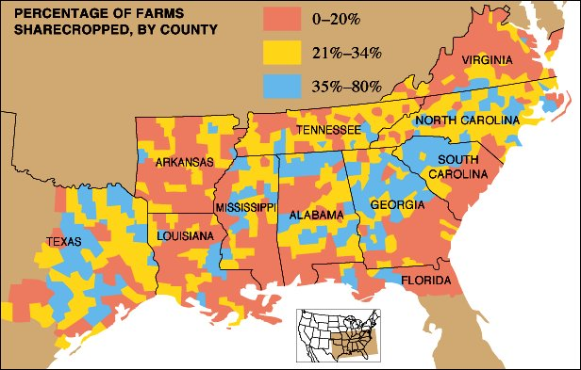

Slide 7
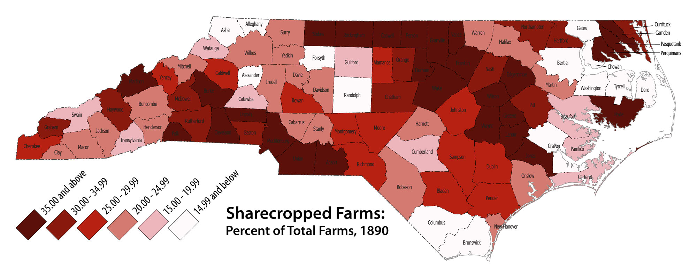
Sharecropping in North Carolina

Slide 8
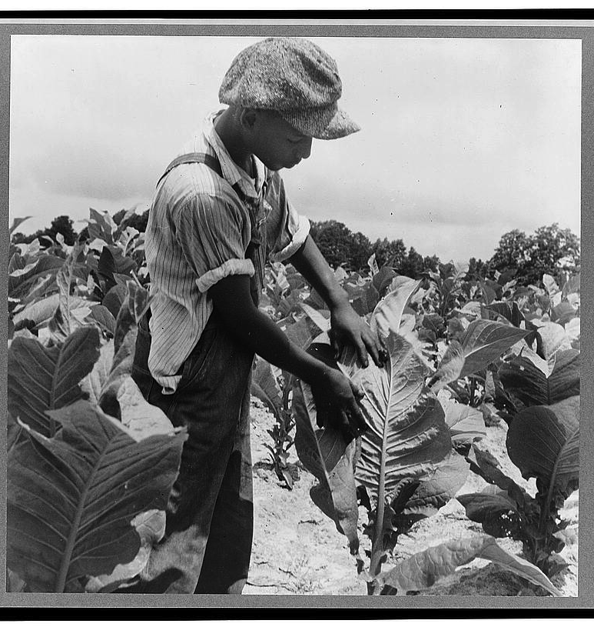
Sharecropping (cont’d)
Life was miserable for many croppers
Many could not make a profit due to the low prices
Landowners often charged high prices in order to keep them in debt
Many left farms for factory jobs in cities

Slide 9
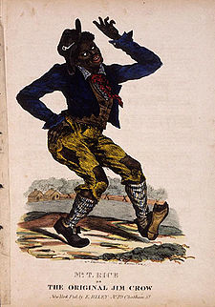
Jim Crow
Jim Crow Laws
Laws that enforced segregation in the South
Named for an old minstrel show that made blacks look foolish and dependent

Slide 10
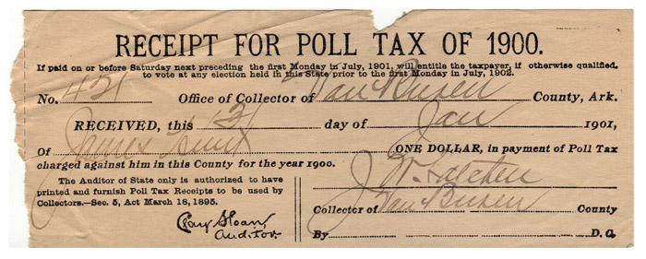
Voting Restrictions
Literacy Tests
If you couldn’t read, you couldn’t vote
Hurt black voters who did not receive an education
Grandfather Clause
If your grandfather could vote before 1867, you could vote anyways
Excluded blacks whose grandparents had been slaves
Poll Taxes
Fees for voting
This especially hurt poor farmers and factory workers

Slide 11
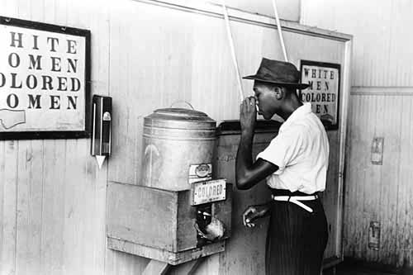
Segregation
Definition
Separation of the races
Segregation was enforced by laws and customs
Going against customs could have deadly results for African-Americans

Slide 12
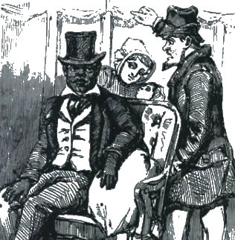
Plessy v. Ferguson
1896
Supreme Court case about segregation on train cars
The decision set the precedent (standard for later decisions) that segregation was legal
“Separate, but equal”
Editorial cartoon of Plessy v. Ferguson case, which established the "separate but equal" principle

Slide 13
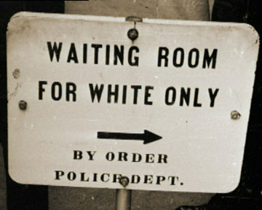
Life in Segregation
Many whites refused to give blacks any respect (e.g., refusing to use titles)
Black and white society mostly operated separately
Violations of segregation could result in deadly consequences
Lynching (mob murder by hanging, shooting, or burning) was not uncommon

Slide 14
Finish Yesterday’s iPad Assignment
goo.gl/A02z1d
A Zero Two z One d

