Slide 1
DO NOW
Identify what happened at each of the following events:
Berlin Crisis
Bay of Pigs Invasion
Cuban Missile Crisis

Slide 2
DO NOW & Homework Due
Identify what happened at each of the following events:
Berlin Crisis
Bay of Pigs Invasion
Cuban Missile Crisis
3rd Period – NONE (finish Vietnam & start End of Cold War)
4th Period – Station Notes Questions (Vietnam & start End of Cold War)
5th Period – NONE (End of Cold War)
6th Period – Station Notes Questions (Vietnam & start End of Cold War)

Slide 3
Learning Goals
EQ:
Did the U.S. do the right thing by fighting in Vietnam?
LT:
Explain the causes and effects of the Vietnam War.
POU:
I can explain the causes and effects of U.S. involvement in the Vietnam War.

Slide 4
The Vietnam War
May 6, 2014

Slide 5
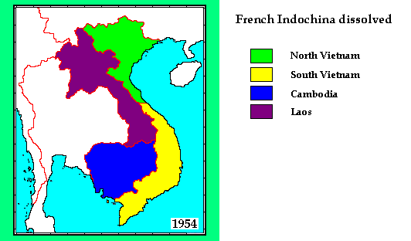
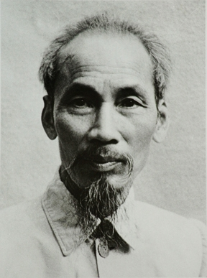
Background
Vietnam is located in Southeast Asia
Formerly colonized by France as part of French Indochina
French were kicked out after Ho Chi Minh led a Communist revolution

Slide 6
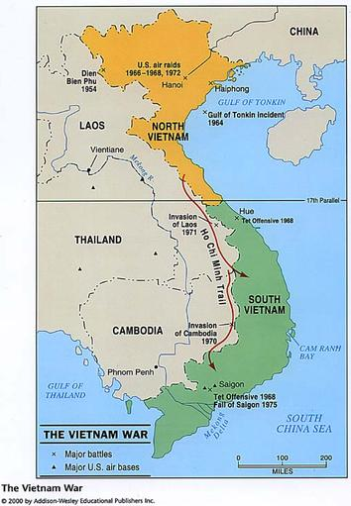
North Vietnam vs. South Vietnam
Ho Chi Minh led the Communist North Vietnam
Backed by China and Soviet Union
Army called the Viet Cong
South Vietnam had a dictator
Backed by France and the U.S.

Slide 7
Cold War & Domino Theory
Domino Theory in Action:
Believed that if Vietnam fell to communism, all of Southeast Asia would become communist
How is this related to the policy of containment?

Slide 8
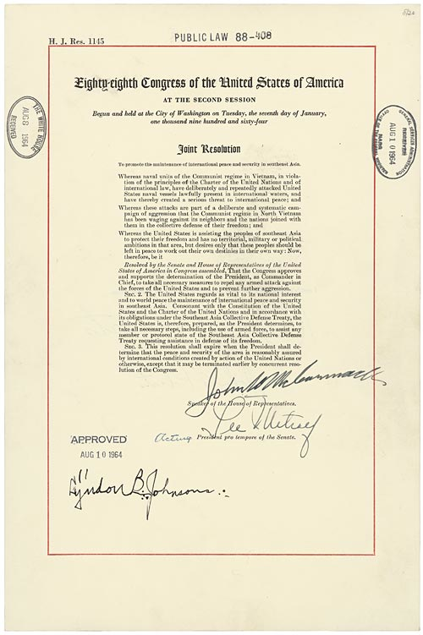
U.S. Gets Involved
U.S. sent “advisors” to South Vietnam to work with government and train their military
Gulf of Tonkin Incident (1964)
North Vietnamese allegedly attack a U.S. Navy ship
Congress approves military action with the Gulf of Tonkin Resolution

Slide 9
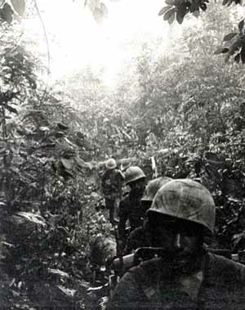
The Quagmire
The U.S. got bogged down in Vietnam
U.S. held major cities, but the Viet Cong’s guerilla tactics caused the U.S. to have trouble fighting in the jungles
U.S. sends 400,000 troops by the end of 1966

Slide 10
U.S. Opinions Turn
Americans begin to turn against the war for many reasons:
Viet Cong making gains in the South
Opposition to the military draft
Photos and video of dead American soldiers on television
Spending nearly $3 Billion a month
Peaceful and violent protests broke out all over the country

Slide 11
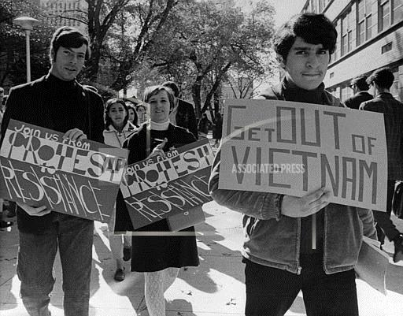
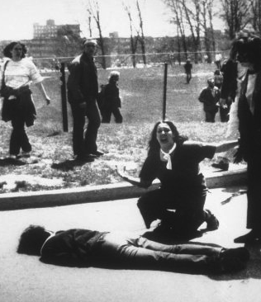

Slide 12
End of the War
Vietnamization
U.S. begins to withdraw troops and turn war over to South Vietnamese in the 1970s
Paris Peace Accords (1973)
U.S. agreed to leave Vietnam
North and South had tentative peace
Saigon Falls
Fighting renews in 1975, capital of South Vietnam falls to the Viet Cong

Slide 13
Consequences of the Vietnam War
Vietnam united as a Communist nation
58,000 American soldiers died
U.S. Congress passes laws to limit the use of the military
26th Amendment
Voting age changed from 21 to 18 for everyone
Second-longest war in U.S. history (Afghanistan is now the longest)

