Slide 1
DO NOW
What condition was the South in following the Civil War?
Why?

Slide 2
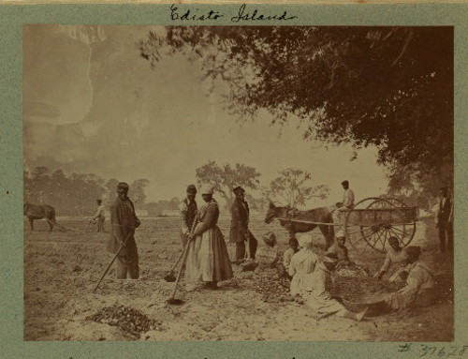
The Beginning of Reconstruction
January 28, 2014

Slide 3
Learning Goals
EQ
Was Reconstruction a success or failure?
LT
Assess the impact of the Civil War and Reconstruction on the United States.
(Assess their impact on slavery in the U.S.)
POU (I’ll know I’ve got it when…)
I can describe how slavery came to an end in the United States.

Slide 4
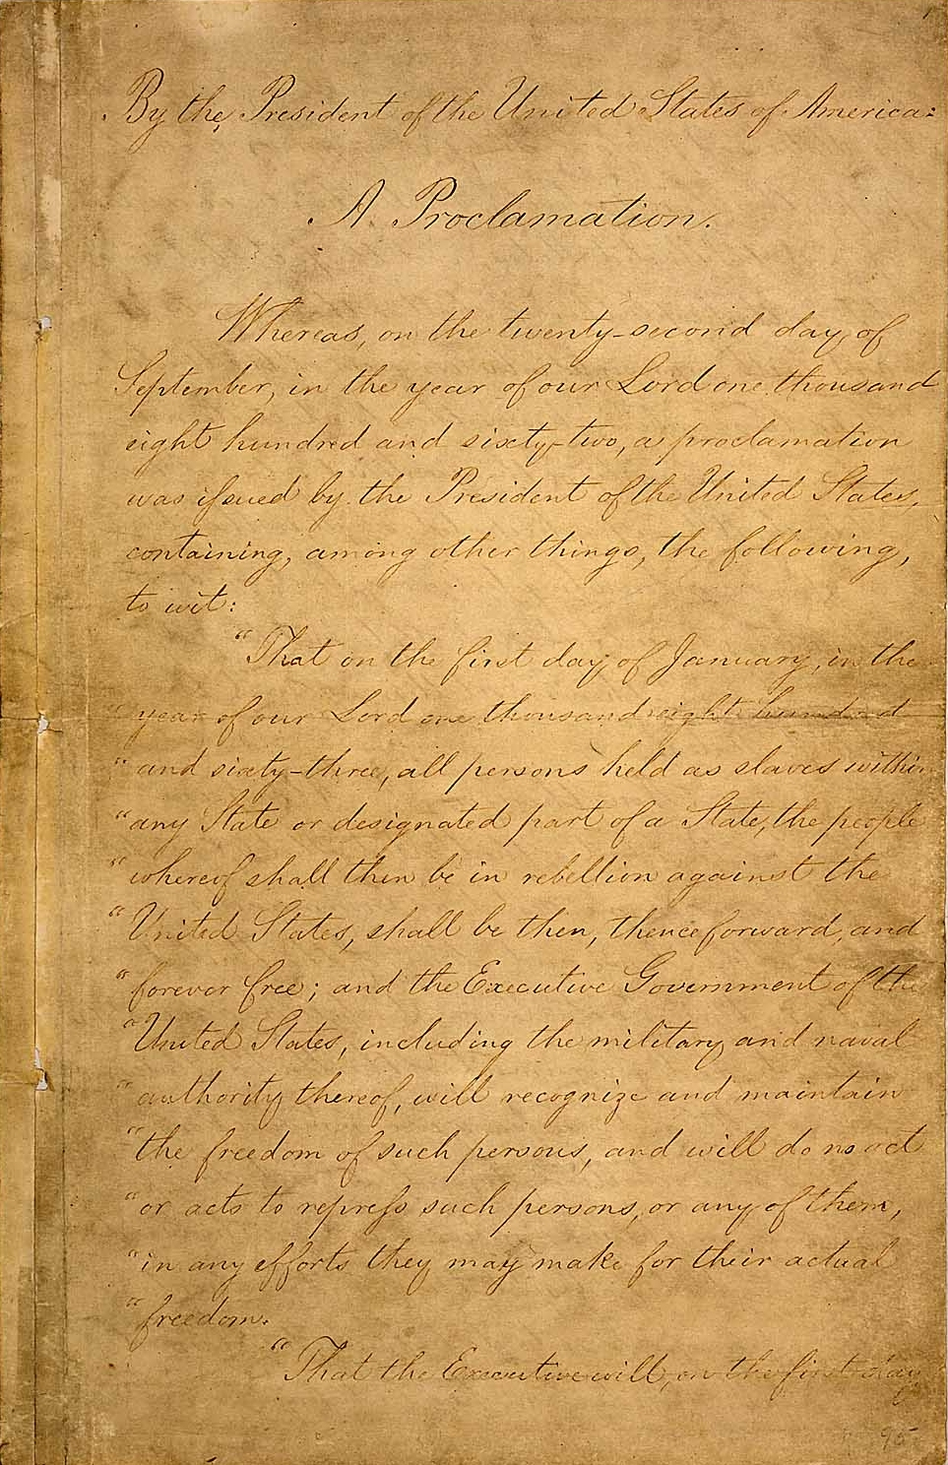
The Emancipation Proclamation
Took effect on Jan. 1, 1863
Freed slaves “in rebelling territories”
Helped to weaken the South
This did not free all slaves in the North

Slide 5
The 13th Amendment
The 13th Amendment freed all slaves in the country
“Neither slavery nor involuntary servitude...shall exist within the United States.”
Southern states had to ratify (accept) the amendment to rejoin the United States
Proposed in 1863, adopted in 1865

Slide 6
13th Amendment Full Text
Section 1. Neither slavery nor involuntary servitude, except as a punishment for crime whereof the party shall have been duly convicted, shall exist within the United States, or any place subject to their jurisdiction.
Section 2. Congress shall have power to enforce this article by appropriate legislation.

Slide 7
Reconstruction
Definition:
A plan to rebuild the South and restore the southern states to the Union after the Civil War
Two phases: Presidential & Congressional
States had to ratify (accept) the 13th, 14th, and 15th Amendments and had to write a new state constitution

Slide 8
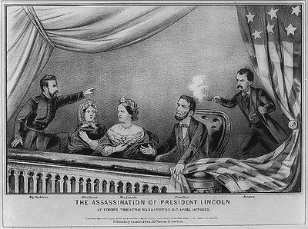
The Assassination of Abraham Lincoln
Lincoln killed while at the theater on
April 14, 1865
John Wilkes Booth shot him in the head
Booth later killed in a fire on a farm

