Slide 1
DO NOW
In exactly 7 words, describe the Vietnam War.

Slide 2
Learning Goals
EQ
How did the Cold War come to an end?
LT
I can explain the change in policy of the U.S. toward the Soviet Union.
POU
I can dominate a quiz in order to check my knowledge of the Cold War Era!

Slide 3
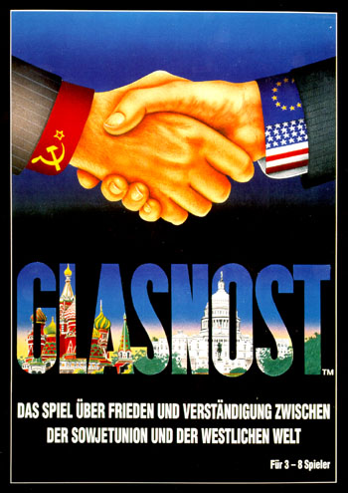
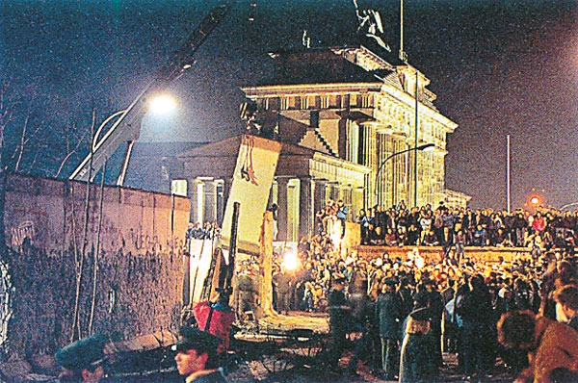
Cold War 1975-1991
May 7, 2014

Slide 4
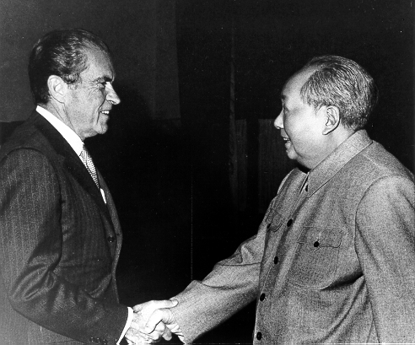
Richard Nixon and Détente
Détente
Lessening Cold War Tensions
Real Politik
dealing with nations in a practical and flexible manner (anti-containment)
Nixon visits China
SALT Treaties
Strategic Arms Limitation Talks
Limited nuclear weapon production
Policies continued with Gerald Ford and Jimmy Carter
Richard Nixon was the 1st U.S. President to visit China

Slide 5
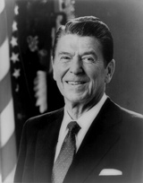
Ronald Reagan
Fiercely Anti-Communist
Moved Away from Détente
Increased Military Spending to try to bankrupt the Soviet Union
Demanded the demolition of the Berlin Wall
Ronald Reagan – 40th President of the United States

Slide 6
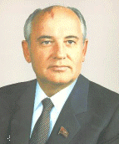
Change in the U.S.S.R.
Mikhail Gorbachev becomes Premier of the Soviet Union in 1985
Begins a series of Reforms and Freedoms in Russia
Glasnost
Perestroika
Democratization
Mikhail Gorbachev, Premier of the Soviet Union

Slide 7
Glasnost
Glasnost = Openness
Churches opened
Press allowed to criticize government
Banned authors allowed to publish books

Slide 8
Perestroika
Perestroika = “Economic Restructuring”
Managers make more decisions
Small private businesses

Slide 9
Democratization
Democratization = Gradual opening of the political system
Election of a new group of lawmakers
Communist Party no longer chose all candidates

Slide 10
The Berlin Wall
Berlin Wall falls in 1989
Symbolic of end of Cold War
Process of reunification of East & West Germany

Slide 11
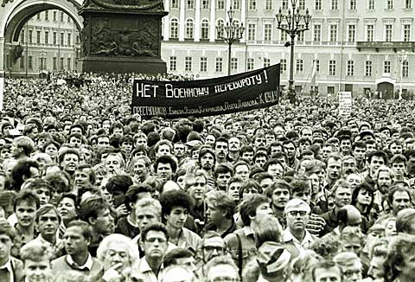
USSR 1991
Nationalities begin to call of Independence
August Coup, by Communist Hardliners
Boris Yeltsin Seen as hero, becomes President of Russia

Slide 12
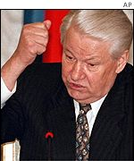
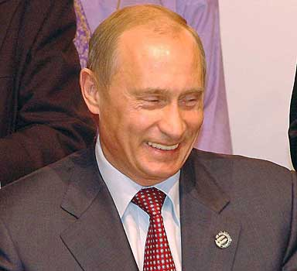
Russia since the Cold War
Boris Yeltsin, President 1991-1999
Formed Commonwealth of Independent States (CIS)
Vladimir Putin becomes President in 1999
Tightened Grip of government on Economy
Restricted Voting Rights and Liberties
Still the leader of Russia!

Slide 13
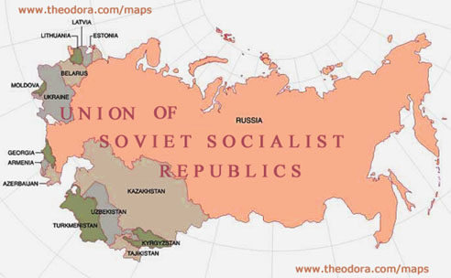
Old vs. New

Slide 14
COLD WAR, HOT QUIZ
Pop Quiz!
goo.gl/fPYXiw

