Slide 1
DO NOW
What were the two main phases of Reconstruction following the Civil War?

Slide 2
Learning Goals
EQ:
Was Reconstruction a success or failure?
LT
Assess the impact of the Civil War and Reconstruction on the United States
POU (I’ll know I’ve got it when…)
I can assess the impact of Reconstruction on different groups in North Carolina.

Slide 3
Impact of Reconstruction in North Carolina
February 3, 2014

Slide 4
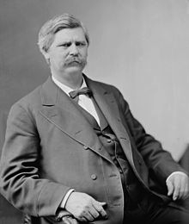
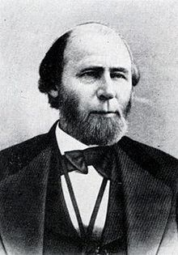
NC After the War
The governor of NC during the Civil War, Zeb Vance, was arrested and jailed
William Holden, who was opposed to the Civil War, was appointed governor by Andrew Johnson
Holden’s reforms would be hurt by violence and intimidation

Slide 5
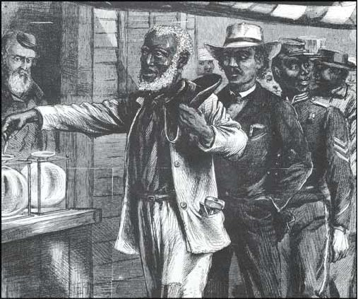
Freedmen
Over 300,000 freedmen (former slaves) faced hardships
Freedmen looked forward to voting and other rights, but whites tried to stand in the way
Congress created the Freedmen’s Bureau to help blacks find jobs, fair wages, education, healthcare, etc.

Slide 6
Black Codes
Black codes were laws that placed harsh economic and social restrictions on blacks
Replaced Slave Codes
Examples
Blacks could not serve on juries
They needed permission to move from one county to another
They could not change jobs more than once a year

Slide 7
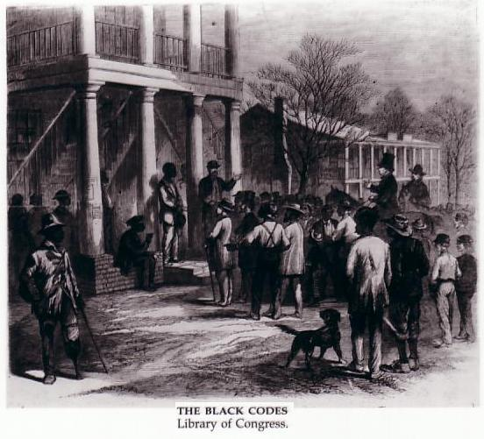
Black Codes (cont’d)
Other provisions:
Blacks could not carry weapons
Blacks could not assemble without permission
Blacks who broke contracts could be arrested and returned to their employers

Slide 8
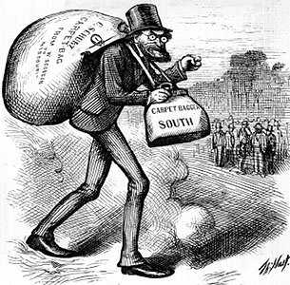
“You’re not welcome here.”
Scalawags
white southerners who supported the Republican Party and Reconstruction
Carpetbaggers
Northerners who supported Reconstruction and came to North Carolina to profit from it

Slide 9
The Constitution of 1868
Due to Congressional Reconstruction, North Carolina was required to write a new state constitution
Three major changes were passed:
Universal Male Suffrage: extended the right to vote to all male citizens of any race
More public offices were chosen by the people
The state provided more services, like public education

Slide 10
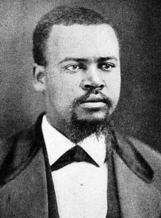
Republican Rule in North Carolina
The Republican Party had taken control of the legislature which included many blacks
The Republican legislature ratified the 14th & 15th Amendments and passed the new state constitution
IN JULY 1868, NORTH CAROLINA WAS FINALLY READMITTED TO THE UNION
John A. Hyman: 1st black U.S. Representative from North Carolina

Slide 11
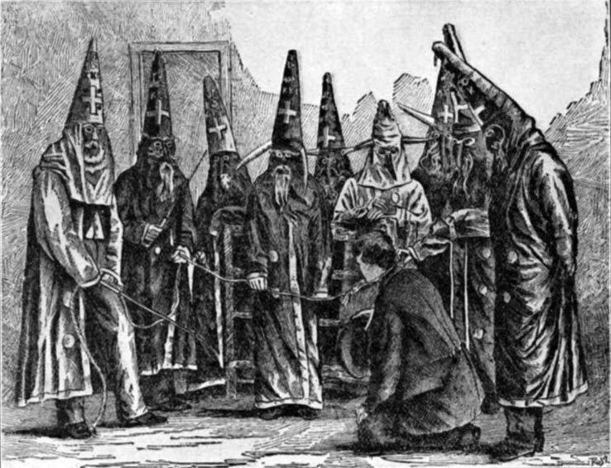
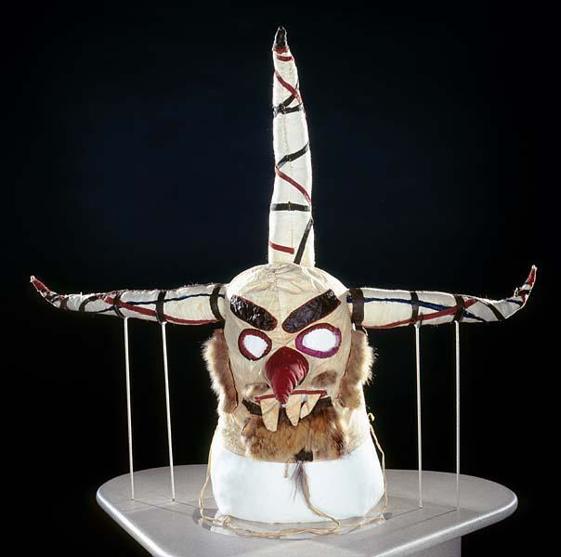
Fighting Against Reconstruction
White Democrats in North Carolina opposed Reconstruction
Blacks were intimidated through economic pressure and violence from such groups as the Ku Klux Klan
About 40,000 whites belonged to the KKK in NC
By 1876, Zeb Vance had been elected governor again!

Slide 12
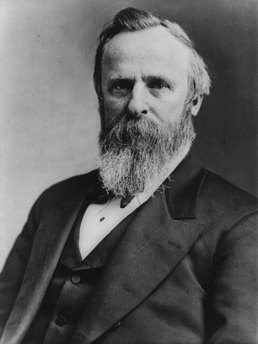
End of Reconstruction
Election of 1876
There was a dispute over who won the Presidential election
Rutherford Hayes (Republican) and Samuel Tilden (Democrat) both claimed to have won
A compromise gave the election to Rutherford B. Hayes in exchange for Union troops being removed from the South in 1877
Rutherford B. Hayes

